Slide 1
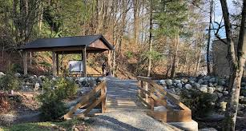
Outdoor Education
Lesson 6 : Grades Gr. K-2
Indigenous Medicine Plants

Slide 2
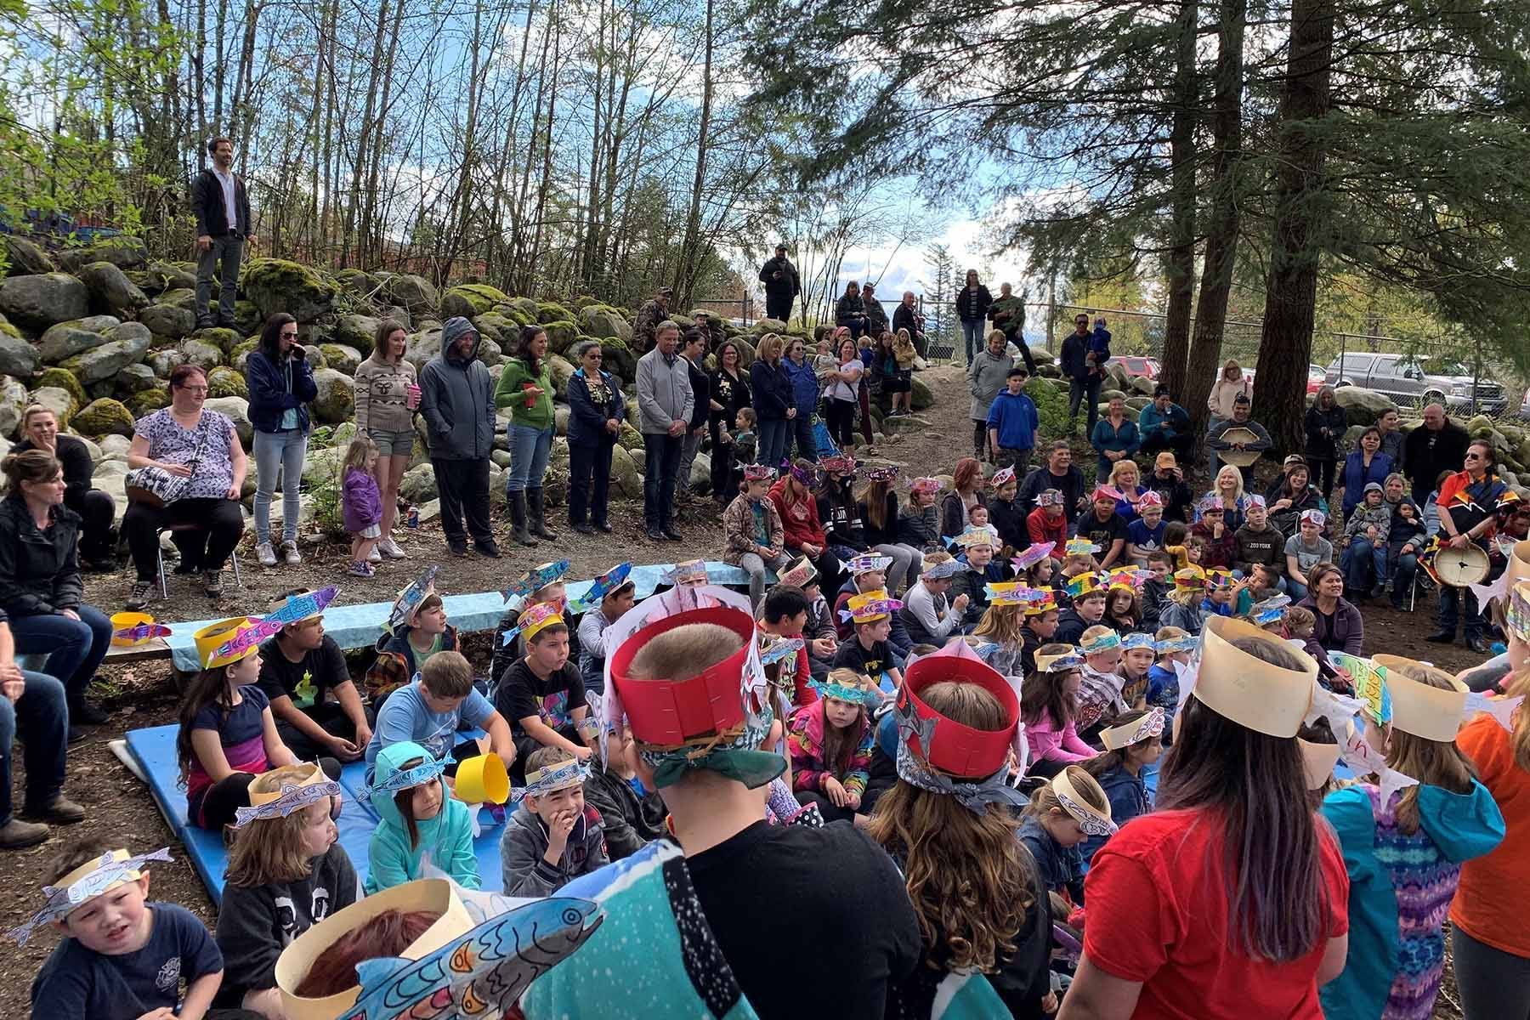
Indigenous Medicine Plants : Sage
Sage is believed to help people get rid of negative energy.

Slide 3
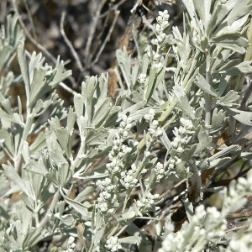
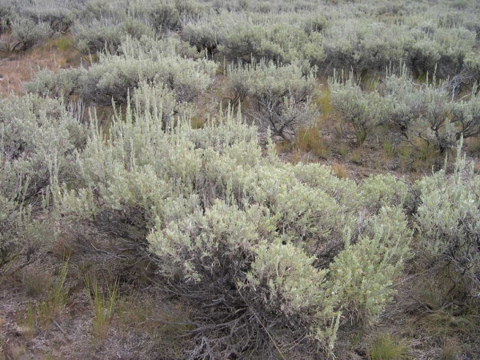
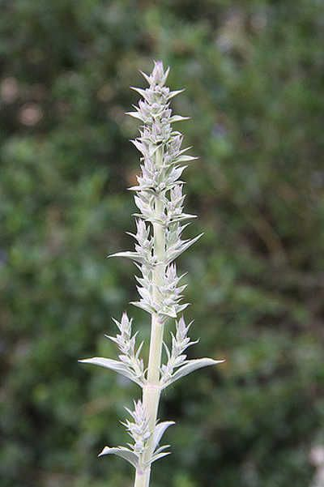
About Sage
There are many kinds of sage. White sage is found in desert areas. A natural sage that grows in BC is sagebrush. There is also blue sage, desert sage and more.
Sagebrush
Big Sagebrush
White Sagebrush
With thanks, this pic is from: http://splitrockenvironmental.ca/product/big-sage/
With thanks, this pic is from: http://linnet.geog.ubc.ca/Atlas/Atlas.aspx?sciname=Artemisia%20tridentata%20ssp.%20vaseyana&noTransfer=0
With thanks, this pic is from: https://www.epicgardening.com/white-sage-plant/

Slide 4
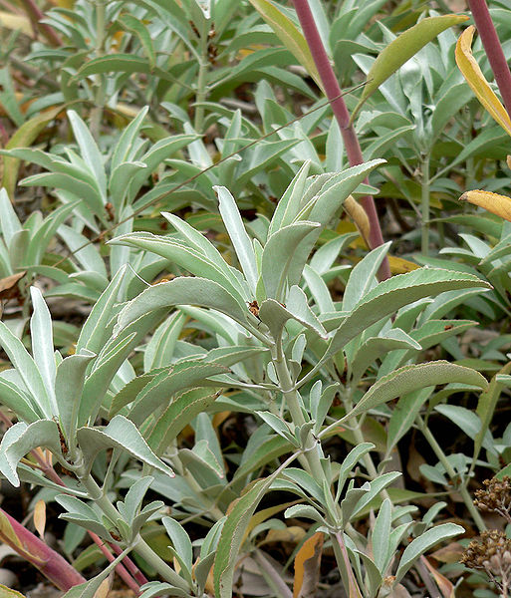
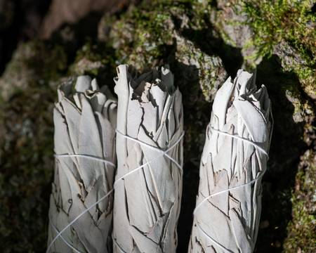
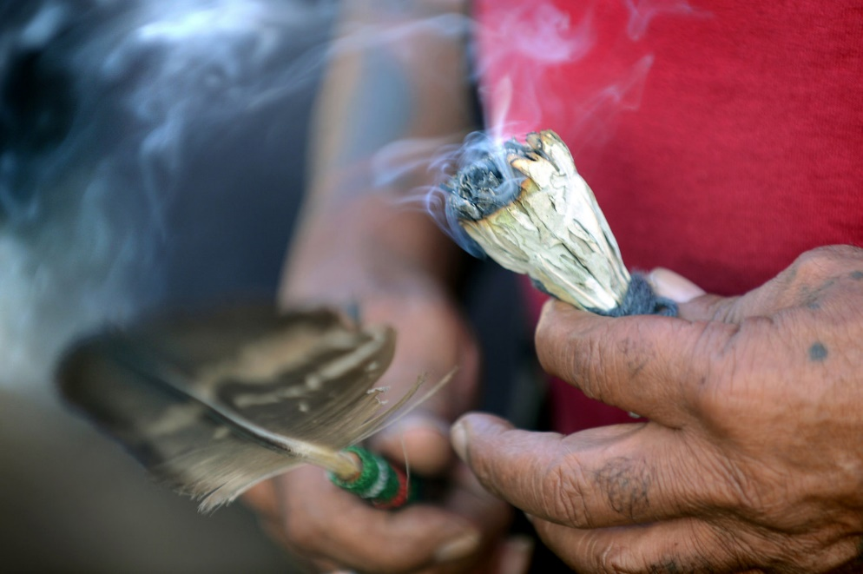
White Sage
White sage is what you often see bundled for smudging.
White Sage
White Sage Bundle
White Sage Smudge
With thanks, this pic is from: https://www.rootsimple.com/2011/09/salvia-means-salvation-white-sage/
With thanks, this pic is from: https://www.123rf.com/photo_112187057_wildcrafted-dried-white-sage-salvia-apiana-leafy-bundles-on-fibrous-tree-bark-in-forest-preserve-smu.html
With thanks, this pic is from: https://www.movingtowardspeace.com/mtpblog/the-ancient-art-of-burning-sage.html

Slide 5
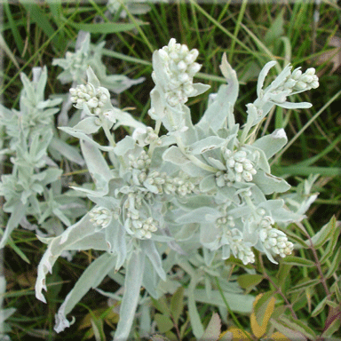
Prairie Sage
Prairie sage is found in the Canadian Prairies.
This is the kind of sage used by many Indigenous cultures in Alberta, Saskatchewan and Manitoba.
With thanks, this pic is from: https://aiglebleu.net/en/2017/08/sage-sacred-wisdom-herb/

Slide 6
Big Sagebrush
Big sagebrush is found in British Columbia.
This is the kind of sage used by many Indigenous cultures in British Columbia.

Slide 7
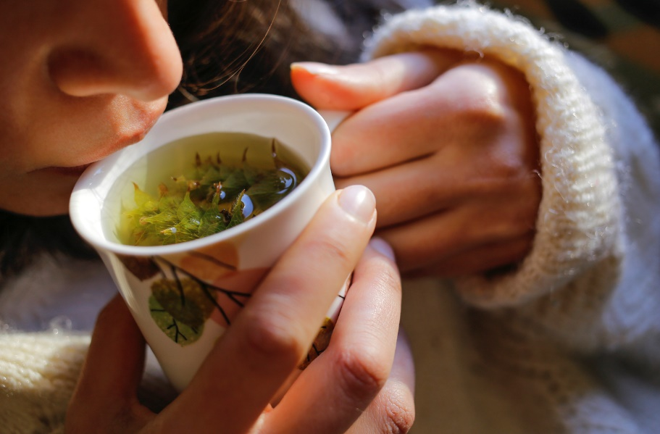
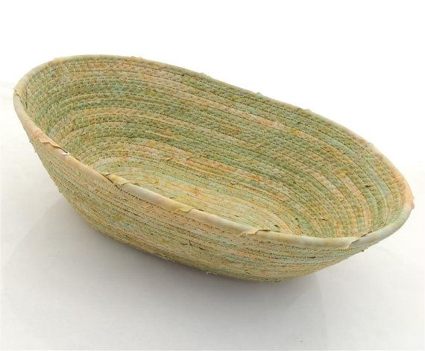
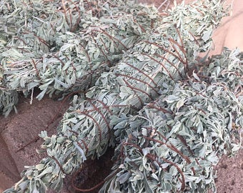
Indigenous cultures use sage for several purposes.
Here are some uses of Big Sagebrush as practiced by some Indigenous peoples in British Columbia.
Make a tea from dried leaves and branches to help with colds and headaches.
Bark woven into baskets, clothing and mats.
Use as a smudge to clear negative energy from a person or a space, and to get rid of harmful bacteria.
With thanks, this pic is from: https://www.wellandgood.com/good-advice/sage-benefits/
With thanks, this pic is from: https://in.pinterest.com/pin/411446115938009336/?amp_client_id=CLIENT_ID(_)&mweb_unauth_id={{default.session}}&from_amp_pin_page=true
With thanks, this pic is from: https://www.etsy.com/market/sagebrush_smudge

Slide 8
Why do Indigenous people smudge?
Watch this video of an Elder teaching her granddaughter about smudging.
https://www.youtube.com/watch?v=6fIMumk2cnA&list=PLeyJPHbRnGaZFu8_xxuXPlYG-j-9cogsx&index=45&t=0s

Slide 9
Now that you’ve watched the video about smudging, try to answer these questions.
What are the actions a person does to smudge?
Why do people smudge?
How to you keep positive with a good heart and mind?
With thanks, this pic is from: https://sd75curriculum.com/page/2/

Slide 10
Sage is a healing Indigenous medicine plant.
What is made to help heal colds and headaches?
Why do people smudge?
What useful items can be made from Big Sagebrush bark?
Where is Big Sagebrush found?
Sage
W
What medicine wheel direction is sage connected with?

Slide 11
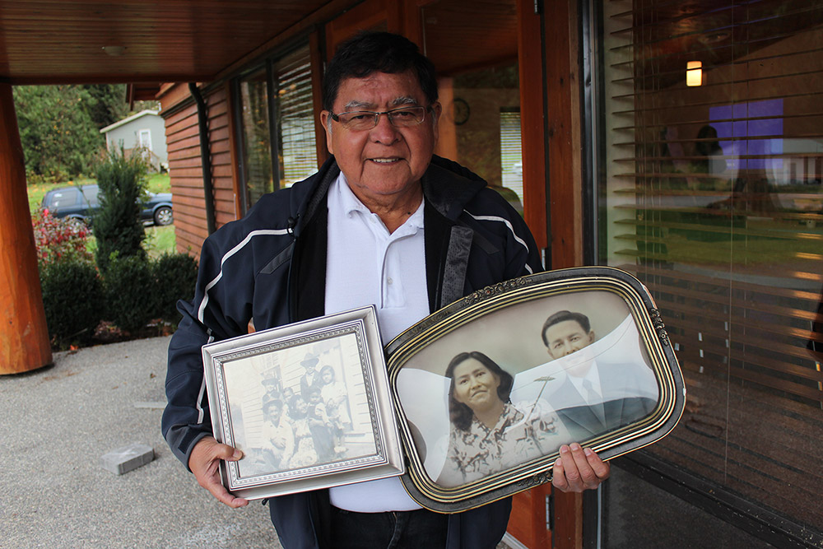
Now it’s your turn. Go for a walk with an Elder or relative
and ask them about sage and smudging.
Maybe they’ll tell you about their experiences.
Enjoy your walk.
With thanks, this pic is from:http://digitalsqewlets.ca/sqwelqwel/xwelmexw/sqewlets_families-familles-eng.php

