Slide 1
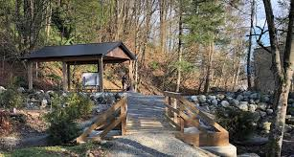
Outdoor Education
Lesson 4 : Grades Gr. 3-6
Sto:lo Medicine Plants

Slide 2
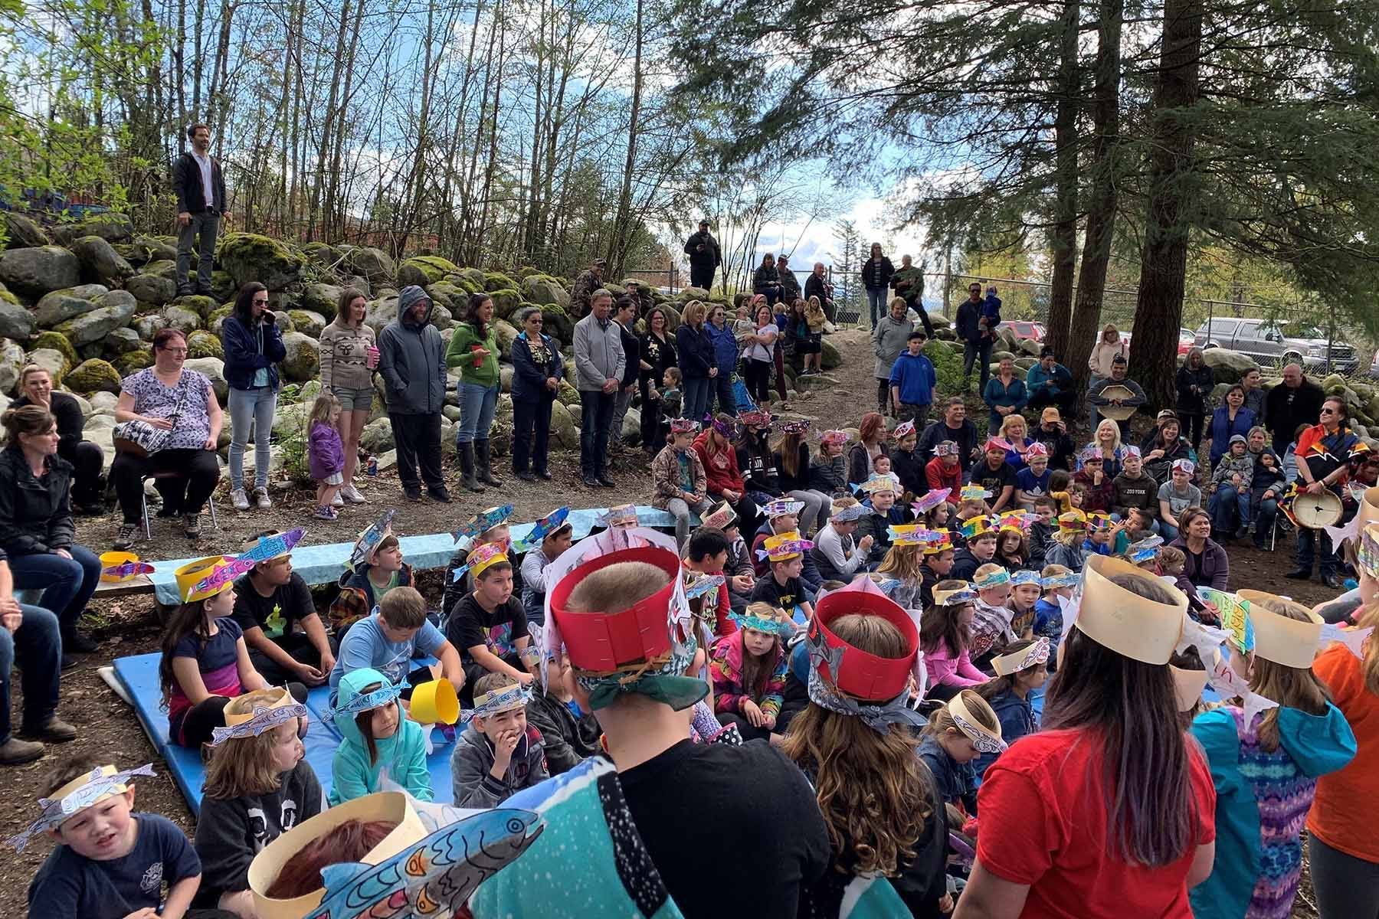
Sto:lo Medicine Plants
Learning Intentions:
I can identify four Sto:lo Medicine plants.
I can relate each of the four medicine plants to a place on the medicine wheel.

Slide 3
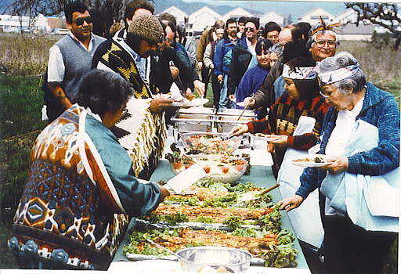
Why do we eat plants as food?
We need plants for food.
Food is like medicine to our bodies because food keeps our bodies healthy.
With thanks, this pic is from: http://digitalsqewlets.ca/sqwelqwel/xwelmexw/culture-eng.php/

Slide 4
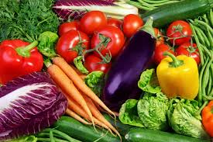
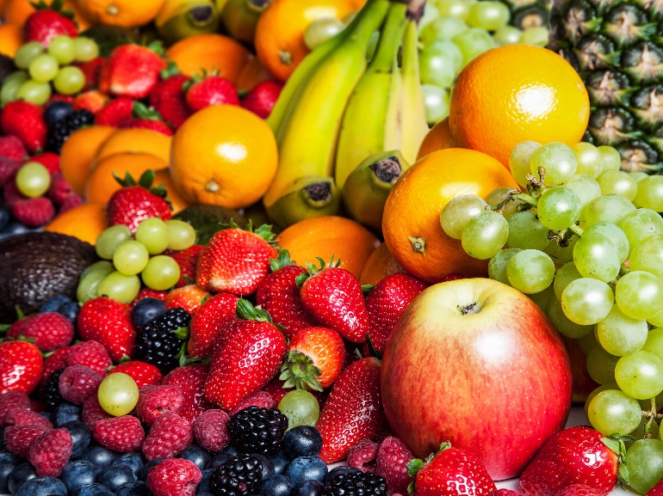
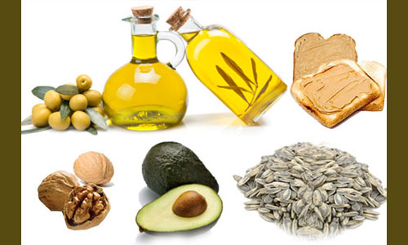
We eat grains to keep us “regular” and our stomach system working properly.
We eat vegetables to keep our blood and body systems working properly.
With thanks, this pic is from: https://slideplayer.com/slide/15761184/
With thanks, this pic is from: https://www.daysoftheyear.com/days/eat-your-vegetables-day/
We eat fruits to keep our blood and body systems working properly.
We eat fats to keep our body warm and to support body systems.
With thanks, this pic is from: https://www.cookinglight.com/eating-smart/nutrition-101/best-sweet-fruits-for-sugar-cravings
With thanks, this pic is from: http://lf2014springa11309.blogspot.com/2014/05/fats.html

Slide 5
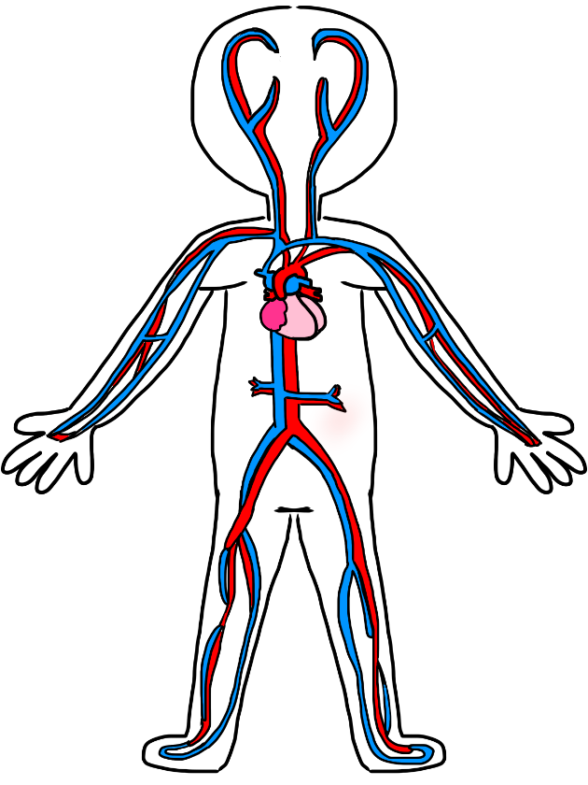
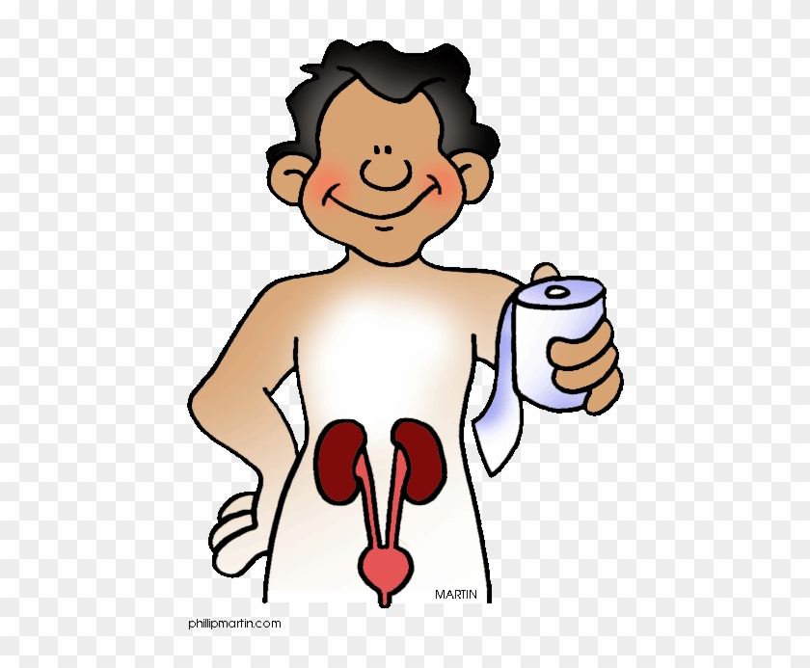
What do you think is meant by the “body systems” plant foods supports?
Look at the picture clues to help you.
With thanks, this pic is from: https://www.clipartmax.com/middle/m2i8Z5Z5Z5N4H7K9_http-www-clipartkid-com-cartoon-body-system-excretory-system-clipart/
With thanks, this pic is from: https://allhealthykids.org/research-reveals-chiropractic-helps-children-massively/
With thanks, this pic is from:https://www.pinterest.ca/pin/85709199142338927/

Slide 6
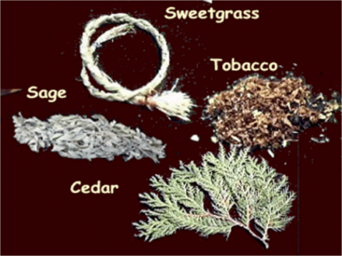
Sto:lo also have 4 sacred medicine plants to help keep people well.
Tobacco
Sage
Sweetgrass
Cedar
With thanks, this pic is from: http://www.northernc.on.ca/indigenous/four-sacred-medicines/

Slide 7
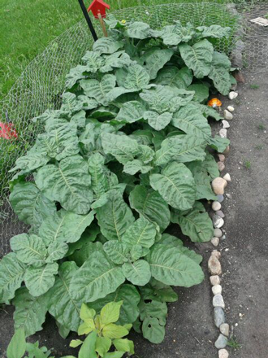
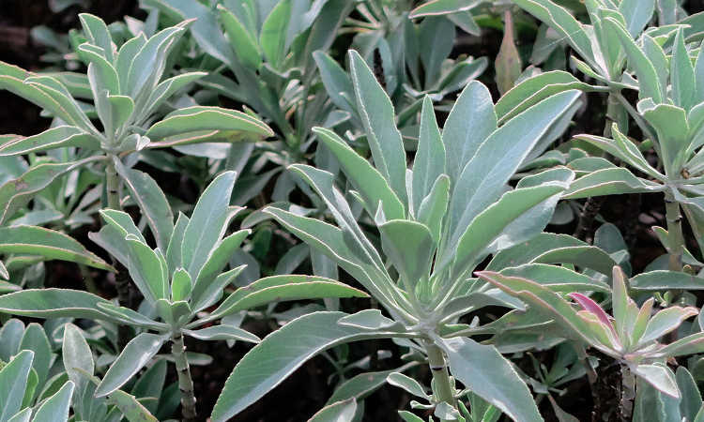
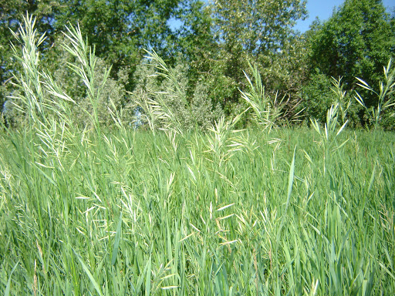
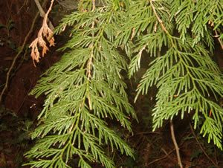
Here’s what each of these sacred plants look like.
Tobacco Sage Sweetgrass Red Cedar
With thanks, this pic is from: https://www.epicgardening.com/white-sage-plant/
With thanks, this pic is from: https://www.gardenguides.com/12545858-how-to-identify-sweet-grass.html
With thanks, this pic is from: https://sierraclub.bc.ca/western-red-cedar/
With thanks, this pic is from: https://www.scientificamerican.com/article/the-fight-to-keep-tobacco-sacred/

Slide 8
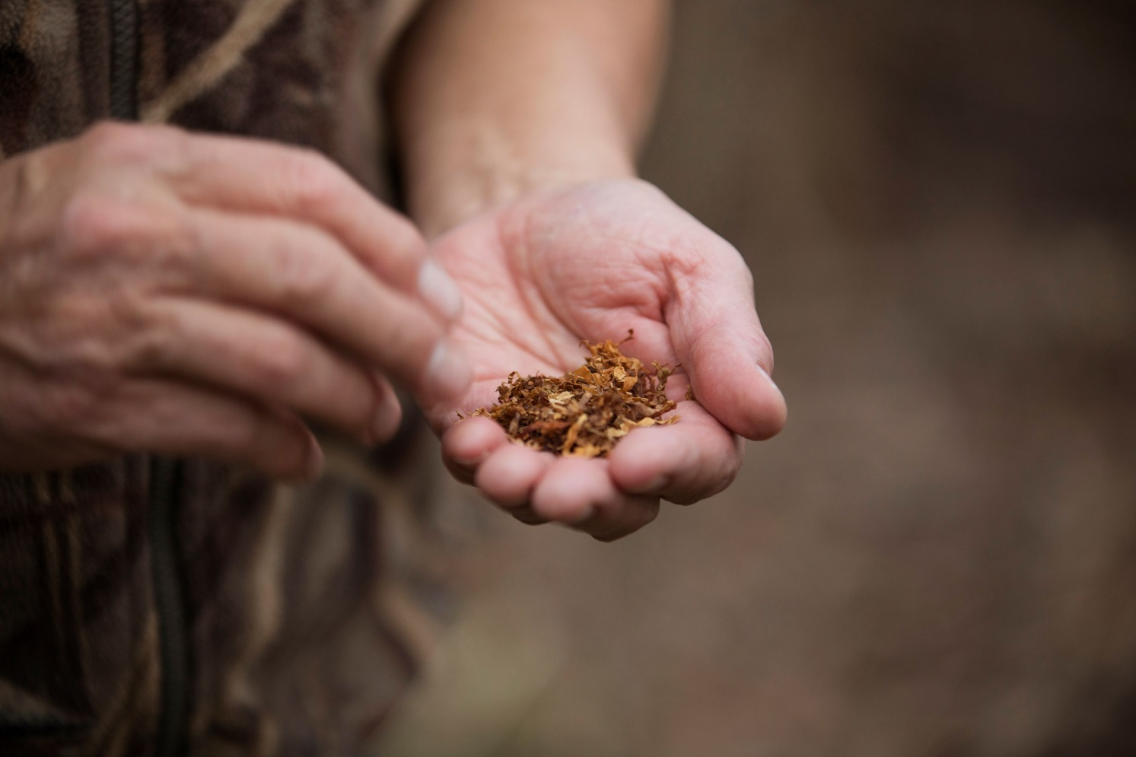
Each of these sacred plants has a special purpose.
Tobacco is for giving thanks.
This is sacred tobacco, not tobacco found in cigarettes.
What do you think is the difference between sacred tobacco and cigarette tobacco?
With thanks, this pic comes from: https://www.pinterest.ca/pin/738308932639704517/

Slide 9
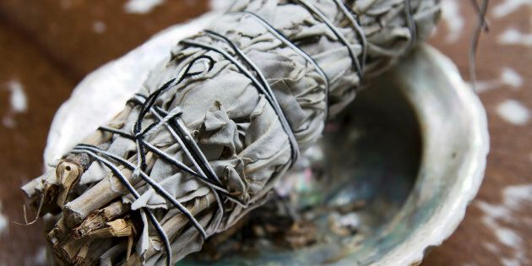
Sage is for smudging.
What is smudging?
Why do you think people smudge?
With thanks, this pic comes from: https://www.huffingtonpost.ca/2018/11/29/indigenous-people-sage-and-smudge-kits_a_23602571/

Slide 10
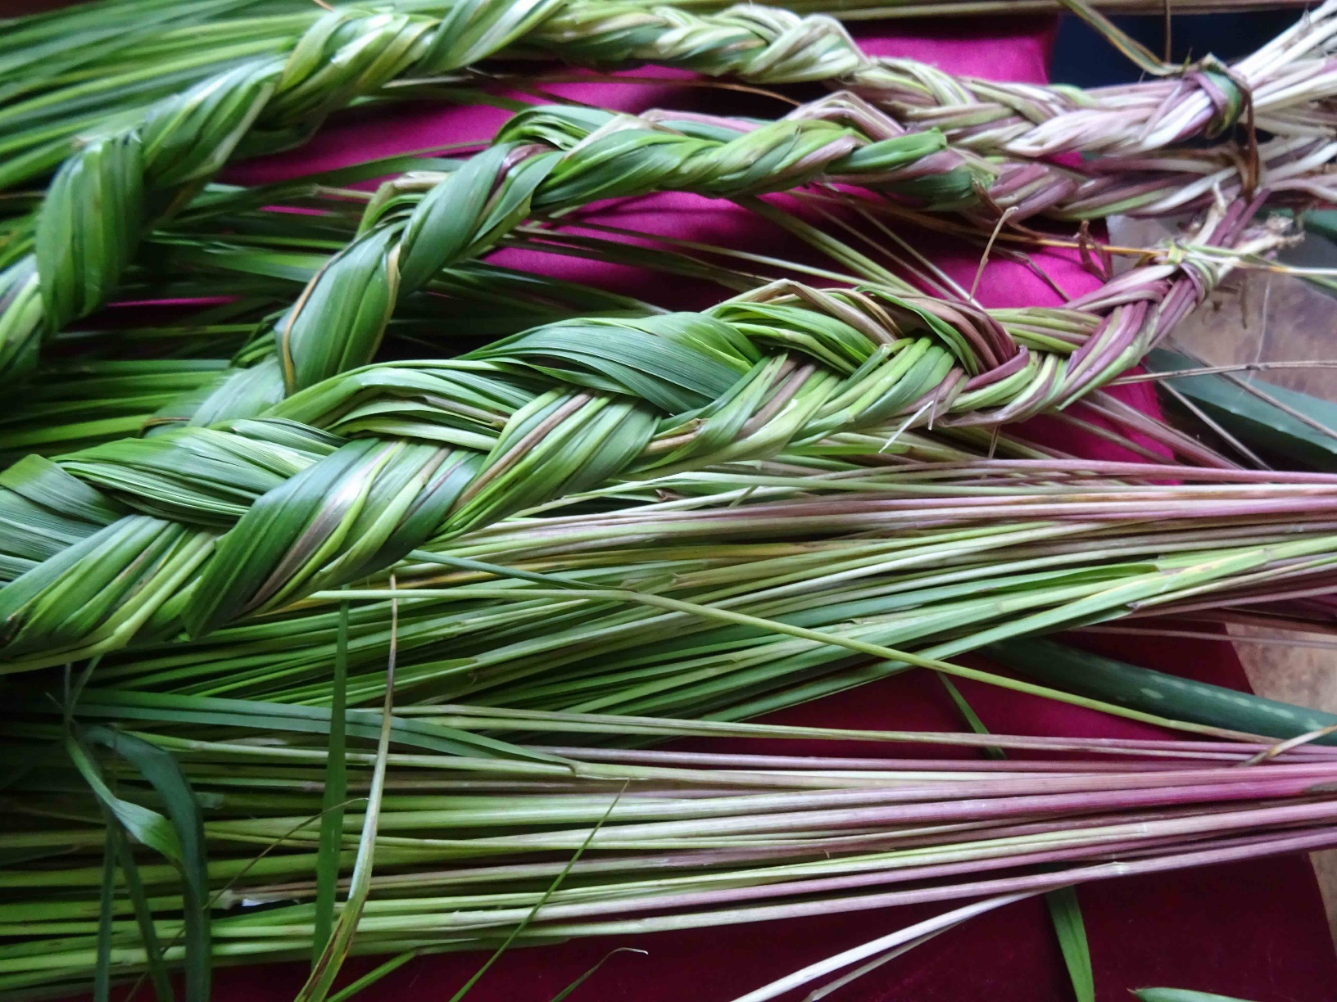
Sweet grass is for smudging
and for making things
like baskets.
What else do you think can be made from sweet grass?
With thanks, this pic comes from: https://www.thecanadianencyclopedia.ca/en/article/sweetgrass

Slide 11
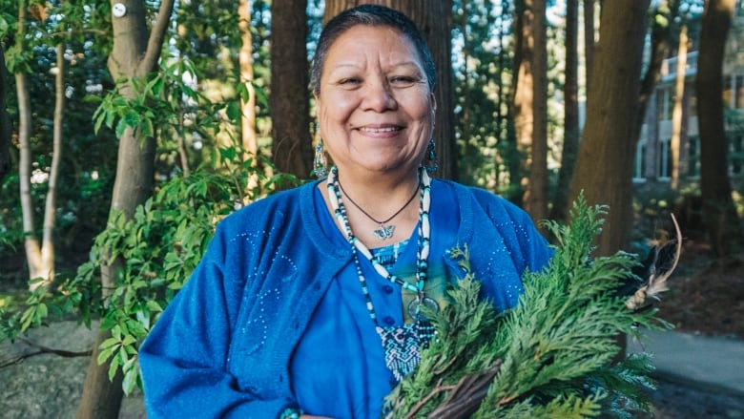
Red Cedar is used
to drive away negative energy
and to make things
like cedar baskets.
What else do you think could be made from red cedar?
Why do you think people want to get rid of negative energy?
With thanks, this pic comes from: https://www.cbc.ca/news/indigenous/indigenous-language-health-care-workers-1.4660009

Slide 12
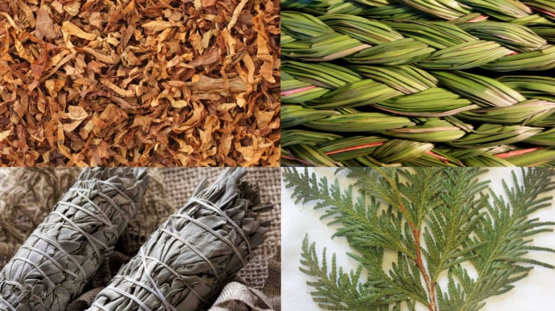
Can you point to and name each of the four sacred medicine plants in this picture?
With thanks, this pic is from: https://www.cbc.ca/radio/unreserved/when-indigenous-healing-practices-meet-modern-medicine-1.3530072

Slide 13
Each sacred medicine is part of the medicine wheel teachings.
What direction does each colour represent?
Why do you think these four sacred plants are part of the medicine wheel teachings?
Sweetgrass
N
Sage
W
E
Tobacco
S
Cedar
With thanks, this pic is from: https://www.clipart.email/clipart/medicine-wheel-clipart-50535.html

Slide 14
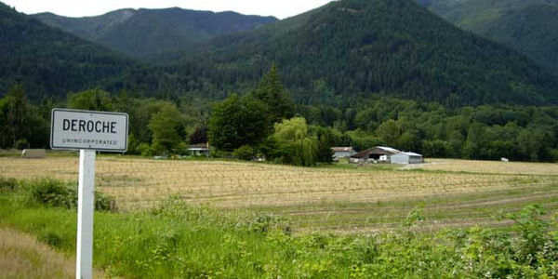
We’ll study more about each plant in future lessons.
For now, it’s your turn. Go for a walk and see if you can find any of these four sacred plants in your area.

Slide 15
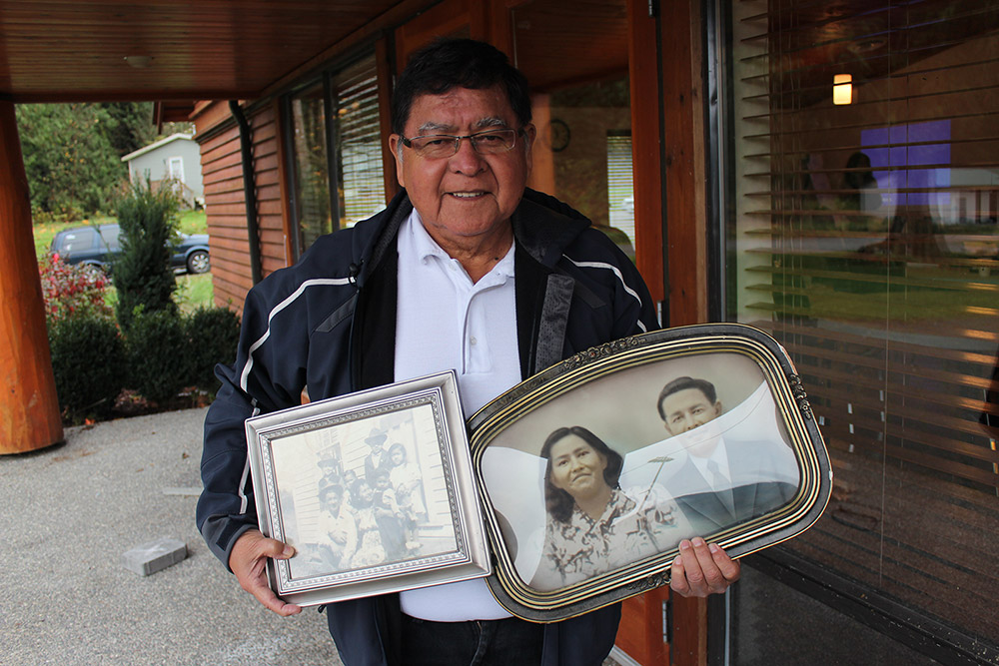
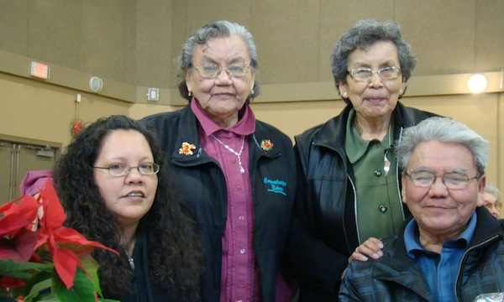
If you have an Elder nearby,
maybe you can ask them to go for a walk with you.
Maybe they’ll tell you about the four sacred medicine plants.
Enjoy your walk.
With thanks, this pic is from:http://digitalsqewlets.ca/sqwelqwel/xwelmexw/sqewlets_families-familles-eng.php
With thanks, this pic is from: http://leqamel.ca/recreation/elders/

