Slide 1
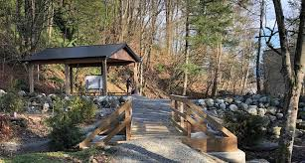
Outdoor Education
Lesson 2 : Grades K-2
Knowing the Birds Around Us

Slide 2
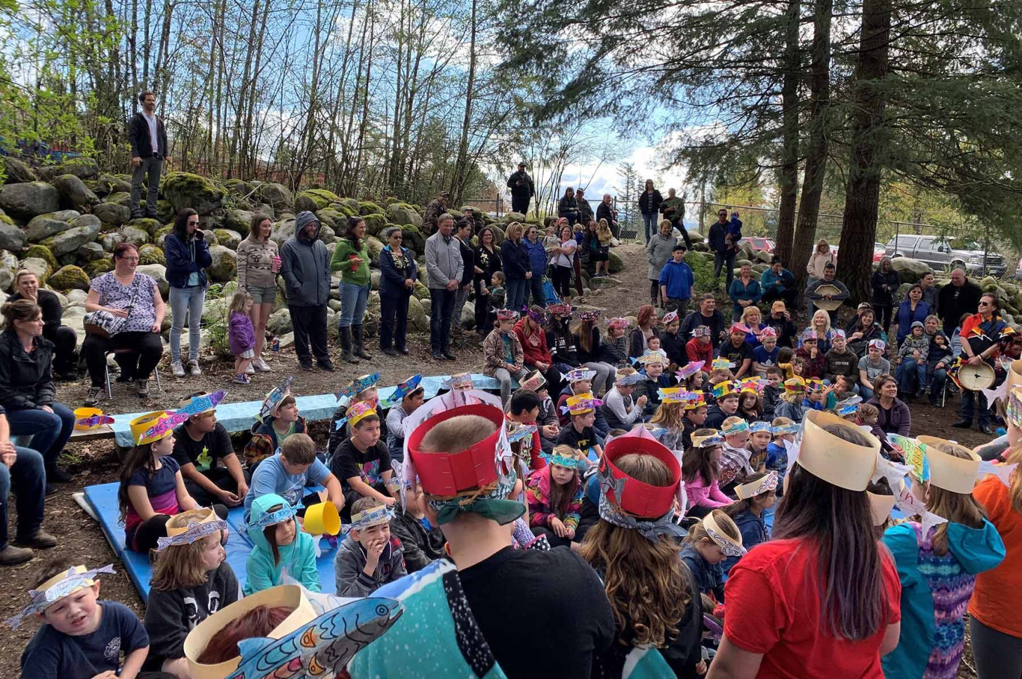
Knowing Birds Around Us
I can identify birds in my backyard by their sounds and songs.

Slide 3
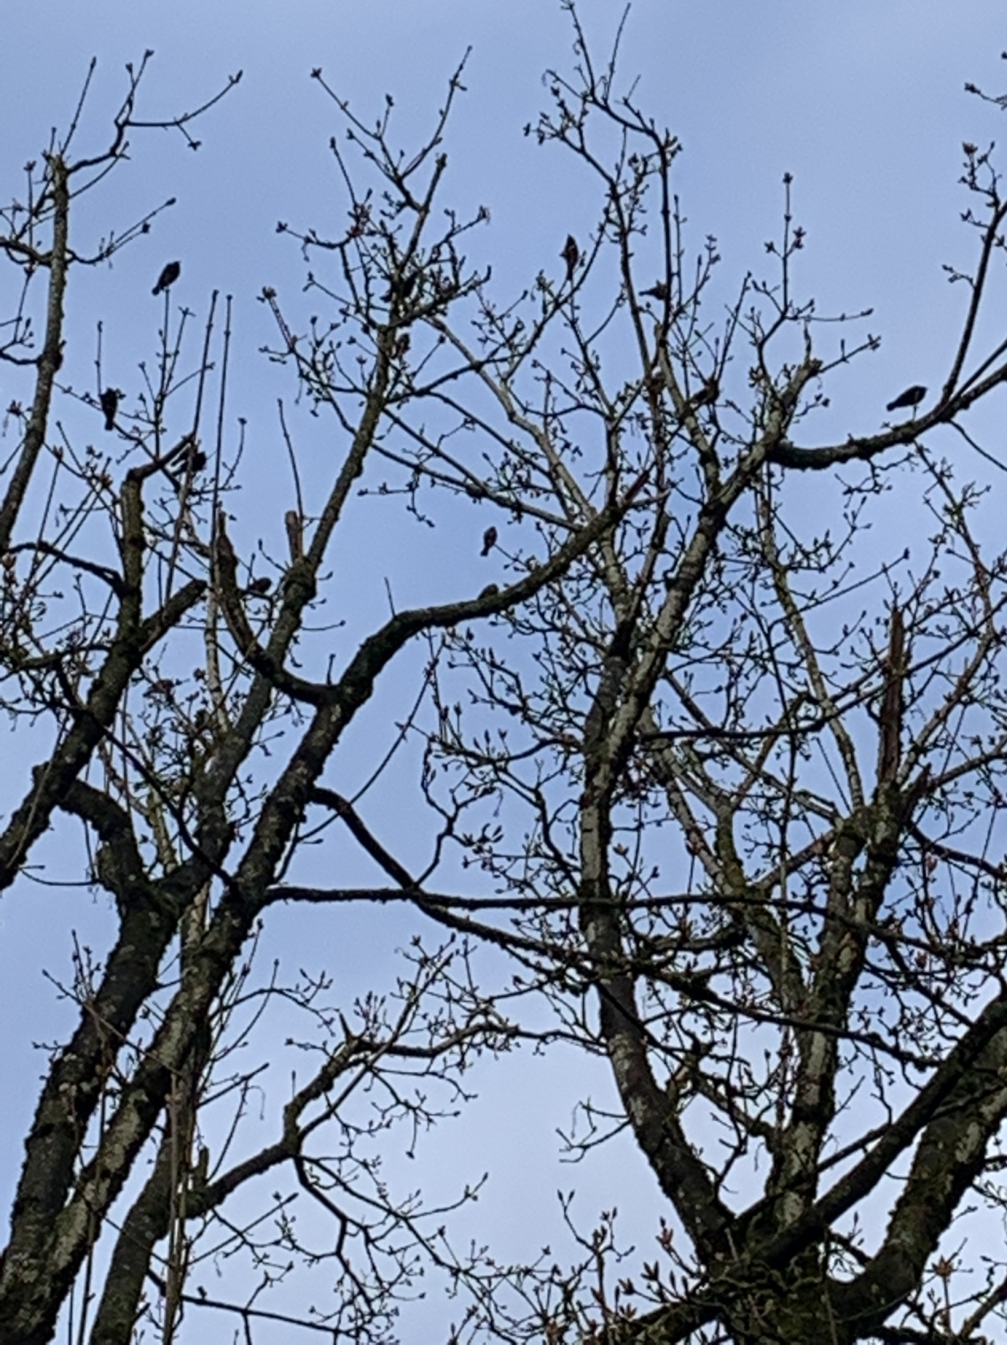
In the lesson “Birds of a Feather”,
did you find flocks of birds to count?
Do you remember how many birds were in a flock you counted?

Slide 4
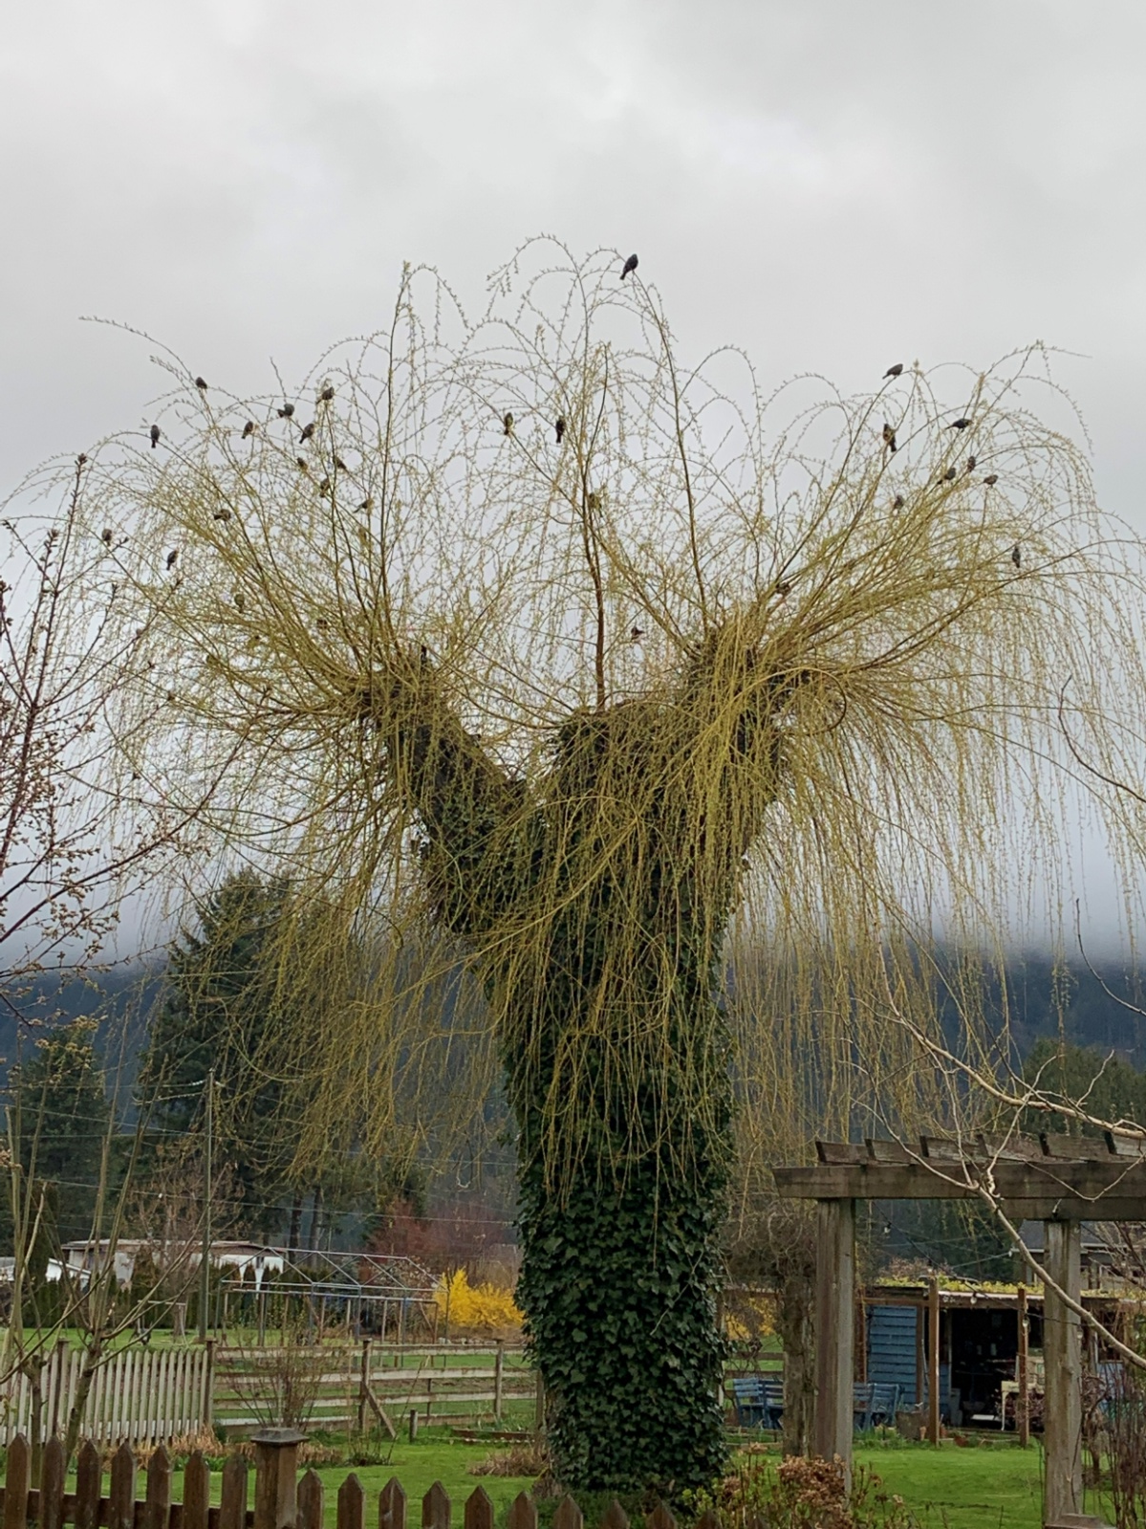
How many birds are in the flock of birds in this tree?
Did you count by 1, 2, 3 or ???

Slide 5
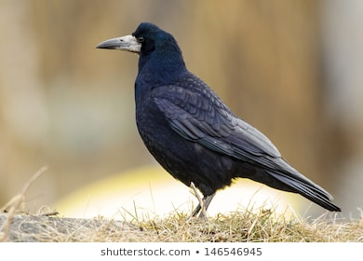
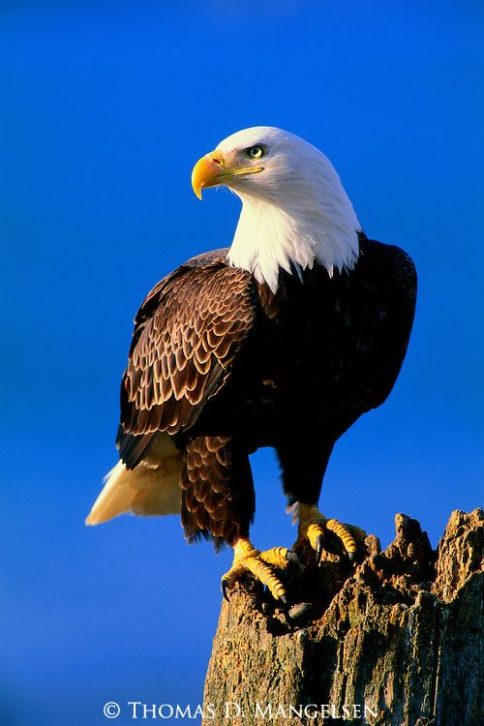
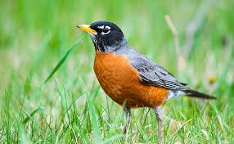
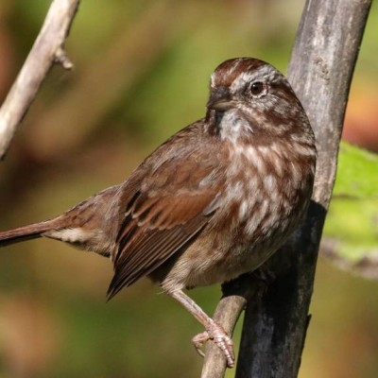
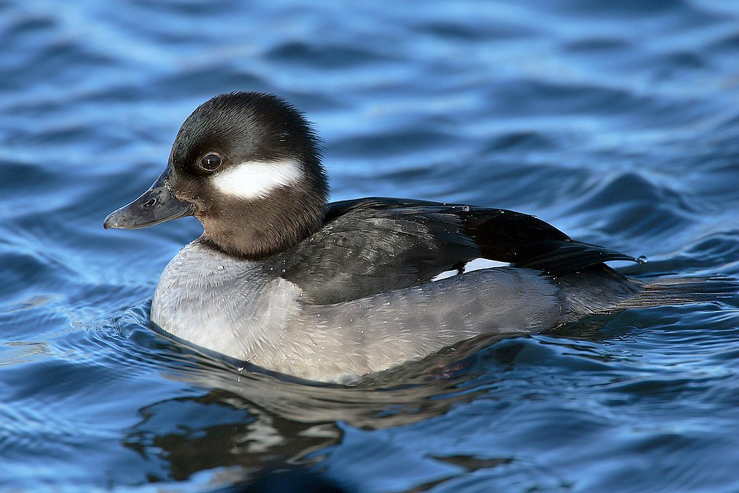
Did you know the kinds of birds you counted?
Crow
Robin
Eagle
Duck
Sparrow

Slide 6
All birds have their own sounds.
Even if you can’t see them, you could hear them.
Click on the links to hear each bird’s call.
Robin: https://www.allaboutbirds.org/guide/American_Robin/sounds
Crow : https://www.allaboutbirds.org/guide/American_Crow/sounds
Eagle: https://www.youtube.com/watch?v=KJovQ5gmxDM
Duck: https://www.youtube.com/watch?v=el1v4RiK3bU
Sparrow: https://www.allaboutbirds.org/guide/Song_Sparrow/sounds

Slide 7
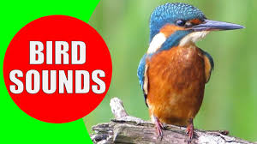
When you go outside, listen carefully.
What bird calls and sounds do you hear?
Which bird calls do you hear everyday in your yard?
Here is a video of bird sounds.
Do you hear any of these birds in your yard?
https://www.youtube.com/watch?v=mfFldO-B8vE (5 min)

Slide 8
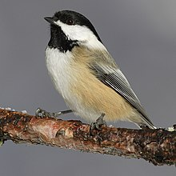
Humans mimic bird sounds.
I bet you can match each sound-word with the picture of the bird.
Quack Caw-caw Chick-a-dee-dee-dee
https://en.wikipedia.org/wiki/American_crow
https://en.wikipedia.org/wiki/Chickadee
https://en.wikipedia.org/wiki/Duck
Can you name each bird in the pictures?

Slide 9
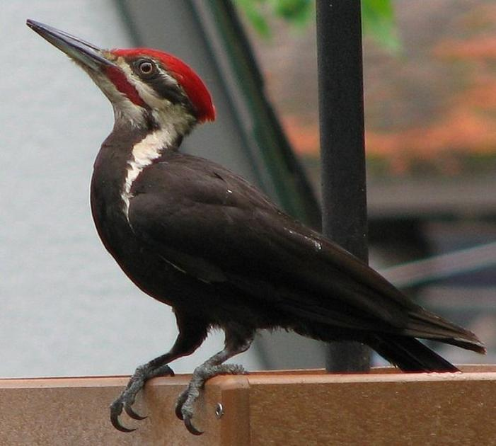
This week, go outside and listen very carefully.
How many different bird calls and sounds did you hear?
Can you identify any of the birds by their sound?
Crow
Sparrow
Robin
Woodpecker
Challenge: Try to mimic bird sounds you hear.

Slide 10
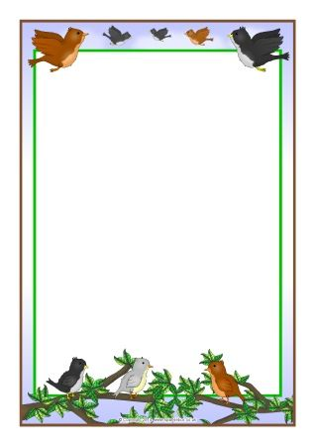
Happy Bird Watching!
Please email Ms. T. if you want to:
Tell her about some birds you find.
Send her a picture of some birds you see.
Write her sounds you hear birds making.
She’d love to hear from you!

