Slide 1
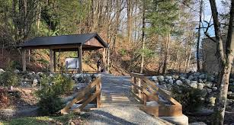
Outdoor Education
Lesson 3 : Grades Gr. 3-6
Earth Day
Wednesday, April 22, 2020

Slide 2
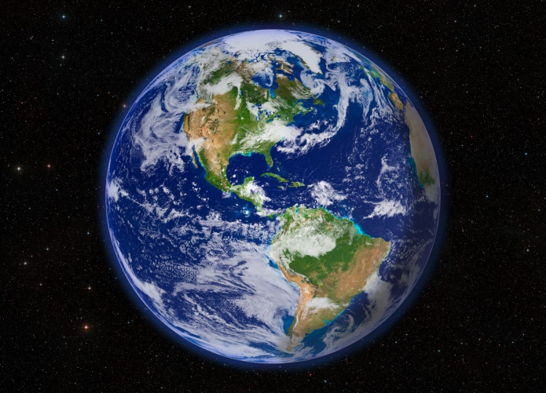
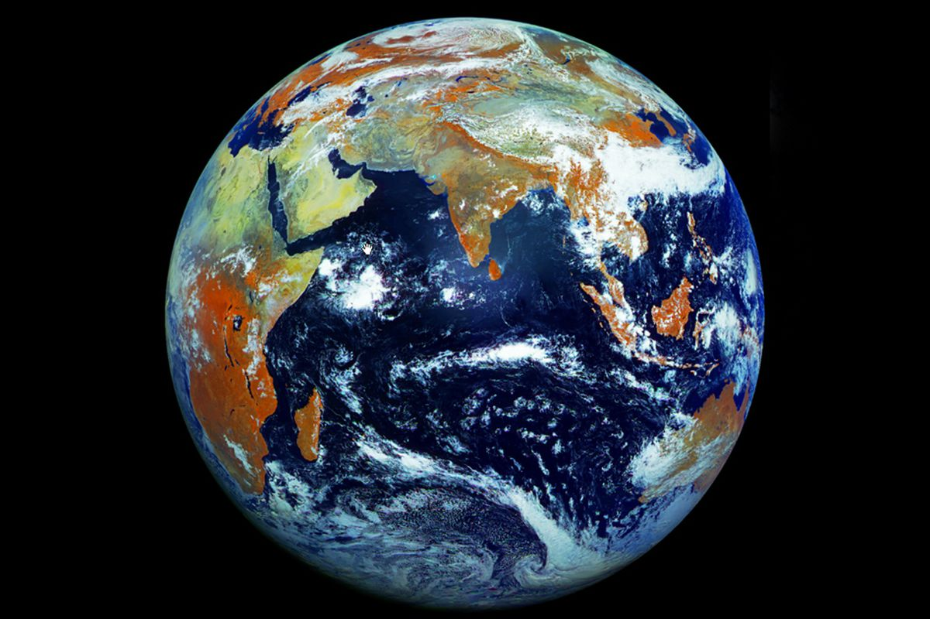
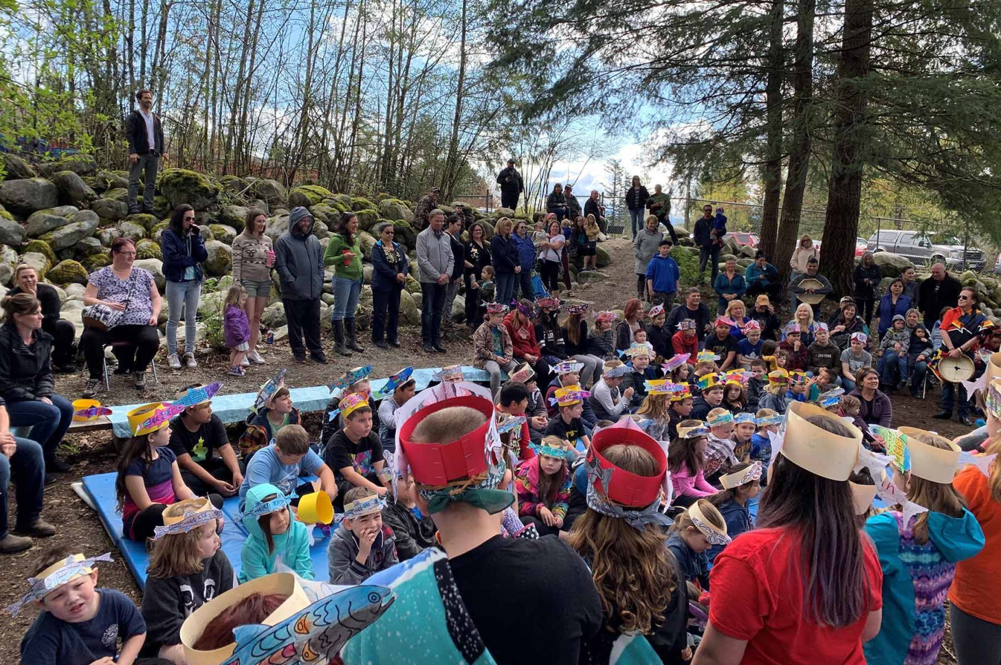
Earth Day
Learning Intentions:
I can learn 3 new things about Earth that I did not know before today.
With thanks, this pic is from: https://www.pinterest.ca/pin/318840848619872362/
With thanks, this pic is from: https://www.theverge.com/2012/5/12/3016254/russian-satellite-earth-from-space-121-megapixels

Slide 3
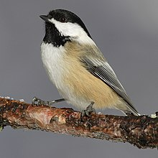
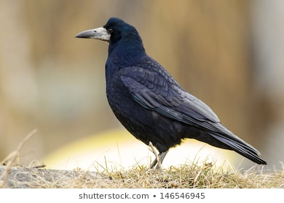
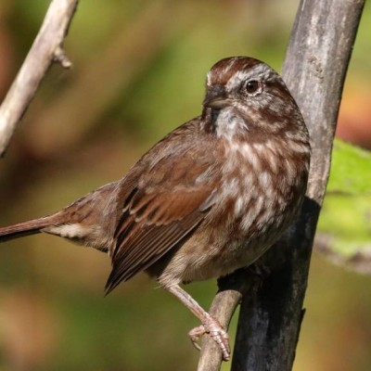
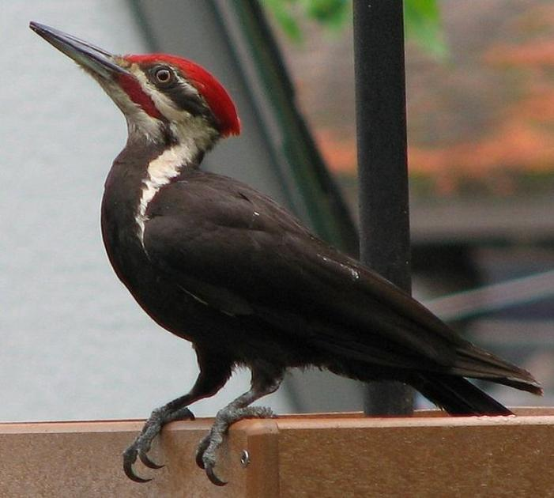
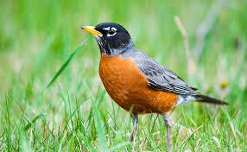
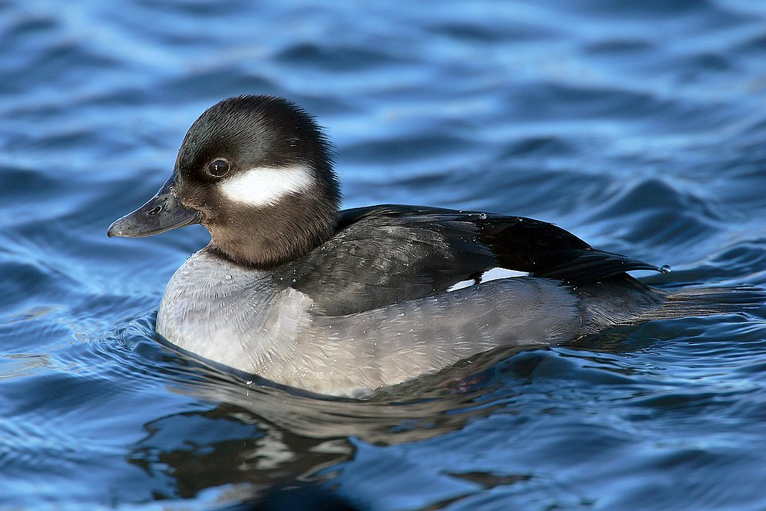
You’ve been outside, observing birds by listening and watching.
When doing this, you have been connecting with nature and Earth.
So, in this week’s lesson, we will celebrate Earth Day with some thinking about our planet.

Slide 4
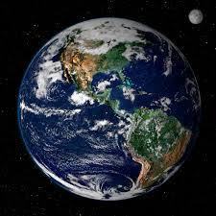
Look carefully at this picture of Earth.
Can you point to where British Columbia is in this photograph?
What else do you see in this photo?
Can you recognize a continent or ocean seen in this picture?

Slide 5
Earth is a precious place. Our home.
Getting to know Mother Earth is our duty to her.
The Elders are Watching
by David Bouchard
https://www.youtube.com/watch?v=9pQftknij8k

Slide 6
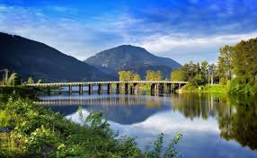
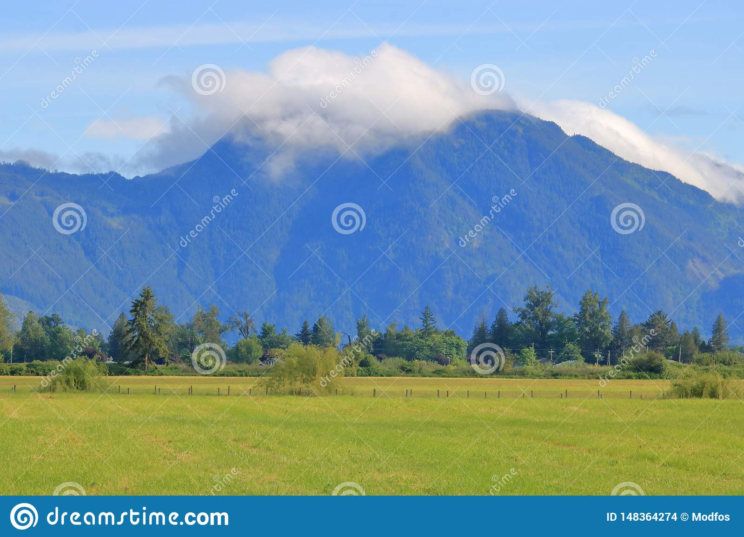
One way we study Earth is by being outside and noticing the life all around us, and appreciating how all of that supports us in our lives everyday.
In what ways does land, the earth, around your house and neighbourhood support you?
With thanks, this pic comes from: https://www.missioncityrecord.com/tourism/deroche-idyllic-farm-community-nestled-on-a-beautiful-waterway/
With thanks, this pic comes from: https://www.dreamstime.com/deroche-mountain-southern-bc-canada-wide-landscape-view-cumulus-clouds-top-high-above-small-british-columbia-image148364274

Slide 7
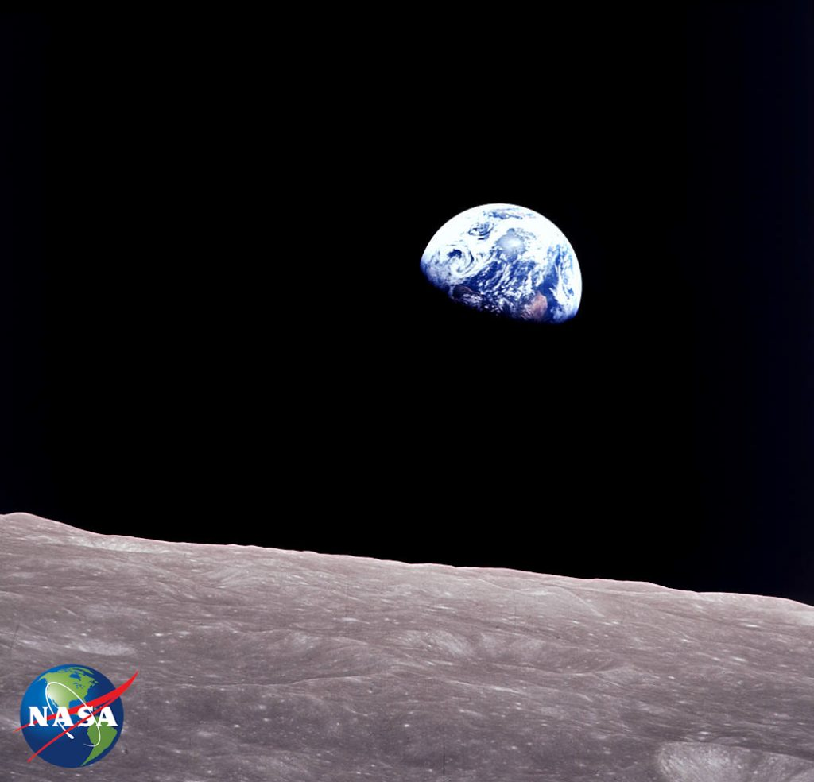
Earth Rise NASA Celebrates Earth Day 2020
NASA studies the earth and the entire universe!
Look at this picture. Where do you think the earth is being viewed from?
Hmmm ….. What does NASA stand for? Do you know? Can you find out?
Check out these videos which shows you some of the ways NASA studies the earth.
Earth Day 2020: NASA Puts Space to Work for the Planet
https://www.youtube.com/watch?v=d815wa7aIMs
NASA Looks Back at 50 Years of Earth Day
https://www.youtube.com/watch?v=BqA1iXYFRIU
With thanks, this pic from: https://blogs.nasa.gov/earthdaycountdown/2020/03/02/t-50-earthrise/

Slide 8
You Are Stardust
by Elen Kelsey
All things on Planet Earth came from stardust. That’s one reason why we, all things on this entire planet Earth, are connected. Sounds strange, I know. Check out the book in the Tumble Library from this link: https://deroche.mpsd.ca/E-Learning/Reading/Pages/default.aspx#/=

Slide 9
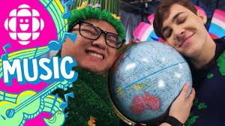
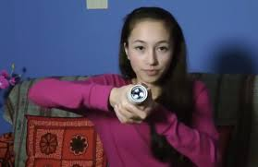
Planet Earth is worth getting to know.
Knowledge is power.
Getting to know the earth and the precious things on our planet .… like plants, animals, rocks, air, water, etc. …. can pay off … in more ways than one.
Check out this video of one girl who learned some specific details about the earth and created an invention where you, the human, holds the power in your hands. Literally!
https://www.youtube.com/watch?v=DLECJbWrKrs
For more inventions, check out this link:
https://www.cbc.ca/kidscbc2/the-feed/5-inventions-changing-the-world

Slide 10
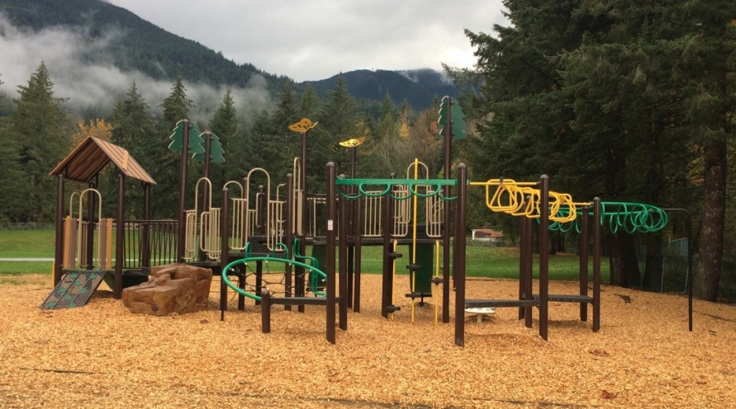
Now, it’s your turn.
Go outside and observe the world around your house. Do you notice something today you did not notice yesterday?
What is your favourite part about where you live?
How do you help to make your community a great place to live and be?

Slide 11
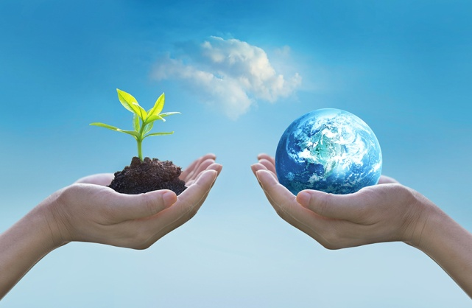
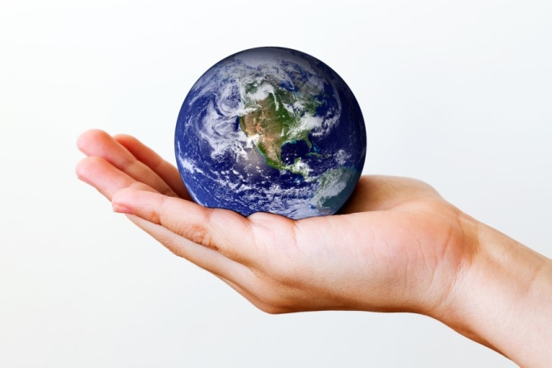
Earth Day
What new things did you learn about Earth today?
With thanks, this pic is from: https://www.pinterest.ca/pin/318840848619872362/
With thanks, this pic is from: https://www.theverge.com/2012/5/12/3016254/russian-satellite-earth-from-space-121-megapixels
Want to learn more? Check out Wonderopolis!
https://wonderopolis.org/wonders?category=&subcategory=&order_by=&q=earth

Slide 12
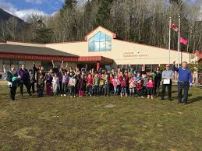
Let’s keep getting to know Mother Earth
by observing her
and learning
how we can help her stay strong
for all us Deroche Bears.

