Slide 1
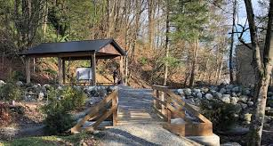
Outdoor Education
Lesson 1 : Grades 3-6
Birds of a Feather

Slide 2
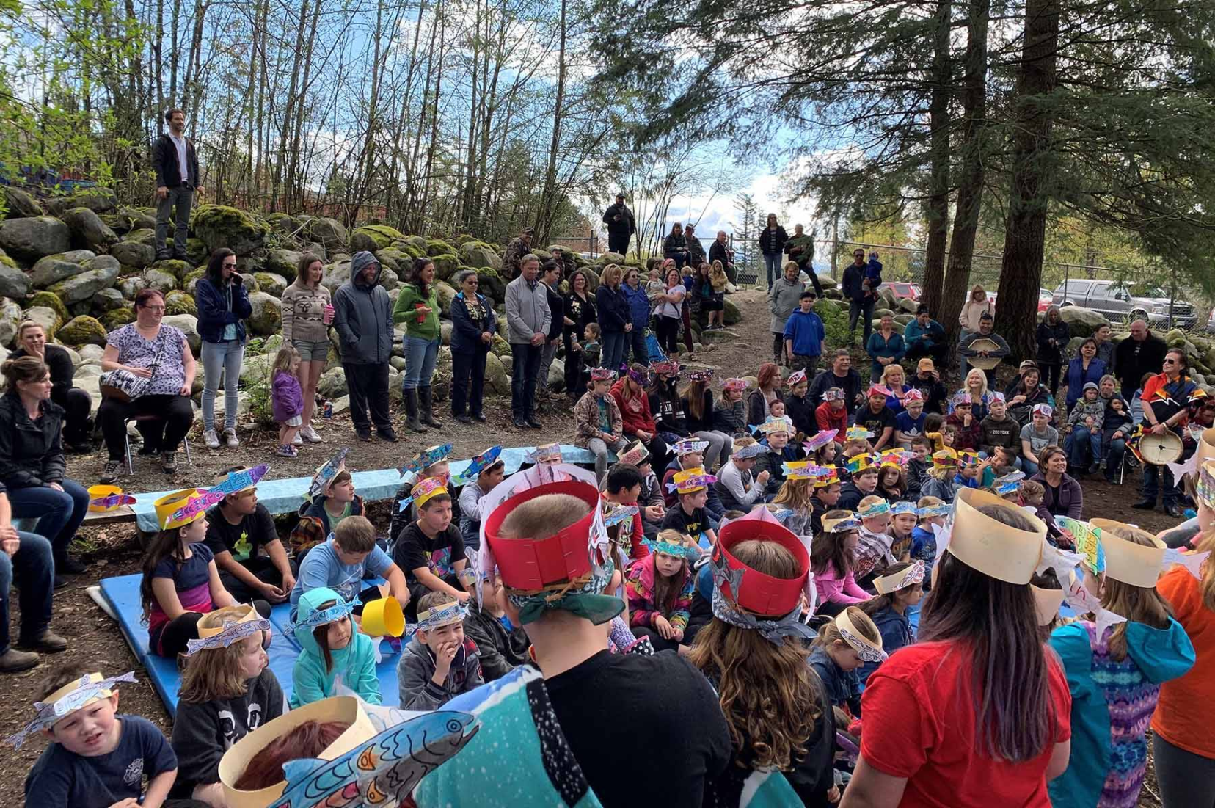
Birds of a Feather
Learning Intention: I can learn about birds by observing them.

Slide 3
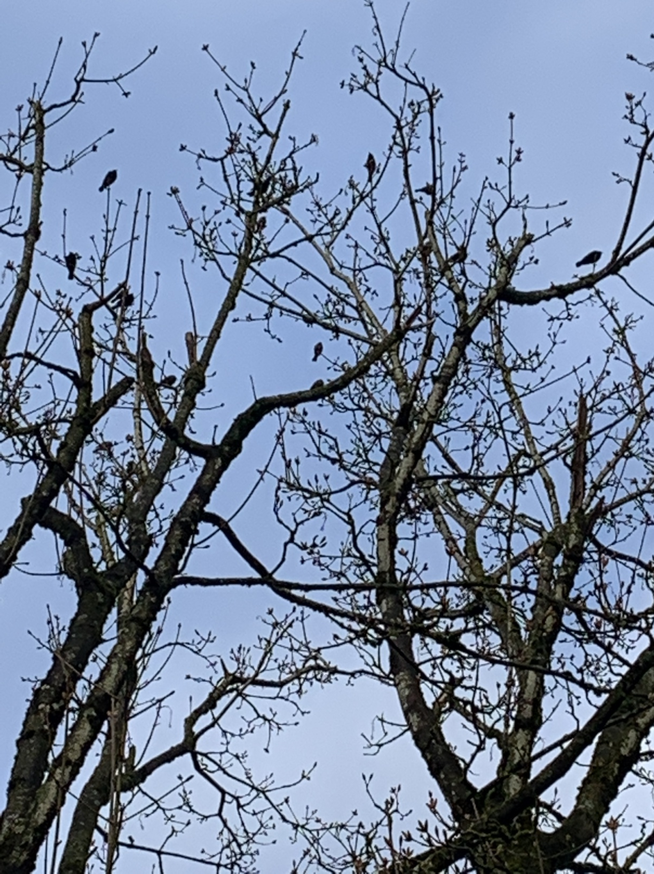
​
Ms. T. was out walking in her neighbourhood a few mornings ago, and spied this group of birds gathered in this tree.
She was curious and had a few questions.

Slide 4
We see and hear birds everywhere right now!
Do you hear them in the morning?
Do you see them busily flying?
Do see them gathering together in trees, like in this picture?
Why do you think there are so many busy birds around right now? Why do you think they are so abundant in our area right now?

Slide 5
Look at this picture carefully.
How many birds do you see?
How did you count them? One by one? In groups?

Slide 6
Look carefully at the outline or silhouette of one bird.
Have you seen this bird in your backyard?
What kind of bird do you think it is?
What sound does it make?

Slide 7
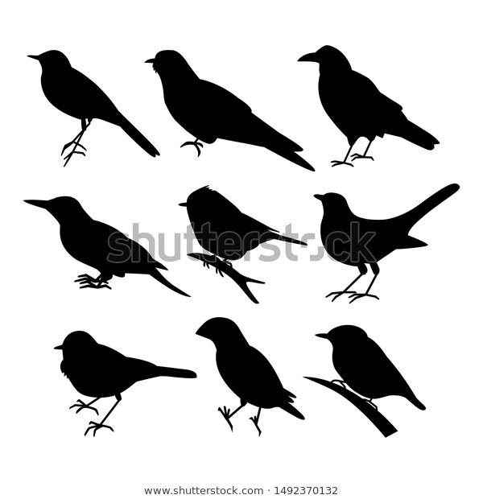
Once you get to know the silhouette of certain birds, you will know what birds you are seeing from a distance.
Like Ms.T. did, why don't you go for a walk and see what birds you can see. Maybe you will take a picture of birds also!
How many birds do you see at one time? How will you count them?
What birds are you seeing that have the same silhouette or different sillhouettes?
What sounds or songs do the birds you observe make?
Can you copy or mimic their sound?
With appreciation, this picture is from this website:
https://www.shutterstock.com/image-illustration/birds-set-black-cute-cheerful-1492370132

Slide 8
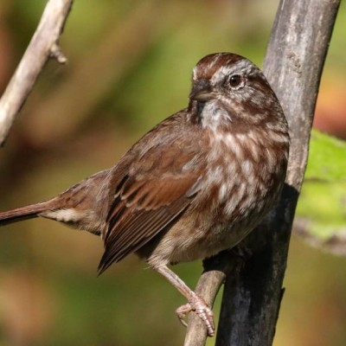
Which silhouette do you think best matches the Song Sparrow?
Song Sparrow
With appreciation, this picture is from this website: http://www.vancouverbirdweek.ca/common-garden-birds/

Slide 9
Birds are abundant in Deroche and around your house right now.
By observing birds in your area, you can find out how many there are, their shapes and their sounds. What else can you find out about birds by observing them?
By observing birds, you can get to know their silhouettes and will be able to easily identify them.
Song Sparrows are abundant in Deroche right now. Can you find Song Sparrows in your backyard? Can you mimic their song?

Slide 10
Well, I hope you will enjoy some birdwatching as you spend time at home. Going outside is OK. Unlike birds, however, gathering together for us is not OK right now.
Maybe you will share bird pictures with your friends? And mimic the bird song for them! Did your friend notice this bird in their backyard, too?
Happy Bird Watching!

