Slide 1
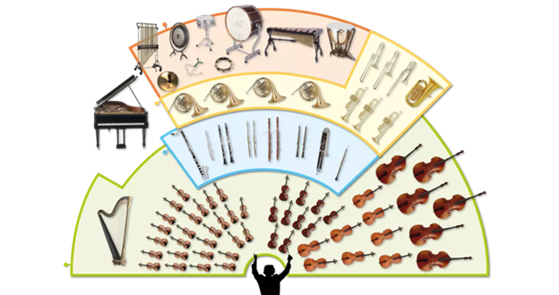
Music Education
Instruments of the Orchestra
Lesson 7 : Grades 3-6

Slide 2
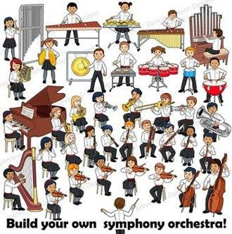
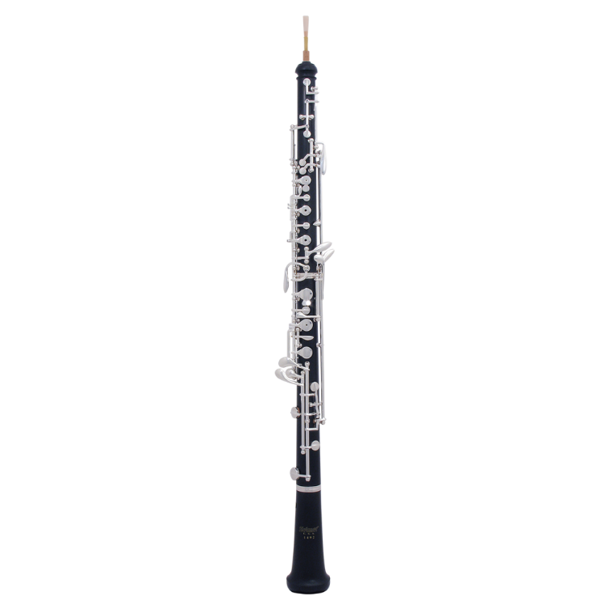
Review of Lesson 6 : Oboe
An oboe is a member of what orchestra instrument family?
An oboe is a _______
reed instrument. (Hint: related to a number)
What is one genre or style of music where the oboe is played?

Slide 3
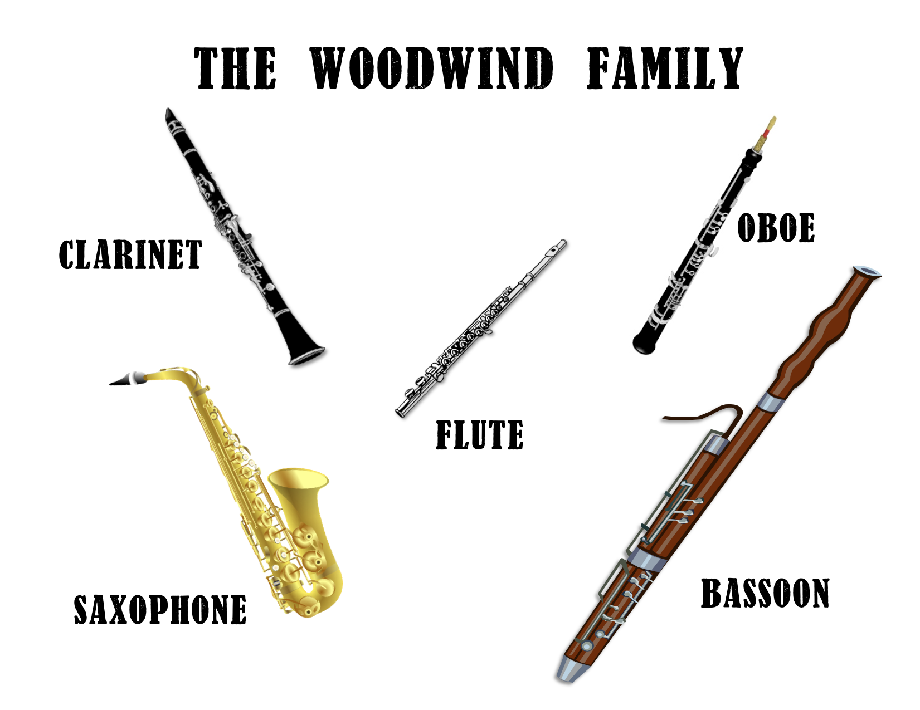
Instruments of the Orchestra
Lesson 7 : Bassoon

Slide 4
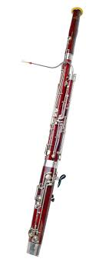
Bassoon
Learning Intentions:
I can identify the sound of a bassoon playing.
I can identify a bassoon.
With thanks, this pic comes from : https://chenyan989.en.made-in-china.com/

Slide 5
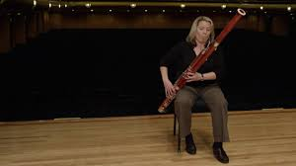
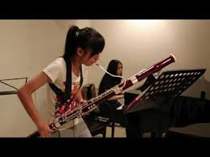
Watch these videos to
hear what a bassoon sounds like,
and see how it is played.
https://www.youtube.com/watch?v=_t2q0lsUl4k https://www.youtube.com/watch?v=XZXippwOh8Q
How might you describe the sound of a bassoon? Warm? Deep? Smooth? ____________?

Slide 6
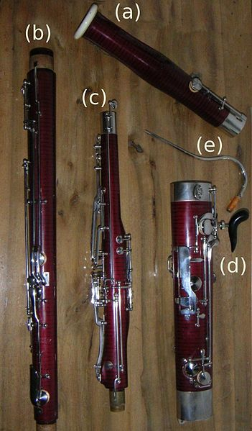
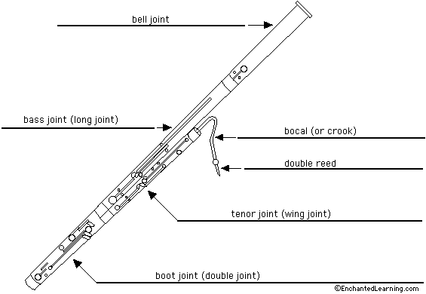
There are 5 main parts of a bassoon.
Look carefully at each picture.
Can you match each letter on the photograph to a part named on the
diagram?
With thanks, this pic comes from: https://sites.google.com/site/ohmusicstudent/band-instruments/bassoon/parts-of-the-bassoon
With thanks, this pic comes from: https://commons.wikimedia.org/wiki/File:Bassoon_parts.jpg

Slide 7
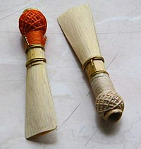
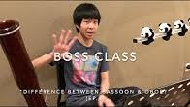
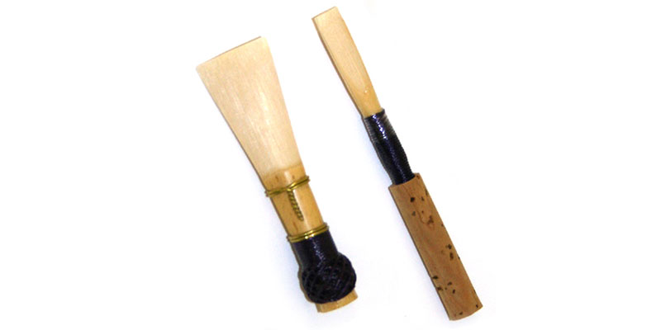
A bassoon is a double reed instrument.
Like the oboe, a bassoon is also a double reed instrument.
If you want to know more about the difference between a bassoon and an oboe, check out this video:
https://www.youtube.com/watch?v=eBdadK3AKSk
With thanks, this pic comes from: https://en.wikipedia.org/wiki/Double_reed
Bassoon Reed
Oboe Reed
With thanks, this pic comes from: https://www.omahaschoolofmusicanddance.com/our-blog/double-reed-instruments-orchestra/

Slide 8
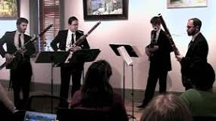
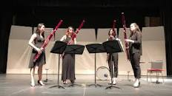
Here are some videos with musicians playing bassoon.
Do you recognize these compositions?
Catina Band from Star Wars
Havana by Camillo Cabello
https://www.youtube.com/watch?v=utwBlsyK9As
https://www.youtube.com/watch?v=XghEYA-edZA

Slide 9
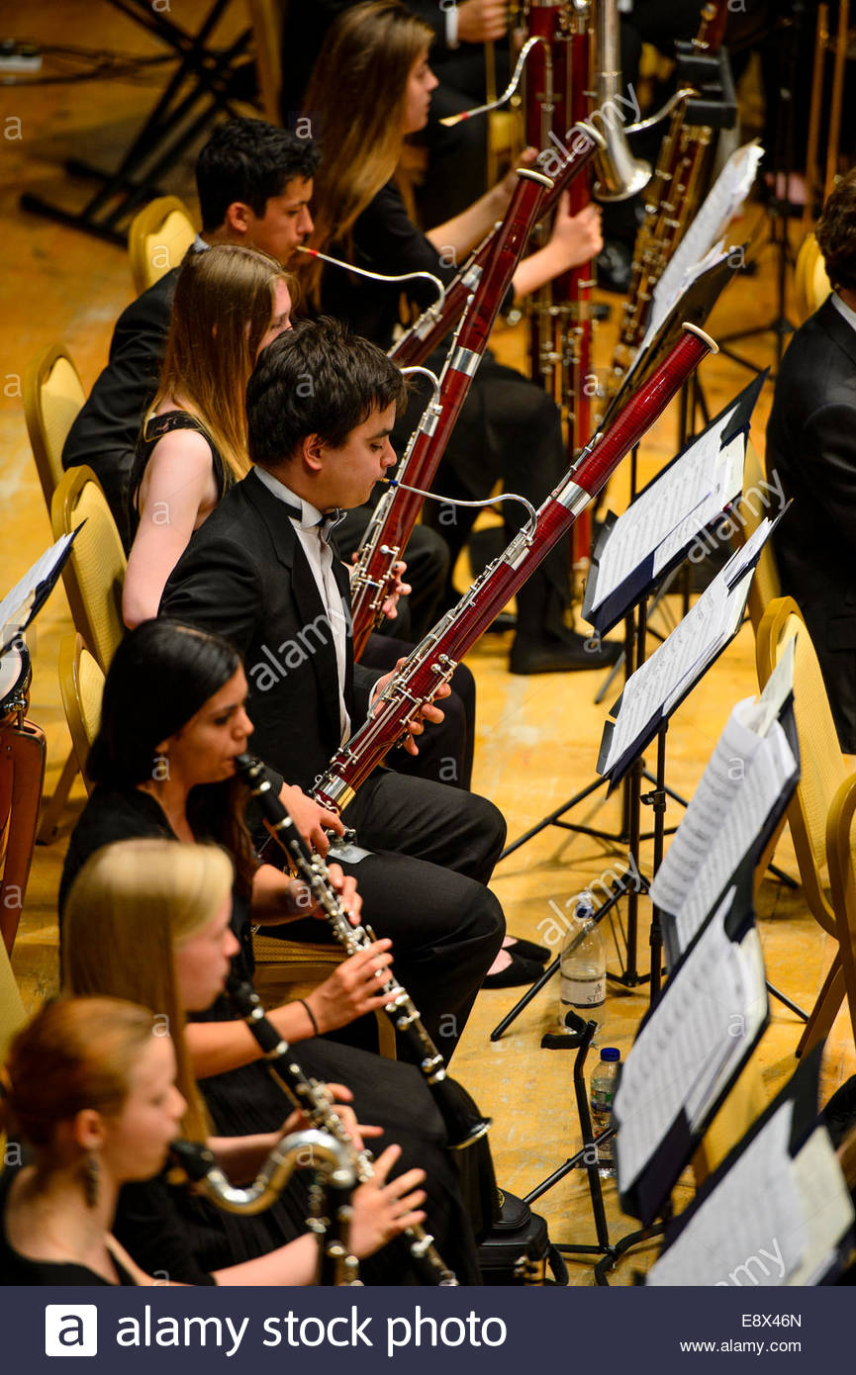
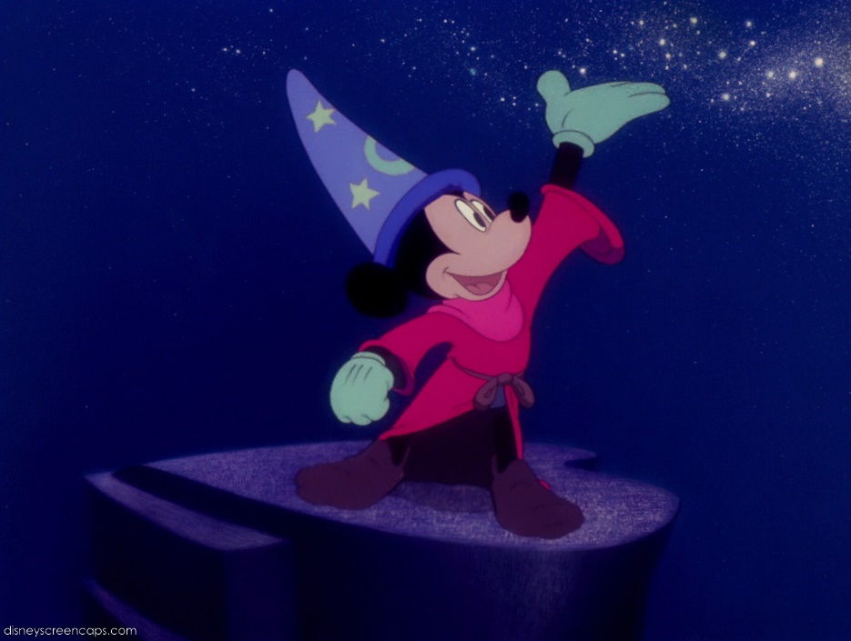
The bassoon is usually played with an orchestra.
Here is the Sourcere’s Apprentice by P. Dukas
https://www.youtube.com/watch?v=U4yH4B9deok
Click here to see a short cartoon with the same music.
https://www.youtube.com/watch?v=LpKA9n-75tQ&t=1s
With thanks, this pic from: https://www.alamy.com/stock-photo-young-musicians-in-the-woodwind-section-clarinet-and-bassoon-of-the-74332797.html
With thanks, this pic from: https://disney.fandom.com/wiki/The_Sorcerer%27s_Apprentice

Slide 10
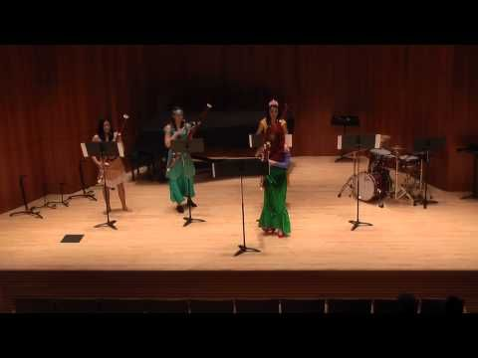
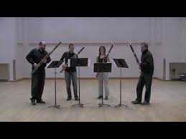
A final short bassoon concert for you to enjoy.
Disney Princess Party (5:27 min)
https://www.youtube.com/watch?v=nQVV472R0Go
Bohemian Rhapsody by Queen (6:00 min)
https://www.youtube.com/watch?v=oSxBnN1KJ-A

Slide 11
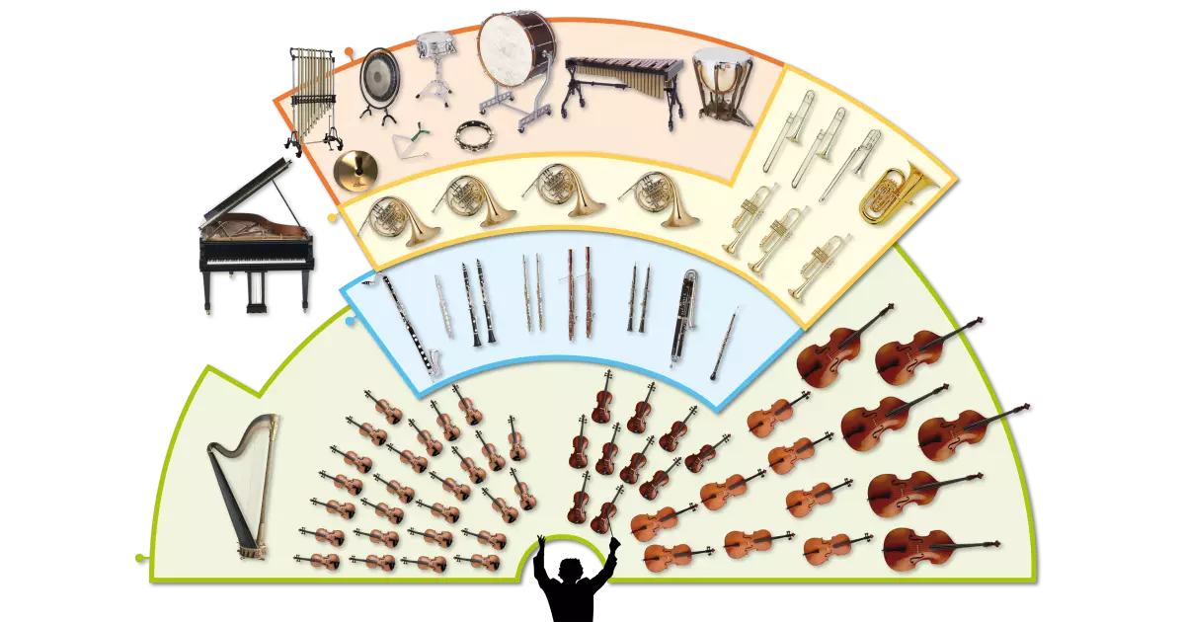
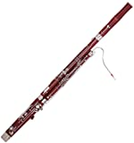
Bassoon
The bassoon is a double reed instrument.
A bassoon is played most often in an orchestra.
bocal
Like the oboe, the bassoon is a double reed instrument.
The bocal (crook) is a unique part of the bassoon.

Slide 12
Listen to music. Dance to music. Play music.
Until next time …....

