Slide 1
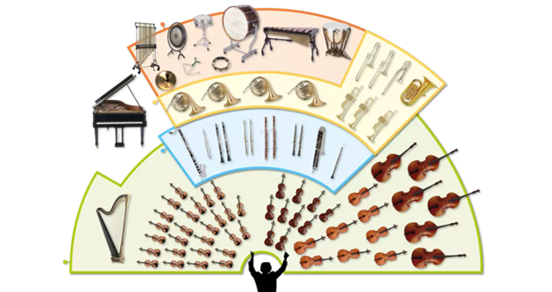
Music Education
Instruments of the Orchestra
Lesson 6 : Grades 3-6

Slide 2
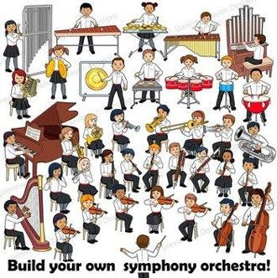
Review of Lesson 5 : Saxophone
A saxophone is a member of what orchestra instrument family?
What are the three parts of a saxophone?
What are 2 styles of music where the saxophone is prominent?

Slide 3
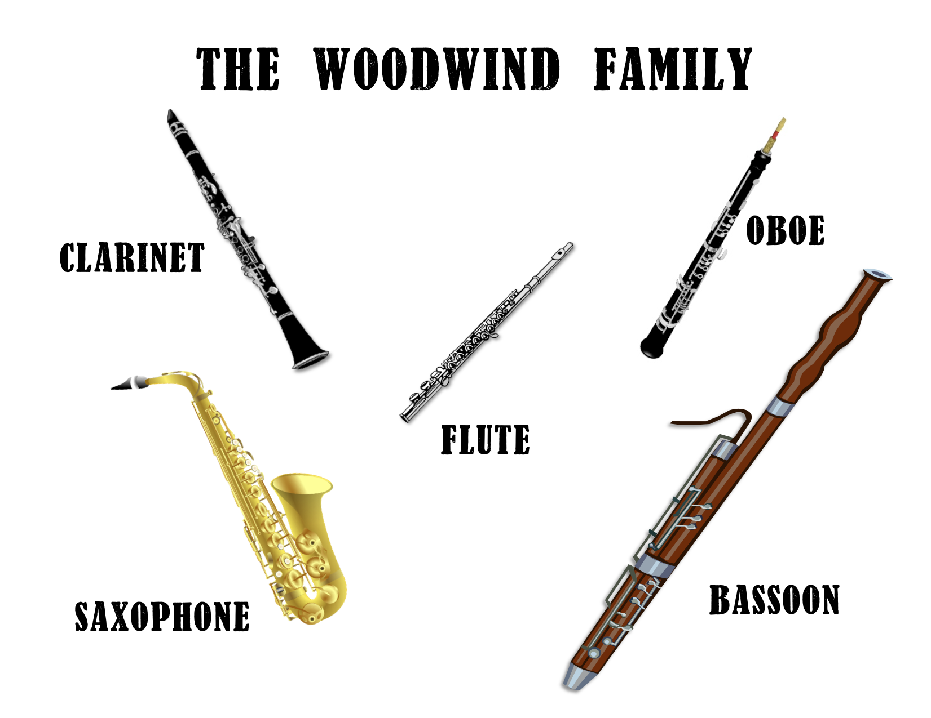
Instruments of the Orchestra
Lesson 6 : Oboe

Slide 4
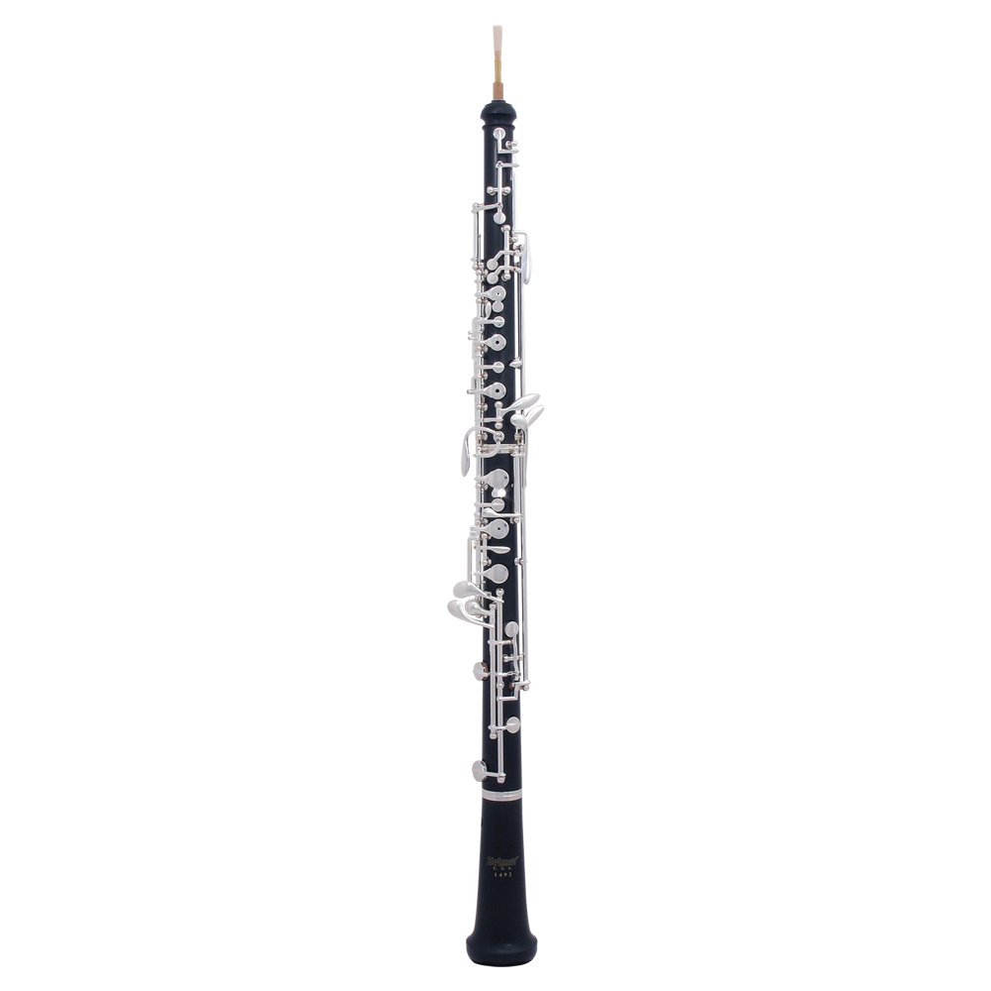
Oboe
Learning Intentions:
I can identify the sound of an oboe playing.
I can identify an oboe reed.
With thanks, this pic comes from : https://www.tomleemusic.ca/33324

Slide 5
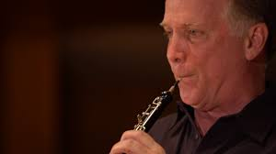
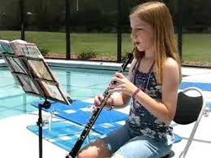
Watch these videos to
hear what an oboe sounds like,
and see how it is played.
https://www.youtube.com/watch?v=8nNilTdpDiE https://www.youtube.com/watch?v=p6ljKY_DYXw

Slide 6
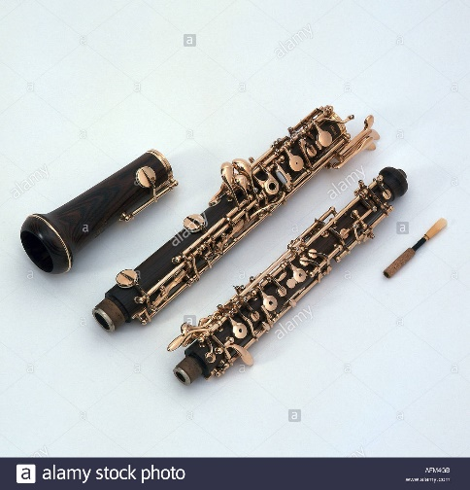
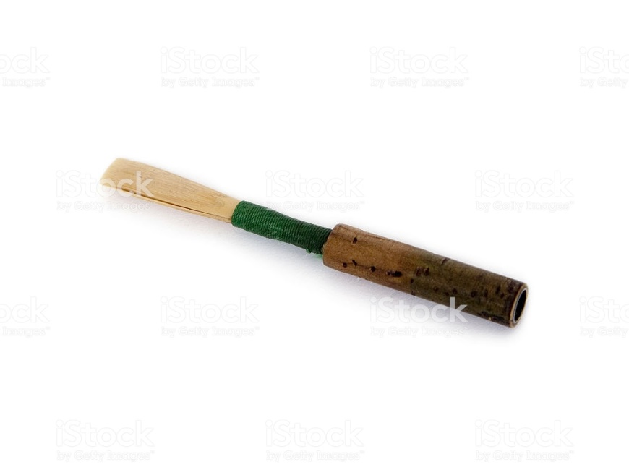
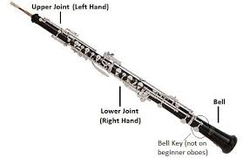
There are 4 main
parts of an oboe:
From the pictures, can you name the four main parts?
With thanks, this pic comes from: https://www.alamy.com/music-instruments-oboe-different-parts-wind-instrument-image7985930.html
With thanks, this pic comes from: https://www.istockphoto.com/ca/photo/oboe-reed-mouthpiece-for-double-reed-musical-instrument-gm172189718-2730426
Look carefully at the picture of an oboe mouthpiece above. What do you notice? How is it different from the reed used with a clarinet or saxophone?

Slide 7
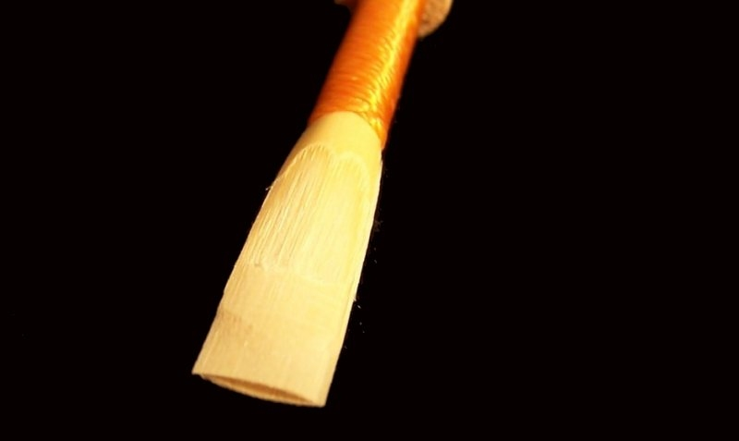
An oboe is a double reed instrument. What is a double reed?
A double reed has two pieces of cane-wood that vibrate against each other when a musician blows against them. The double reed acts as a fipple to produce the unique sound. Check out this video to see what I mean.
https://www.youtube.com/watch?v=YUhVwJqial0
The double reed is fitted into a cork piece, which can then be attached to the upper joint of the oboe.
If you want to know more, here is a video to watch:
https://www.youtube.com/watch?v=hgWe6av1lag
With thanks, this pic comes from: https://www.kesslerandsons.com/product/kessler-custom-artist-series-oboe-reed/

Slide 8
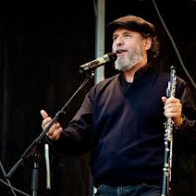
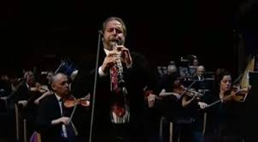
The oboe is usually played with an orchestra.
Here is Gabriels’s Oboe by Ennio Morricone.
https://www.youtube.com/watch?v=2WJhax7Jmxs
Oboist is Henrik Chaim Goldsmidt.

Slide 9
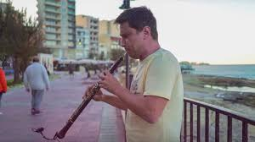
Here are some videos with musicians playing oboe.
Do you recognize these compositions?
Hallelujah by Leonard Cohn
Havana by Camillo Cabello
https://www.youtube.com/watch?v=xl8GGmedWl0
https://www.youtube.com/watch?v=Un-K6g2rQN8&list=TLPQMTIwNTIwMjDjFBUPqlgEuA&index=1

Slide 10
Here is a famous piece called “Morning Mood”.
It is part of a longer composition called “Peer Gynt” by Edvard Grieg
https://www.youtube.com/watch?v=x463zoWpiVI&list=RD-rh8gMvzPw0&index=3
Can you hear when the oboe is playing?
What other wind instruments do you hear?
With thanks, this pic comes from: https://fineartamerica.com/featured/riverwalk-by-sunrise-deroche-dave-kennedy.html

Slide 11
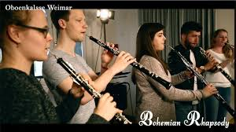
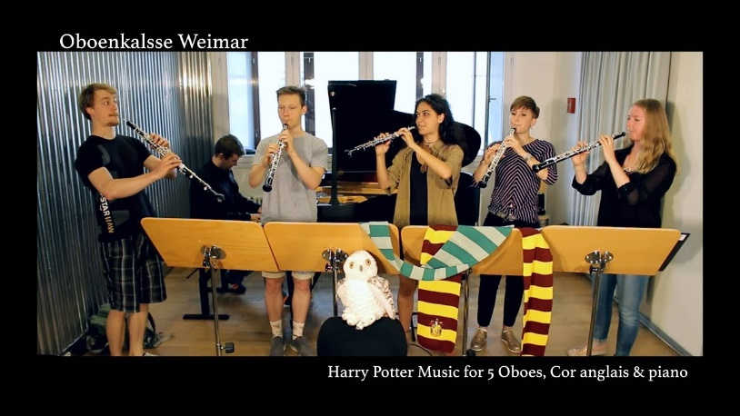
A final short oboe concert for you to enjoy.
Bohemian Rhapsody by Queen (8:02 min)
https://www.youtube.com/watch?v=goeYNLK_0X8
Hedwig’s Theme from Harry Potter (5:32 min)
https://www.youtube.com/watch?v=9s2-x40HvHU

Slide 12
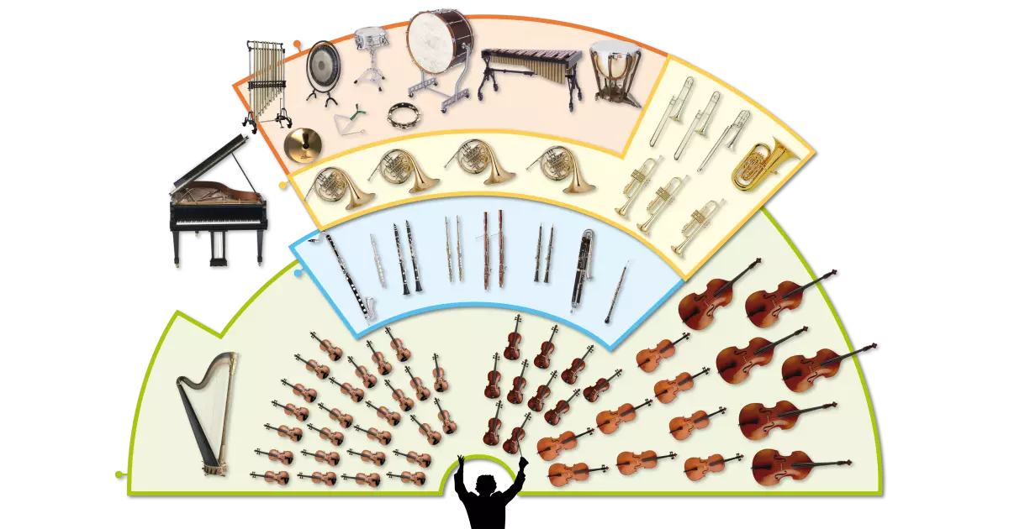
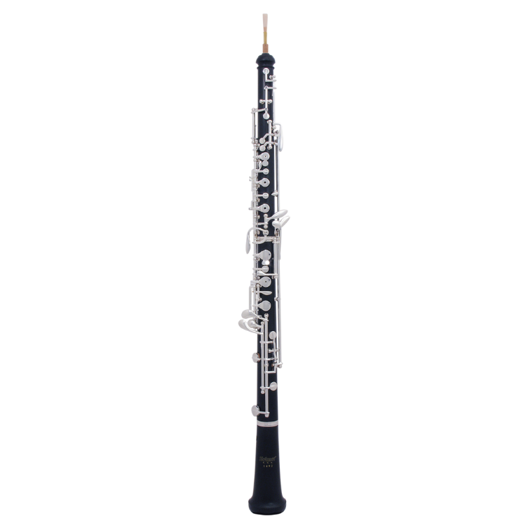
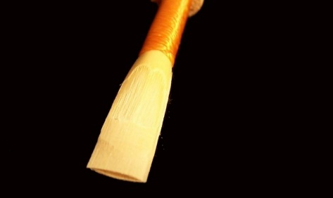
Oboe
The oboe is a double reed instrument.
An oboe is usually only included within an orchestra.
A double reed instrument has two small reads secured together.

Slide 13
Listen to music. Dance to music. Play music.
Until next time …....

