Slide 1
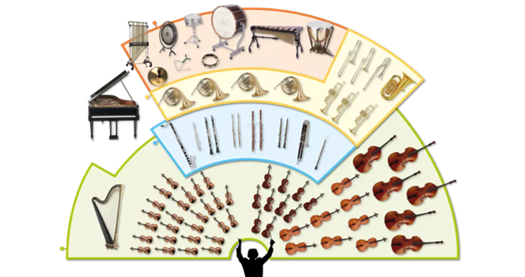
Music Education
Instruments of the Orchestra
Lesson 4 : Grades 3-6

Slide 2
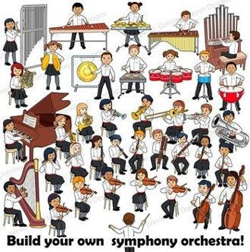
Review of Lesson 3 : Flute
A flute is a member of what orchestra instrument family?
A flute played in an orchestra (transverse flute) has three parts. What are they? (Hint: Think of your body.)
What kind of flute is a traditional instrument of Indigenous people in Peru? (Hint: Think of cooking.)

Slide 3
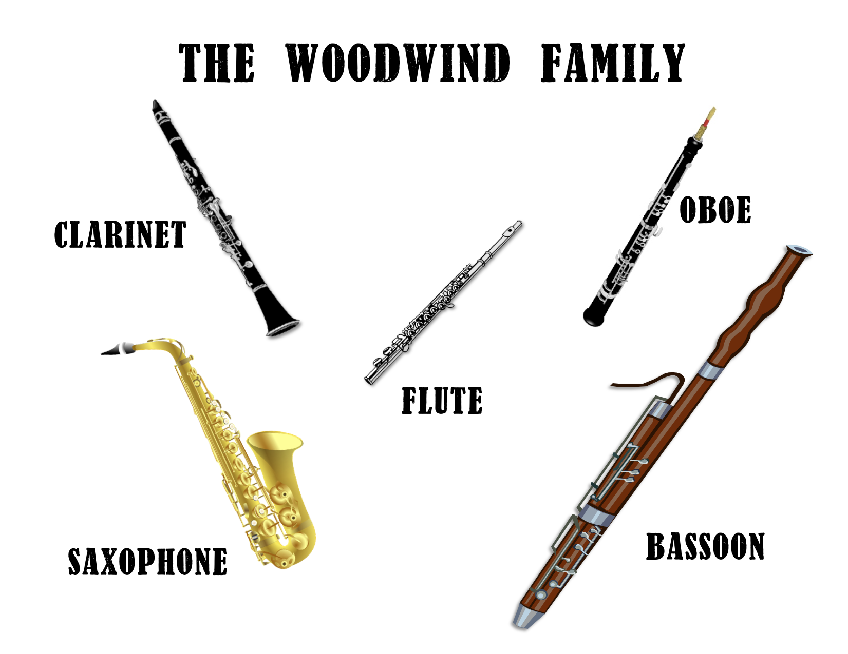
Instruments of the Orchestra
Lesson 4: Clarinet

Slide 4
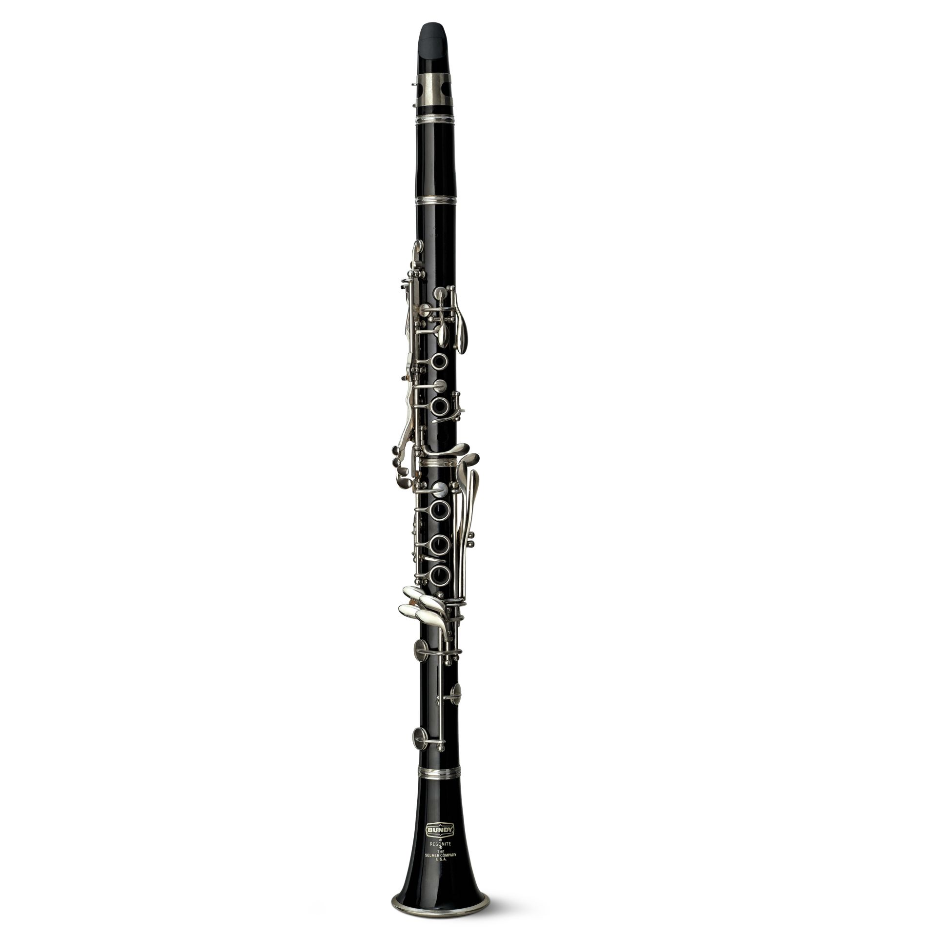
Clarinet
Learning Intentions:
I can identify the sound of a clarinet playing.
I know three kinds of music where clarinet is highlighted or prominent.
With thanks, this pic comes from: https://www.dkfindout.com/us/music-art-and-literature/musical-instruments/clarinet/t

Slide 5
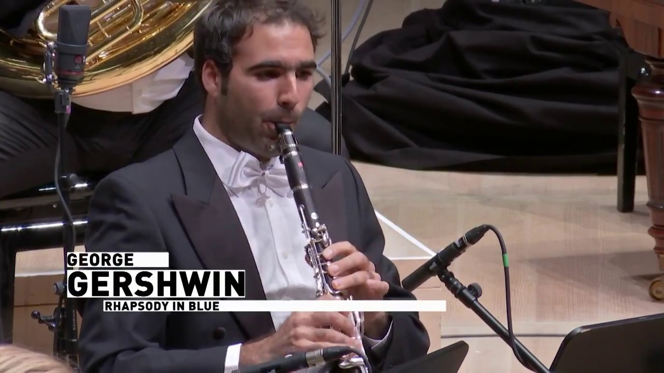
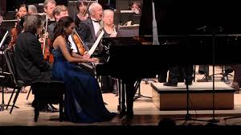
Rhapsody in Blue by George Gershwin
This YouTube video shows a most famous clarinet part for orchestra.
https://www.youtube.com/watch?v=xiYxLKWVfR8
Did you notice the warm sound of the clarinet.
Would you like to hear the whole composition?
Click on this link.
https://www.youtube.com/watch?v=7-MJZJjJs4A
What does this song make you think about?
What other instrument is prominent in this composition?

Slide 6
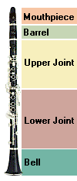
There are 5 parts to the Clarinet.
Has a reed and is where the tone is created.
Can be longer or shorter. It finetunes the clarinet’s pitch.
Keys for the left hand.
Keys for the right hand.
Responsible for the lowest tone.
With thanks, this pic comes from: http://www.the-clarinets.net/english/clarinet-instrument.html

Slide 7
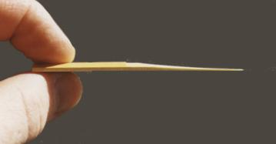
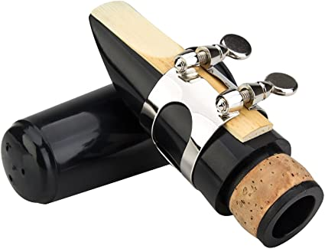
What is a reed for the mouthpiece of a clarinet?
The reed is a thin piece of wood made to act as a fipple for creating the sound of some instruments, including the clarinet.
The reed is attached to the mouthpiece.
With thanks, this pic comes from: http://www.the-clarinets.net/english/clarinet-reed.html/
With thanks, this pic comes from: https://www.amazon.com/Clarinet-Mouthpiece-Ligature-Plastic-Cap-black/dp/B00P0AHRQ0/

Slide 8
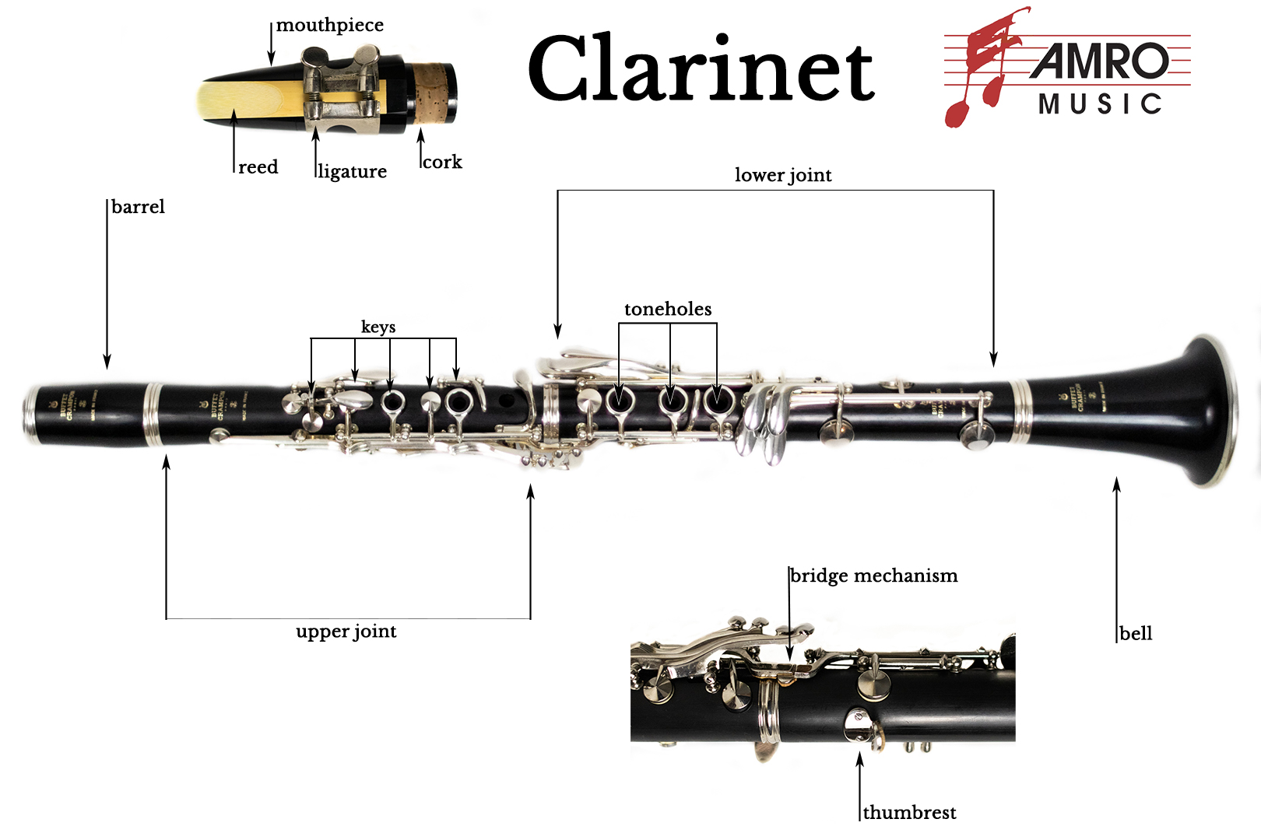
Here’s a diagram of more detailed parts of a clarinet.
With thanks, this pic comes from: https://www.amromusic.com/clarinet

Slide 9
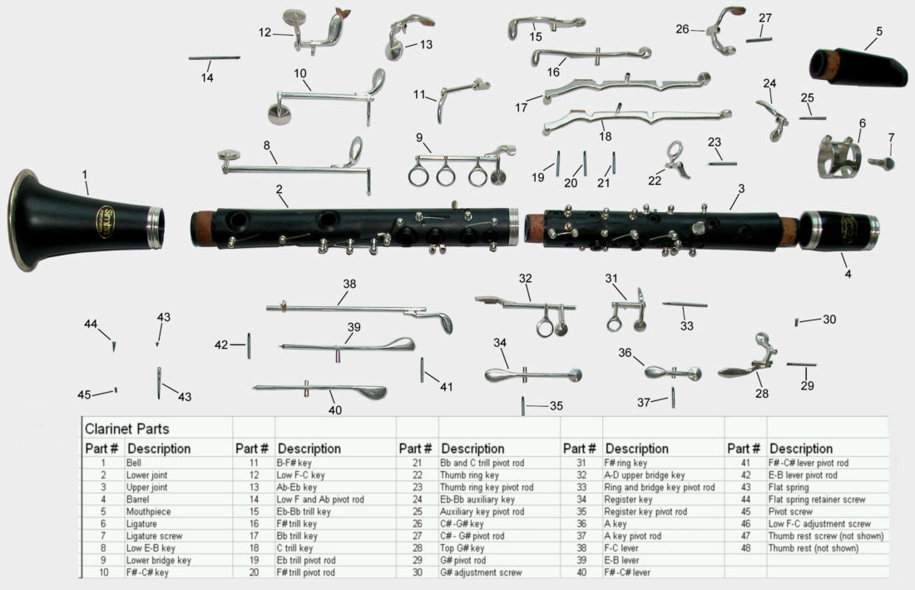
How a Clarinet is Made
There is quite a process to making a clarinet. Below is a video that shows you the factory process of making a clarinet. If you are interested in building things, you may find this process fascinating.
How It’s Made – Clarinet
https://www.youtube.com/watch?v=bqdtnBPlVfM
With thanks, this pic comes from: https://publish.illinois.edu/dailyhailey/how-writing-is-similar-to-playing-the-clarinet/

Slide 10
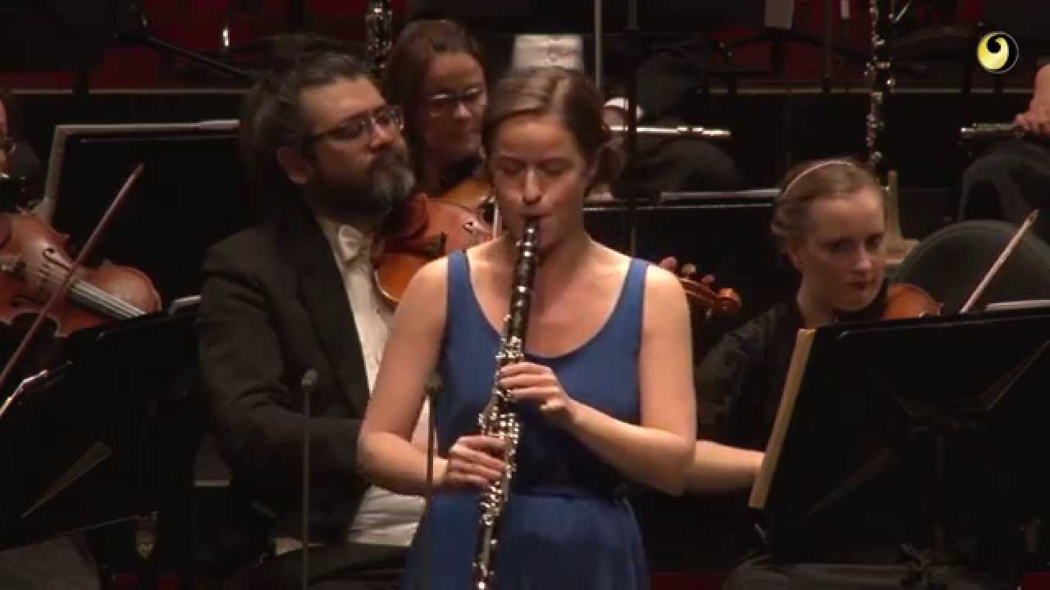
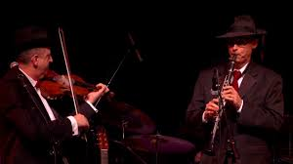
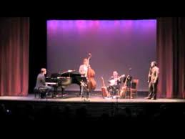
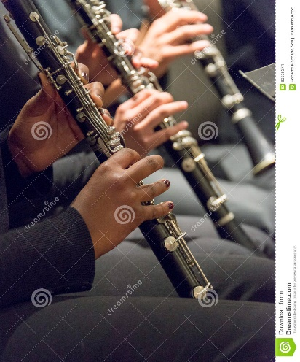
Clarinet plays a key role in several styles or genres of music.
Genre: Classical Music
https://www.youtube.com/watch?v=YT_63UntRJE
Genre: Klezmer Music
https://www.youtube.com/watch?v=yNUY9pqyEaI
Genre: What is your guess? Do you recognize this piece?
https://www.youtube.com/watch?v=xb_O_P84Akw
Genre: Jazz Music
https://www.youtube.com/watch?v=uN6Nul5DS0o
Genre: What is your guess? Do you recognize this piece?
https://www.youtube.com/watch?v=nLaFKsnlvig
With thanks, this pic comes from: https://www.dreamstime.com/stock-photo-musicians-playing-clarinet-band-close-up-image60028374

Slide 11
A final short concert for you to enjoy.
Lean On (3:30 min)
https://www.youtube.com/watch?v=nuEMqMc1Fh4
Despacito (3:30 min)
https://www.youtube.com/watch?v=ZHEA1G4FO5c

Slide 12
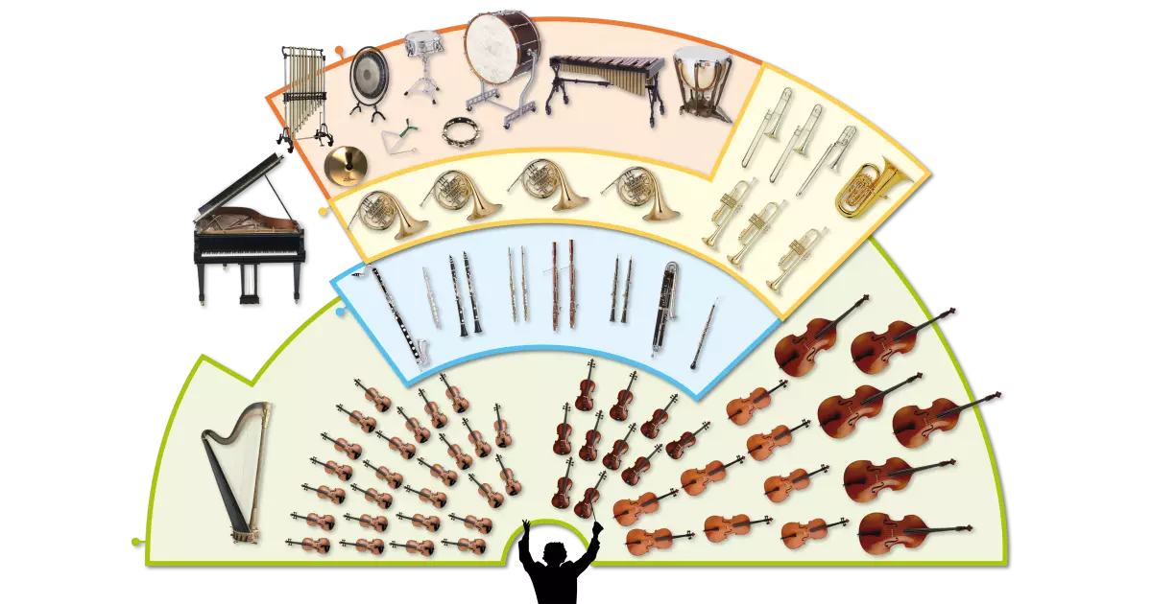
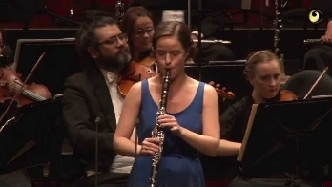
Clarinet
The clarinet has a very warm sound.
In an orchestra, a clarinet is a member of the woodwind family.
The clarinet is important in several genres or styles of music.
3 genres of music where clarinet can be prominent are classical, jazz, and klezmer.

Slide 13
Listen to music. Dance to music. Play music.
Until next time …....

