Slide 1
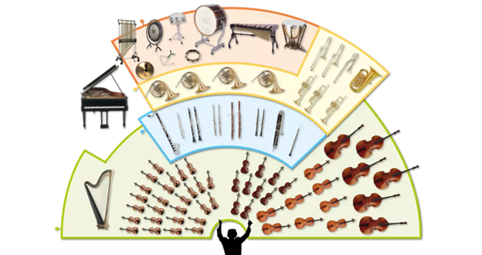
Music Education
Instruments of the Orchestra
Lesson 3 : Grades K-2

Slide 2
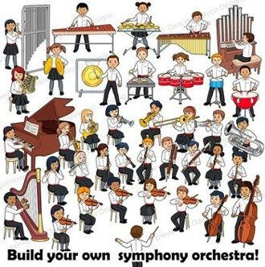
Review of Lesson 2 : Woodwind Family
What are names of some instruments in the Woodwind Family?
To make a sound, you blow into a woodwind instrument. How are the different notes made?

Slide 3
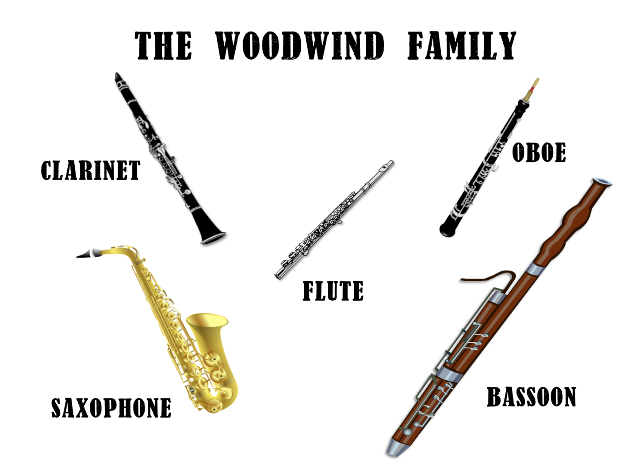
Instruments of the Orchestra
Lesson 3: Flute

Slide 4
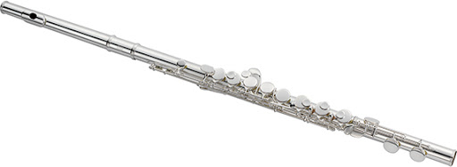
Flute
This week you will learn to identify the sound of a flute being played, and how to make a pan flute.
With thanks, this pic comes from: http://jupitermusic.com/international/products/woodwinds/flutes/

Slide 5
What does a flute sound like?
How do you play a flute?
To find out, watch Jenny’s Juke Box Jam video.
https://www.youtube.com/watch?v=OWT4VlGm_N8

Slide 6
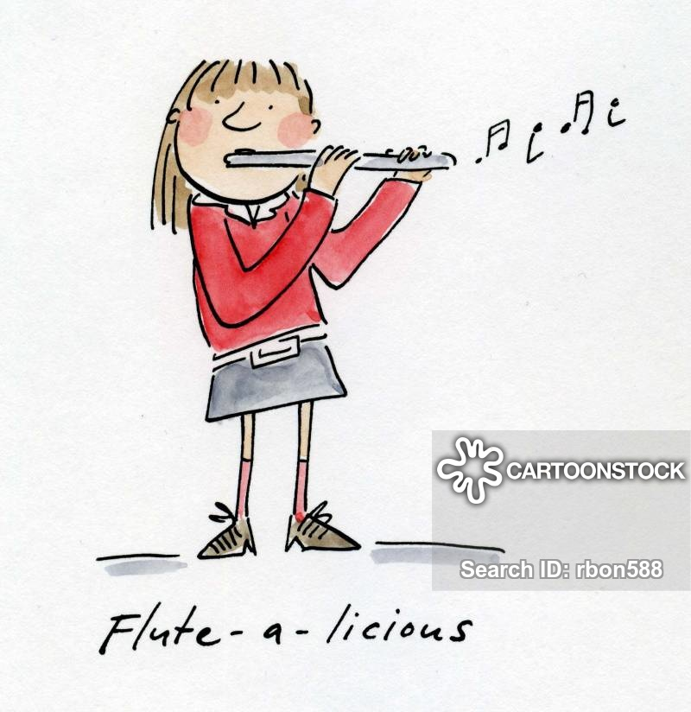
Learn more about the flute.
Pretend to play a flute along with this video!
https://www.youtube.com/watch?v=FmsKQRON3zY
With thanks, this pic is from: https://www.cartoonstock.com/directory/f/flute_player.asp

Slide 7
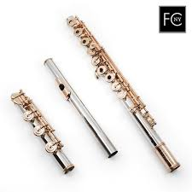
There are 3 parts to the flute.
From this picture, take a guess by pointing to each part:
Head joint
Body
Foot Joint
With thanks, this pic comes from: https://www.flutes4sale.com/products/haynes-pt

Slide 8
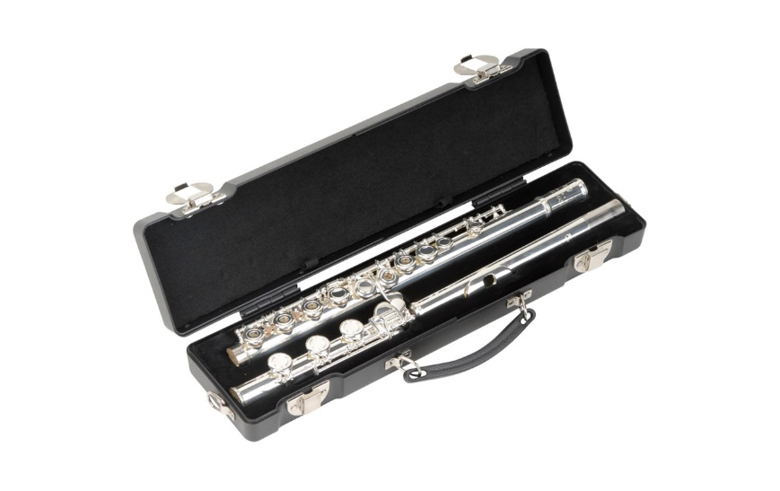
How do you play a flute?
Check out these videos to learn about the flute.
Opening the case and naming the parts.
https://www.youtube.com/watch?v=w9TQS1Ejedo
With thanks, this pic comes from: https://www.lunchboxaudio.com/skb-cases-b-foot-flute-case/
How to make a sound from the head joint.
https://www.youtube.com/watch?v=I7_ABj5Z2Jw

Slide 9
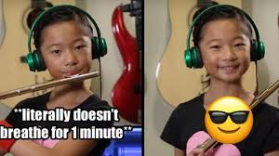
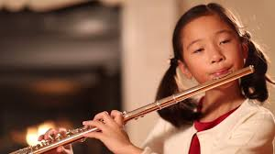
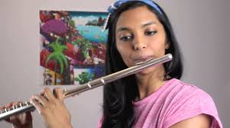
Can you identify the songs in these videos?
https://www.youtube.com/watch?v=pt480pC37DQ
https://www.youtube.com/watch?v=CmwXjj1B4UE
https://www.youtube.com/watch?v=QqIPJZ70khc
https://www.youtube.com/watch?v=J212cbf8esw

Slide 10
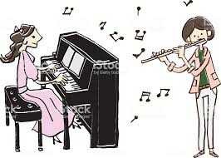
Listen to the songs in this video.
Which ones have you heard before?
https://www.youtube.com/watch?v=cZ6jv0C2I-4
With thanks, this pic is from: https://www.istockphoto.com/ca/vector/music-player-piano-flute-gm817311006-132230759

Slide 11
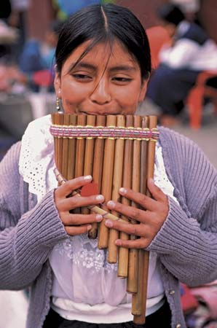
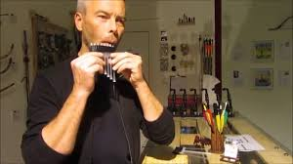
Make a Pan Flute
A pan flute is an instrument that has origins in ancient cultures. It is also a traditional instrument played by Indigenous people of Peru, a country in South America.
You can make a pan flute out of straws. Watch this video to see how to make one, and start playing! (You will need an adult to help you because a small flame is used to make this instrument.)
https://www.youtube.com/watch?v=sglOT1J80Ss
You will need: 8+ plastic drinking straws, scissors, plyers, tape and a lighter.
With thanks, this pic is from: https://feltmagnet.com/crafts/Make-Your-Own-Instrument---Pan-Pipes

Slide 12
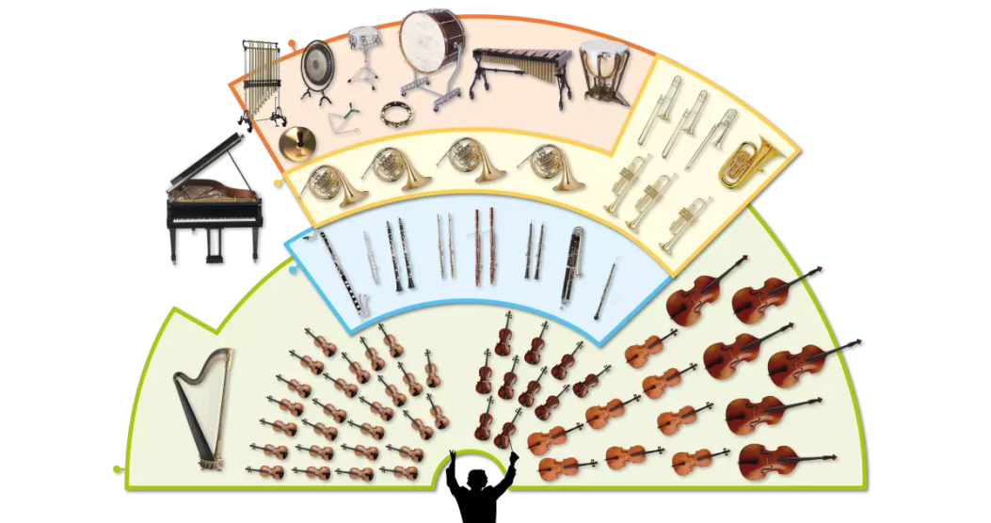
Flute
The flute can have a very high pitched sound, as well as low pitched sounds.
In an orchestra, a flute is a member of the woodwind family.
There are many kinds of flutes. A transverse flute is played in an orchestra.
A pan flute is a traditional instrument.

Slide 13
Listen to music. Dance to music. Play music.
Until next time …....

