Slide 1
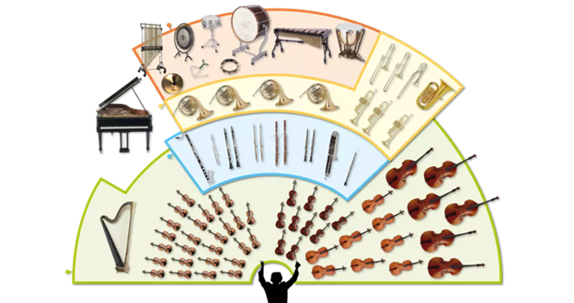
Music Education
Instruments of the Orchestra
Lesson 2 : Grades K-2

Slide 2
Review of Lesson 1 : Instruments of the Orchestra
How many instrument families are in an orchestra?
Look at this picture. Point to each section.
Do you remember the names of each instrument family? Hint:
Per......
Bra......
Woo....
Str......

Slide 3
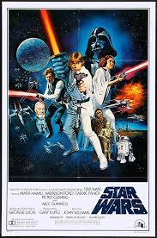
Weller and Jackson emailed Ms. T., wondering where the music from "Star Wars" was. (You can email Ms. T., too.)
Did Ms. T. forget to include this music?
Click here for the "Stars Wars" theme music:
https://www.youtube.com/watch?v=pU8D7qZ3RDw (31 min.)

Slide 4
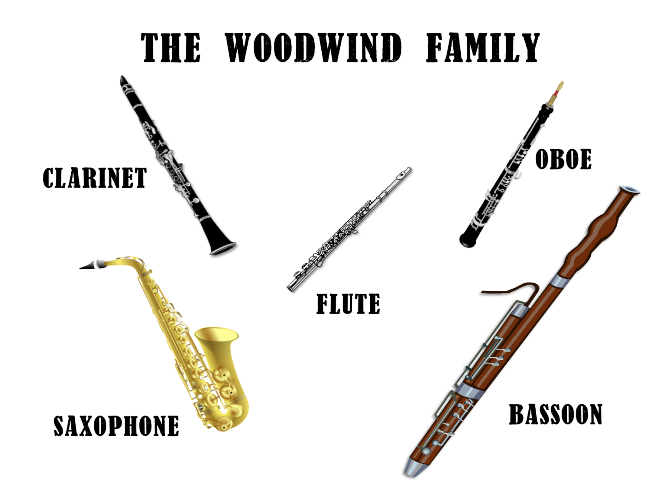
Instruments of the Orchestra
Lesson 2: Woodwind Family

Slide 5
Woodwind Family
This week you will learn how the woodwinds work and how they sound.

Slide 6
Look carefully at this picture.
Which woodwinds have you heard played before?
Which woodwinds have you not heard played before?

Slide 7
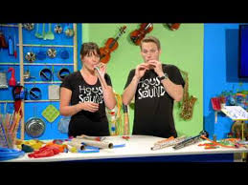
How does a woodwind instrument work?
Check out this video to find out:
https://www.youtube.com/watch?v=S6gBYYxvizs

Slide 8
Did you see how a flute sound is made?

Slide 9
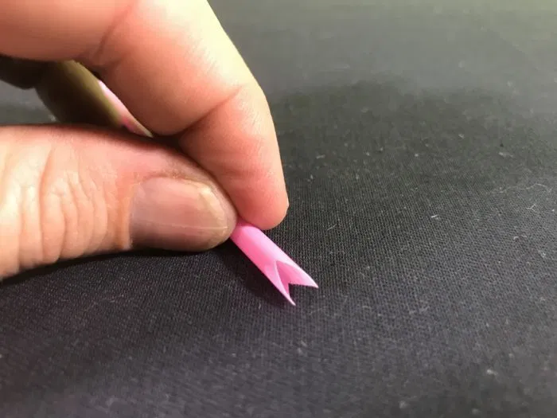
Did you make a straw flute?
Did you make different pitches,
high and low sounds,
with your straw flute?
Click here for steps and instructions:
https://www.fizzicseducation.com.au/150-science-experiments/light-sound-experiments/make-a-straw-flute/ (With thanks, these picture here came from this website.)

Slide 10
How do woodwind instruments sound?
Watch this video to learn how each woodwind instrument sounds.
https://www.youtube.com/watch?v=Cwfj9Xx2LF4

Slide 11
Which woodwind instrument is your favourite?
If you want to see musicians playing the woodwinds, click on this link: https://www.youtube.com/watch?v=7OjqeyOvC1c

Slide 12
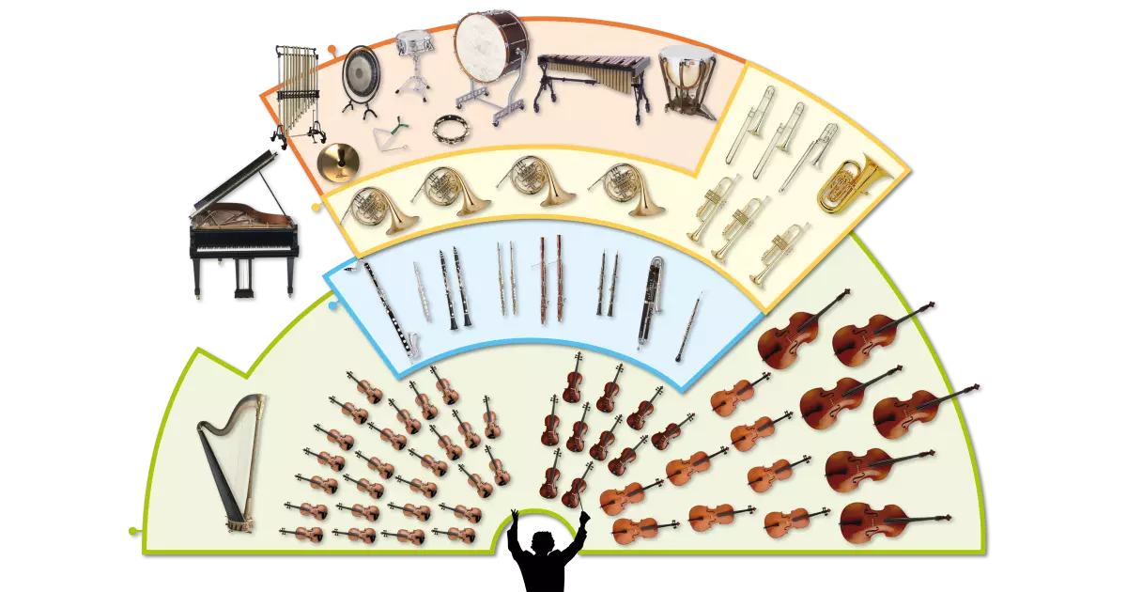
Woodwind Family
Point to the instruments in the woodwind section.
Can you name them?

Slide 13
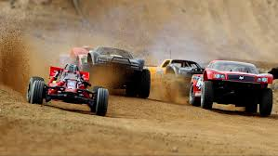
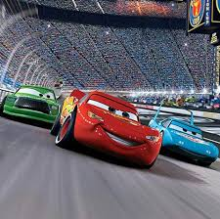
Woodwind Family
Here is the full composition called "Short Ride in a Fast Machine".
https://www.youtube.com/watch?v=5LoUm_r7It8
What woodwind instruments did you see and hear?
With thanks, this picture is from:
With thanks, this picture is from:
https://www.dronesglobe.com/rc-cars/under200usd/
https://www.goodhousekeeping.com/life/entertainment/g25436424/best-toddler-movies/

Slide 14
Listen to music. Dance to music. Play music.
Until next time …....

