Slide 1
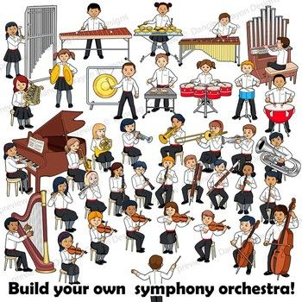
Music Education
Lesson 1: Grades 3-6
Instruments of the Orchestra
With appreciation, this picture is from this website: https://www.pinterest.ca/pin/44613852544747596/

Slide 2
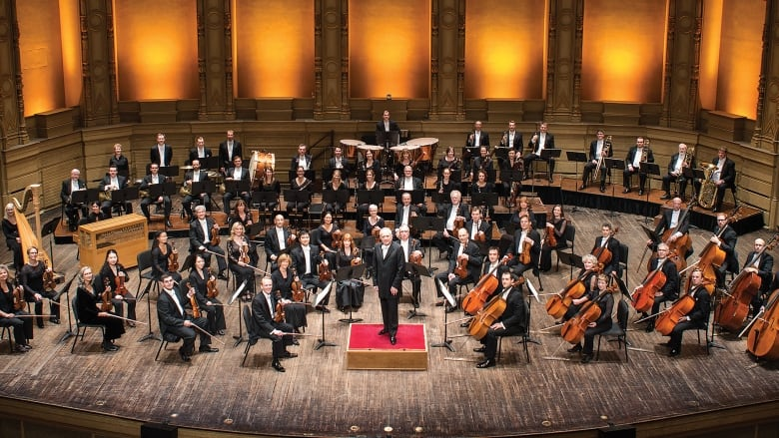
Instruments of the Orchestra
Learning Intention: I can learn what each instrument of the orchestra looks like and how each one sounds.
With appreciation, this picture is from this website: https://www.cbc.ca/news/canada/british-columbia/we-re-going-to-have-the-biggest-birthday-party-ever-vso-top-brass-reflect-on-100-year-history-1.4994237

Slide 3
An orchestra is a very big group of people
playing many kinds of instruments together, at one time.
Look carefully at this picture.
Which instruments are familiar to you and you have heard them played before? Can you name any of them?
Which instruments are you unfamiliar with, and you haven't heard them played before?

Slide 4
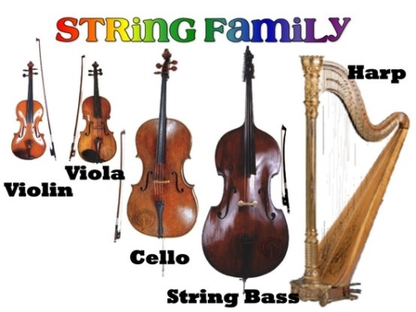
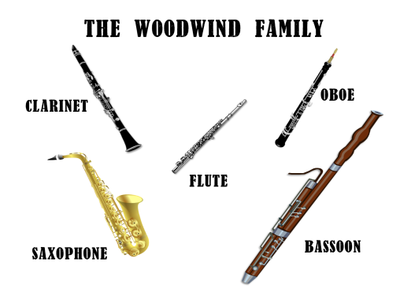
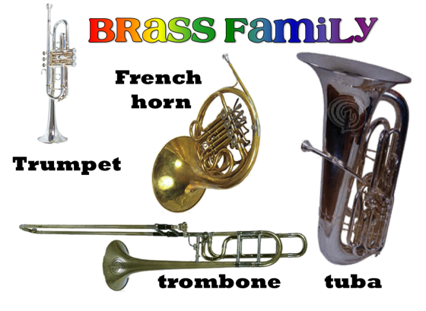
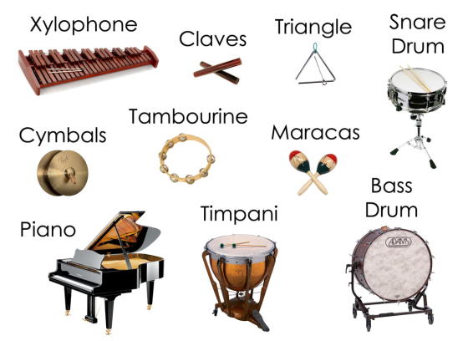
Here are a few links to videos where you will see orchestras playing.
Can you identify (name) the song (compostion) they are playing?
Video 1: Have you heard this composition before?
https://www.youtube.com/watch?v=BekjyAH7c2A
Video 2: Where have you heard this piece before? https://www.youtube.com/watch?v=1zaJ5LLIRn0
Video 3: What movie is this composition heard in? https://www.youtube.com/watch?v=__LU8E6dUsI
Video 4: What cartoon movie is this from? https://www.youtube.com/watch?v=Mvm2r1igPtM

Slide 5
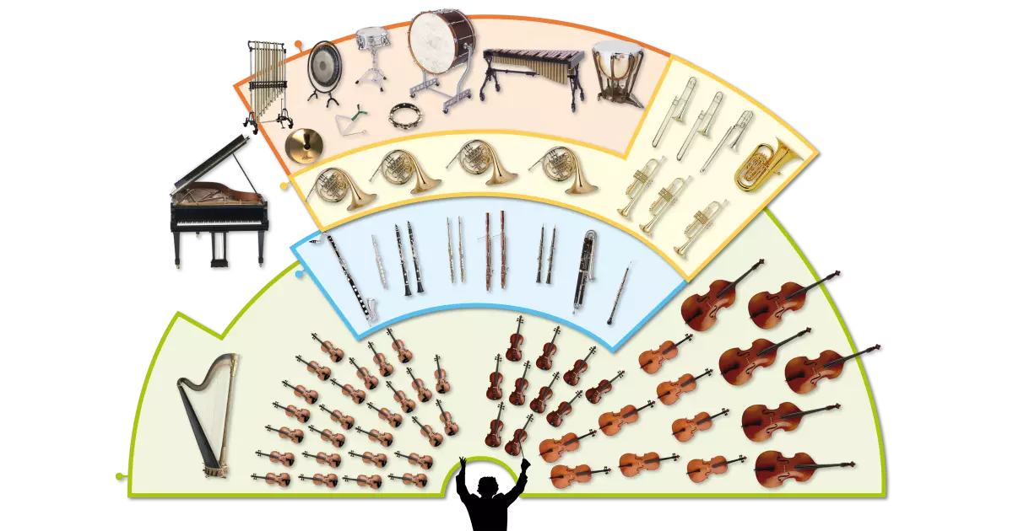
An orchestra has four main sections or instrument families.
Study the picture below.
What do you think are the four main instrument families in an orchestra?

Slide 6
Percussion Family
With appreciation, this picture comes from this website: https://www.teachingkidsmusic.com/percussion-family.html

Slide 7
String Family
With appreciation, this picture comes from this website: http://wadsworthmusic.weebly.com/string-family.html

Slide 8
Woodwind Family
With appreciation, this picture comes from this website: https://www.pinterest.ca/pin/158118636888236793/

Slide 9
Brass Family
With appreciation, this picture comes from this website: https://www.pinterest.ca/pin/543317142525050433/

Slide 10
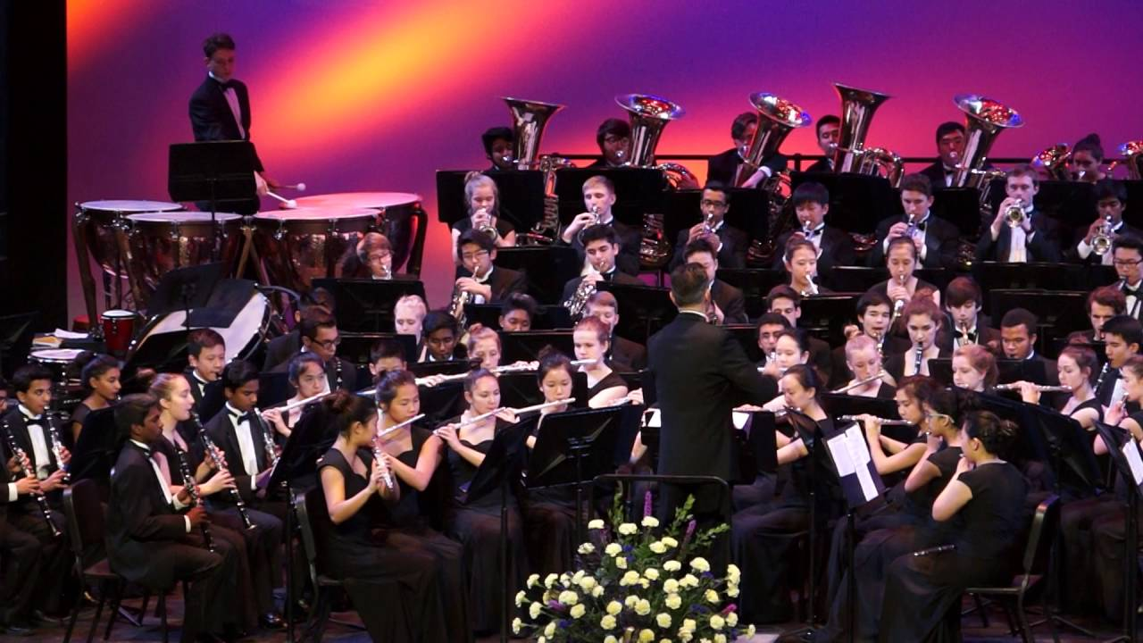
Over the coming weeks, as we continue to learn how to do school from home, we will have lessons that introduce you to instruments in the orchestra.
I wonder which instrument you might like to learn to play some day?
Maybe you'll join the band in Middle School?
Here's one last tune from a high school band.
Don’t Stop Me Now
by Queen
https://www.youtube.com/watch?v=FTOSe7Kjdyg
Do you know other songs by the group Queen?

