Slide 1
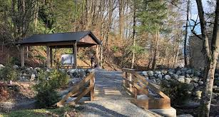
Outdoor Education
Lesson 6 : Grades Gr. 3-6
Indigenous Medicine Plants

Slide 2
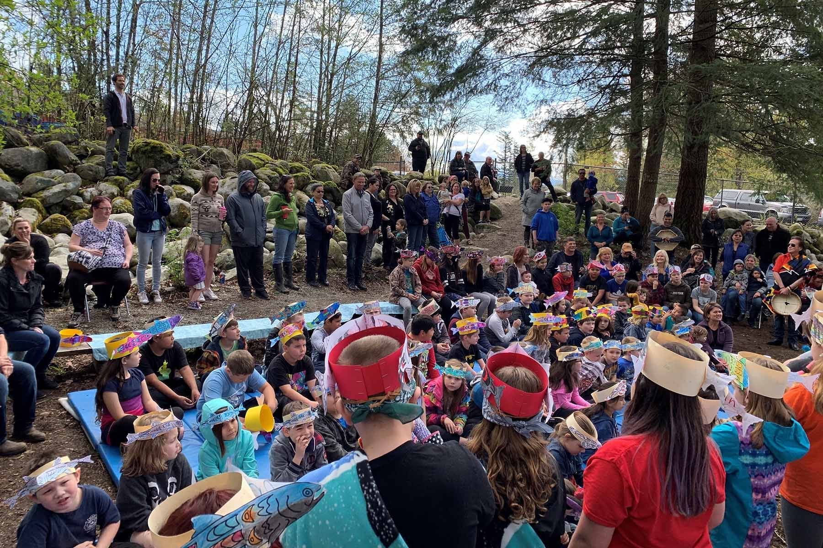
Indigenous Medicine Plants : Sage
Learning Intentions:
I understand the Indigenous traditional uses of sage.
I can recognize a sage plant.

Slide 3
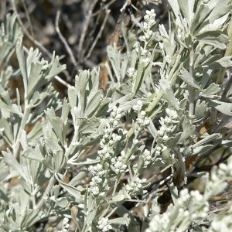
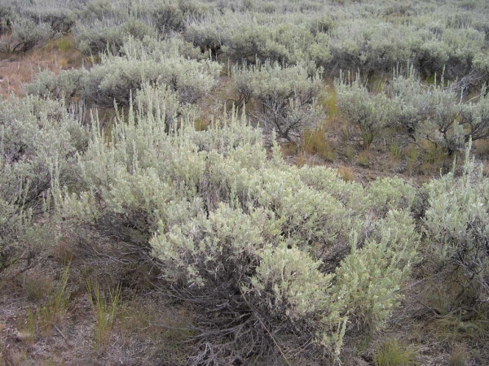
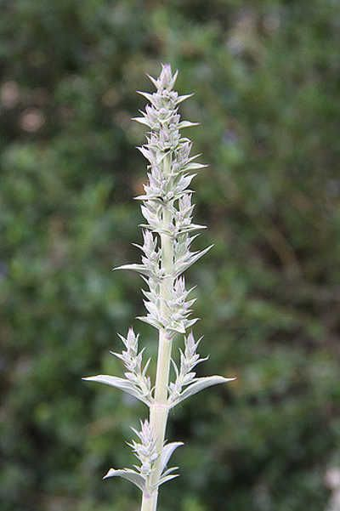
About Sage
There are many kinds of sage. White sage is found in desert areas. A natural sage that grows in BC is sagebrush. There is also blue sage, desert sage and more.
Sagebrush
Big Sagebrush
White Sagebrush
With thanks, this pic is from: http://splitrockenvironmental.ca/product/big-sage/
With thanks, this pic is from: http://linnet.geog.ubc.ca/Atlas/Atlas.aspx?sciname=Artemisia%20tridentata%20ssp.%20vaseyana&noTransfer=0
With thanks, this pic is from: https://www.epicgardening.com/white-sage-plant/

Slide 4
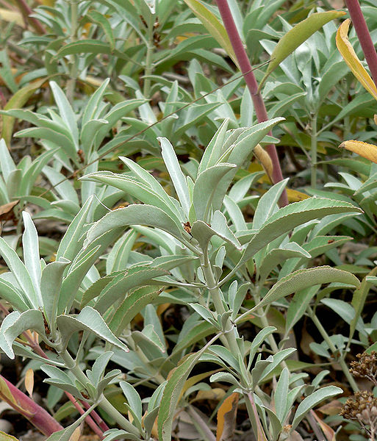
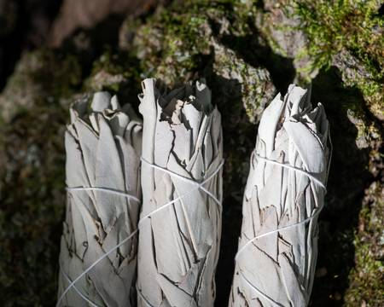
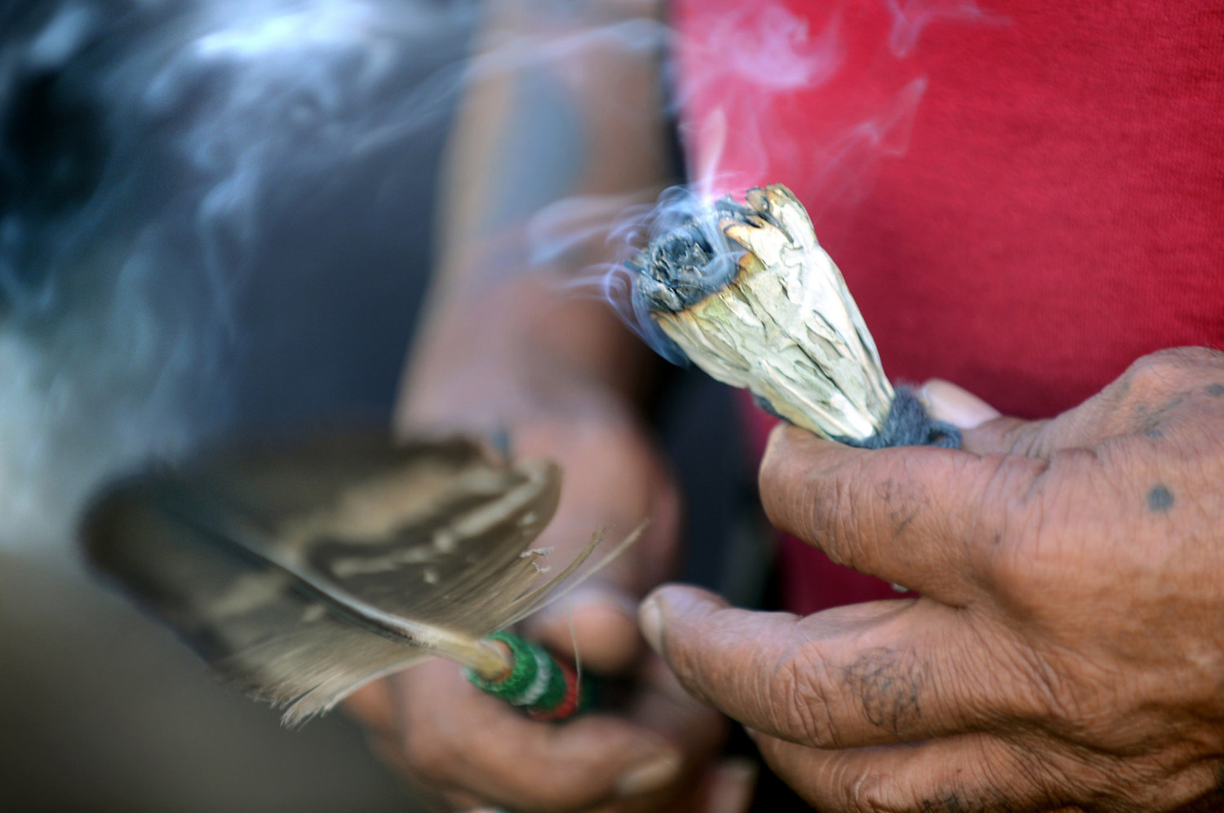
White Sage
White sage is what you often see bundled for smudging.
White Sage
White Sage Bundle
White Sage Smudge
With thanks, this pic is from: https://www.rootsimple.com/2011/09/salvia-means-salvation-white-sage/
With thanks, this pic is from: https://www.123rf.com/photo_112187057_wildcrafted-dried-white-sage-salvia-apiana-leafy-bundles-on-fibrous-tree-bark-in-forest-preserve-smu.html
With thanks, this pic is from: https://www.movingtowardspeace.com/mtpblog/the-ancient-art-of-burning-sage.html

Slide 5
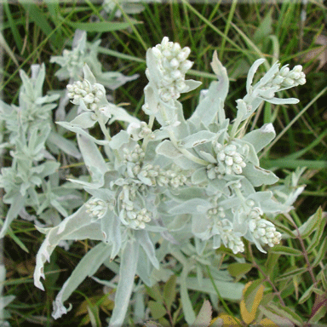
Prairie Sage
Prairie sage is found wild in the Canadian prairies; Alberta, Saskatchewan, Manitoba.
You have to be careful if you pick this plant. Leave the root in place, in the ground.
Why do you think this is the right practice for gathering or harvesting this plant?
With thanks, this pic is from: https://aiglebleu.net/en/2017/08/sage-sacred-wisdom-herb/

Slide 6
Big Sagebrush
Big sagebrush is found in the interior of British Columbia.
If this plant is being disturbed, it will “talk” to other plants. It will release a chemical that will cause nearby sage to increase production of repellent chemical compounds.
How do you think this “talking” is helpful to this plant?

Slide 7
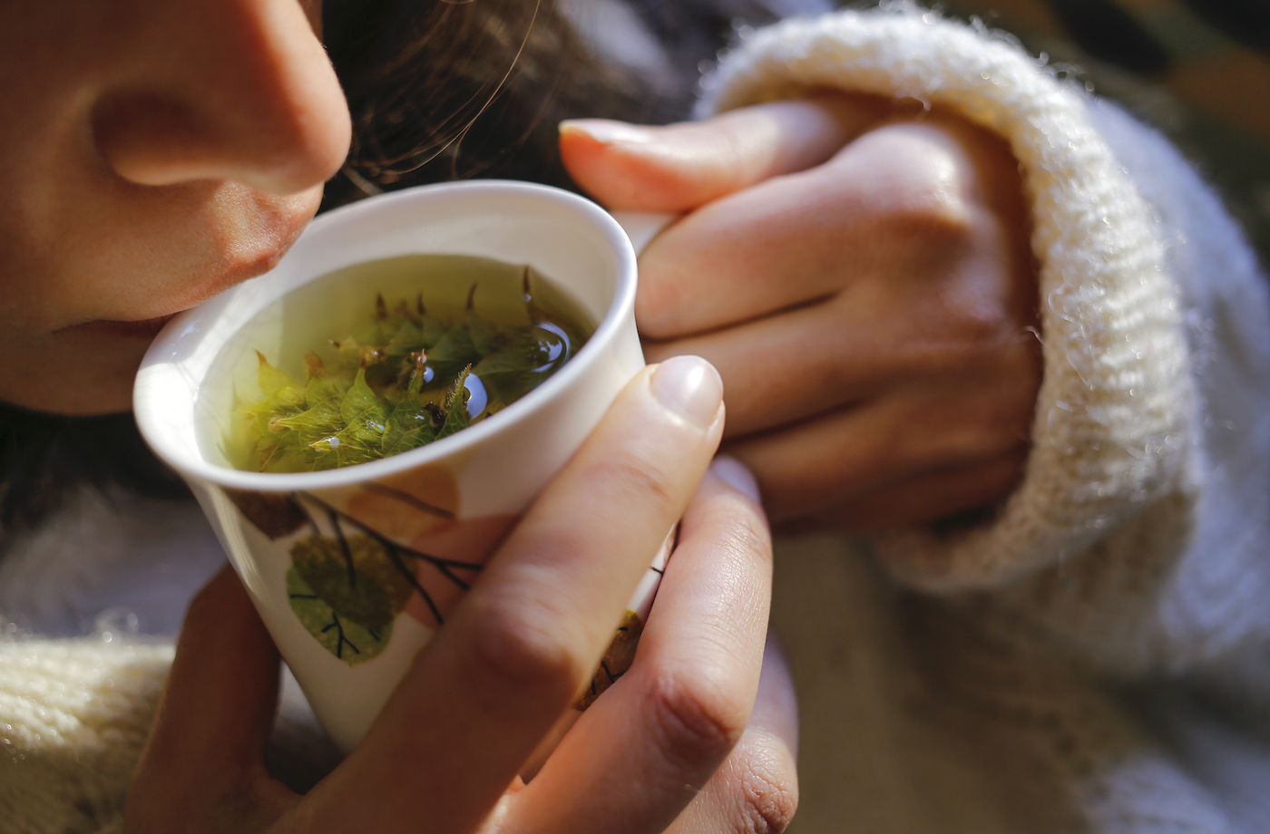
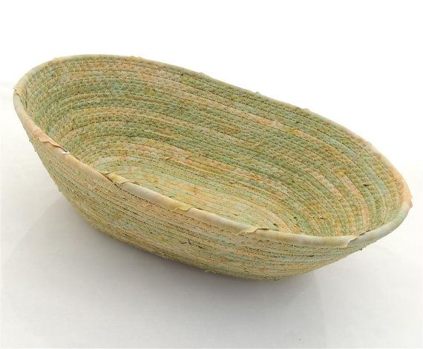
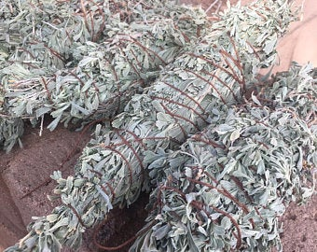
Indigenous cultures use sage for several purposes.
Here are some uses of Big Sagebrush as practiced by some Indigenous peoples in British Columbia.
Make a tea from dried leaves and branches to help with colds and headaches.
Bark woven into baskets, clothing and mats.
Use as a smudge to clear negative energy from a person or a space, and to get rid of harmful bacteria.
With thanks, this pic is from: https://www.wellandgood.com/good-advice/sage-benefits/
With thanks, this pic is from: https://in.pinterest.com/pin/411446115938009336/?amp_client_id=CLIENT_ID(_)&mweb_unauth_id={{default.session}}&from_amp_pin_page=true
With thanks, this pic is from: https://www.etsy.com/market/sagebrush_smudge

Slide 8
Why do Indigenous people smudge?
Watch this video of an Elder teaching her granddaughter about smudging.
https://www.youtube.com/watch?v=6fIMumk2cnA&list=PLeyJPHbRnGaZFu8_xxuXPlYG-j-9cogsx&index=45&t=0s

Slide 9
What did you learn about the Indigenous practice of smudging from the video?
What are the actions a person does to smudge?
Why do people smudge?
How to you keep positive with a good heart and mind?
With thanks, this pic is from: https://sd75curriculum.com/page/2/

Slide 10
Sage is a healing Indigenous medicine plant.
What is made to help heal colds and headaches?
Why do people smudge?
What useful items can be made from Big Sagebrush bark?
Where is Big Sagebrush found?
Sage
W
What medicine wheel direction is sage connected with?

Slide 11
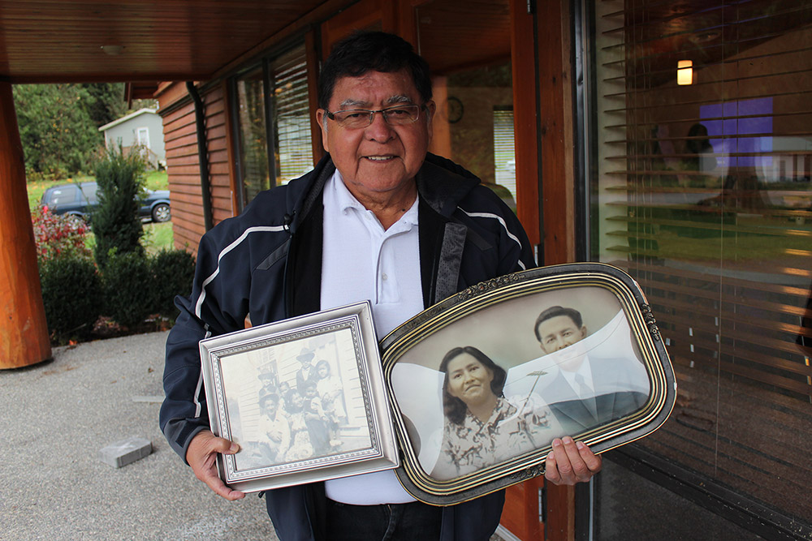
Now it’s your turn. Go for a walk with an Elder or relative
and ask them about sage and smudging.
Maybe they’ll tell you about their experiences.
Enjoy your walk.
With thanks, this pic is from:http://digitalsqewlets.ca/sqwelqwel/xwelmexw/sqewlets_families-familles-eng.php

