Slide 1
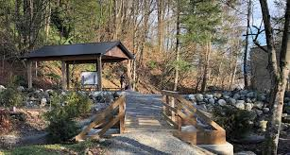
Outdoor Education
Lesson 3 : Grades Gr. K-2
Earth Day
Wednesday, April 22, 2020

Slide 2
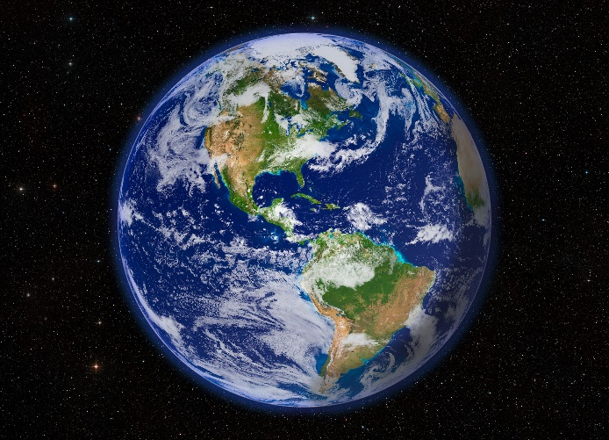
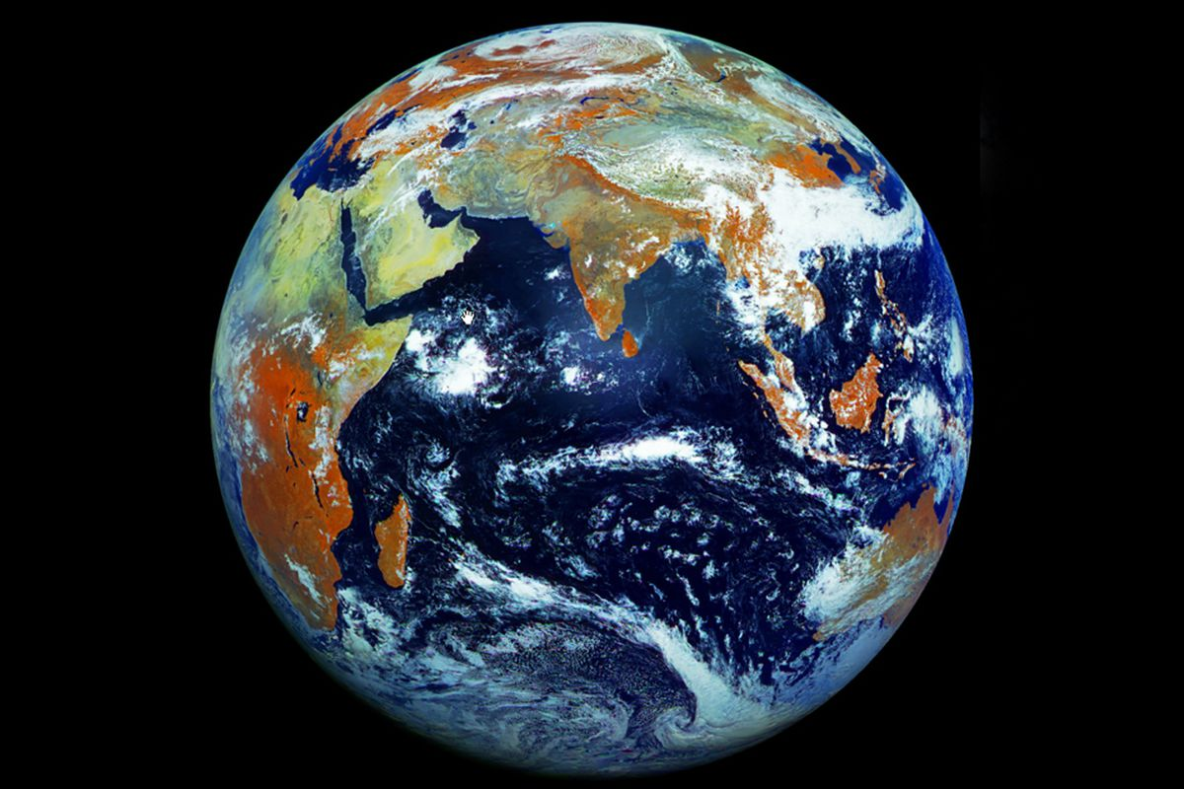
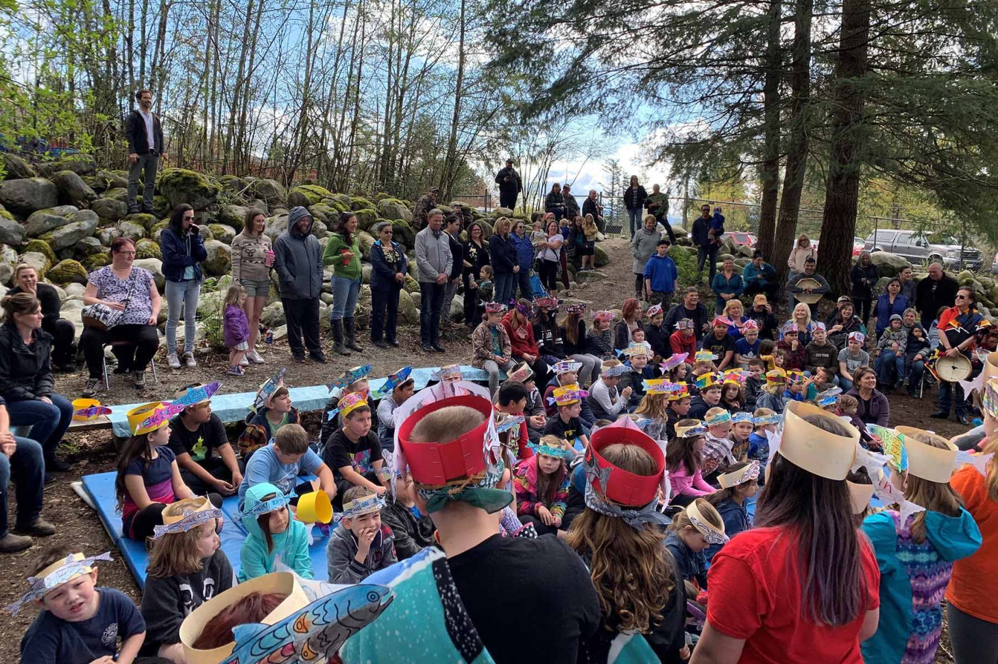
Earth Day
I can do things to help take care of my community and Mother Earth.
With thanks, this pic is from: https://www.pinterest.ca/pin/318840848619872362/
With thanks, this pic is from: https://www.theverge.com/2012/5/12/3016254/russian-satellite-earth-from-space-121-megapixels

Slide 3
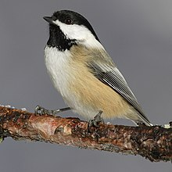
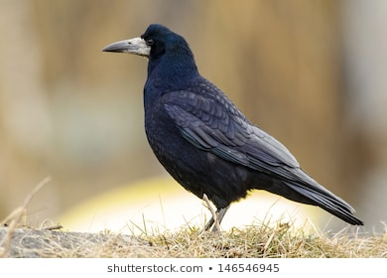
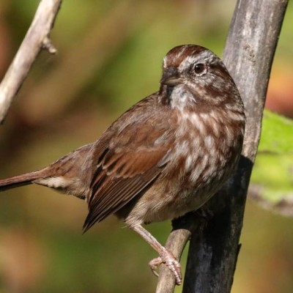
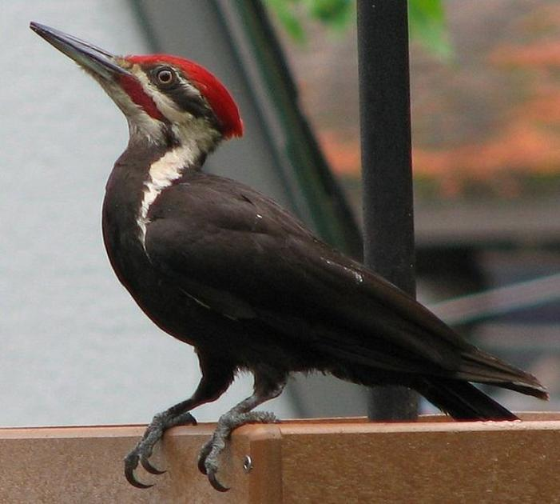
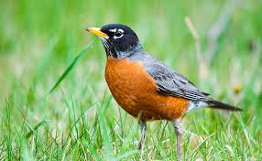
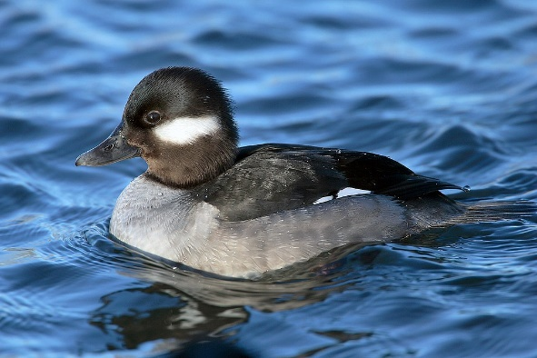
You’ve been outside, observing birds by listening and watching.
When you do this, you are learning about nature, your community and Mother Earth.
So, in this week’s lesson,
we will celebrate Earth Day
with some stories
and some thinking
about how you can help.

Slide 4
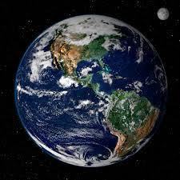
Look carefully at this picture of Earth.
What do you notice in this photo?
How do you think this photo of Earth could have been taken?

Slide 5
Mother Earth is a precious place.
Watch this story video.
The Elders are Watching
by David Bouchard
https://www.youtube.com/watch?v=9pQftknij8k

Slide 6
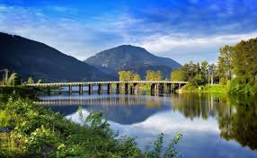
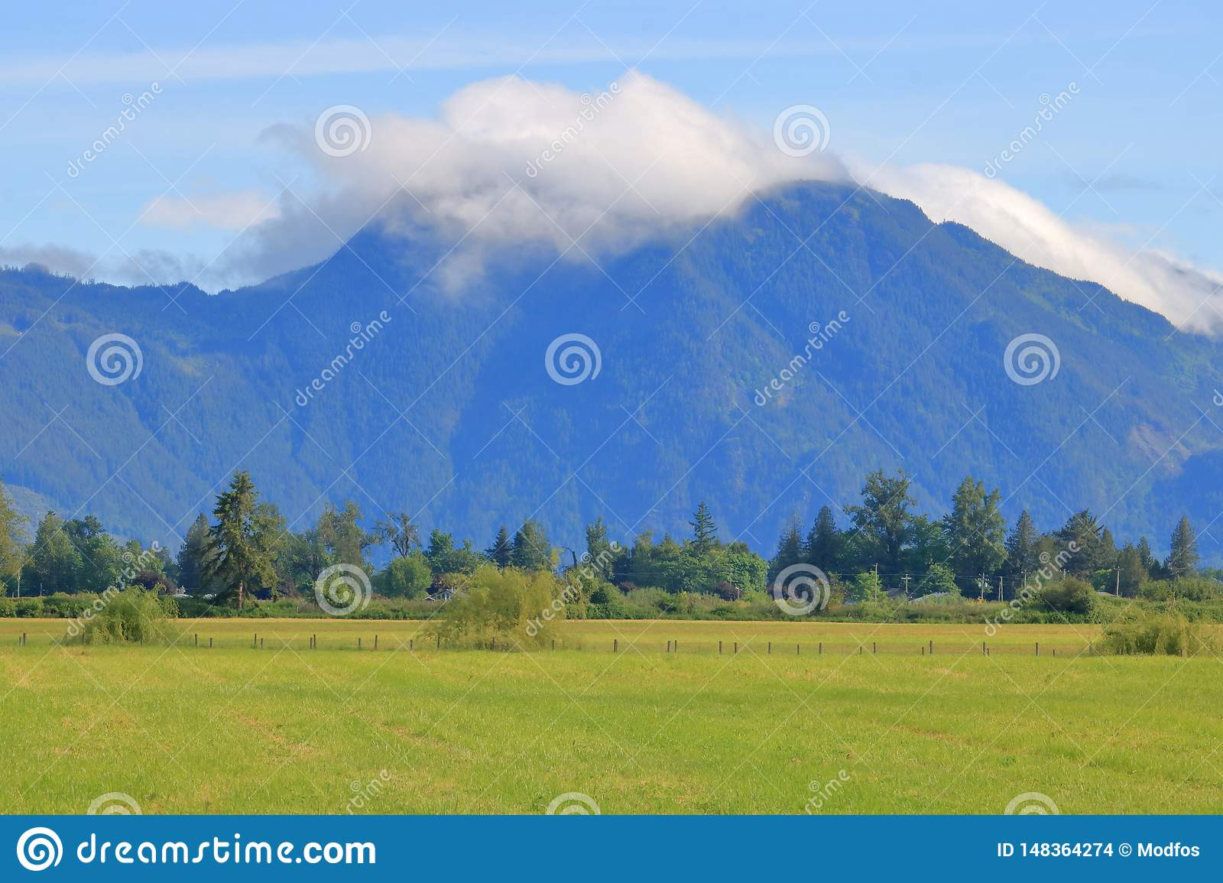
What would you like to say about the story, “The Elders Are Watching”? Did you learn something new?
How does the land around you, the land in your community, help you in your life everyday?
With thanks, this pic comes from: https://www.missioncityrecord.com/tourism/deroche-idyllic-farm-community-nestled-on-a-beautiful-waterway/
With thanks, this pic comes from: https://www.dreamstime.com/deroche-mountain-southern-bc-canada-wide-landscape-view-cumulus-clouds-top-high-above-small-british-columbia-image148364274

Slide 7
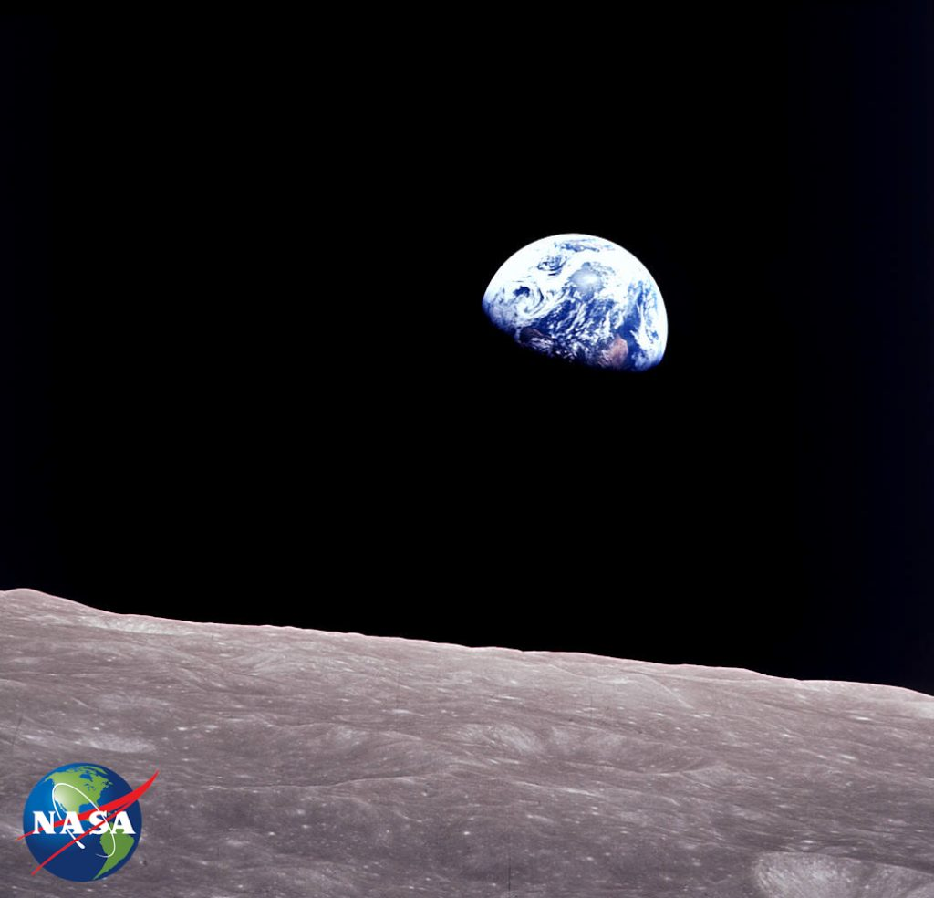
Earth Rise
What is the title of this photograph?
Do you see the earth in this picture?
Do you see the moon in this picture?
Where does this photo come from?
How do you think this photograph was taken?
With thanks, this pic from: https://blogs.nasa.gov/earthdaycountdown/2020/03/02/t-50-earthrise/

Slide 8
What Matters
by Alison Hughes and Holly Hatam
How can something I do really make a difference to my community? Read this book to find out!
https://www.tumblebooklibrary.com/Result.aspx?m=Title&key=What%20Matters

Slide 9
I can help my community be strong and healthy.
What do you think you can do to help your community?
Think, think, think …. ?
If you need help with ideas, play this video where Todd Parr reads his own book; The Earth Book.
https://www.youtube.com/watch?v=aXnWUS_K0XQ

Slide 10
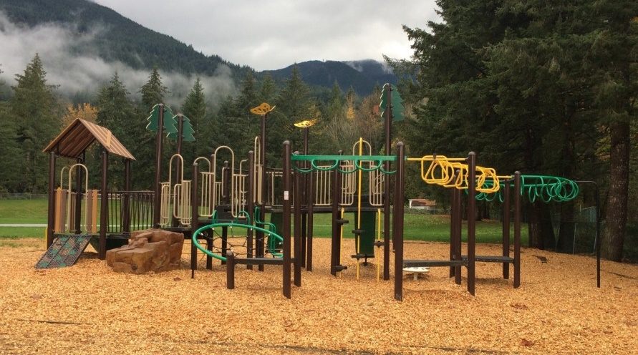
Now, it’s your turn.
Go outside and observe the world around your house.
As you look around, do you think of new ideas of how you can help your community?

Slide 11
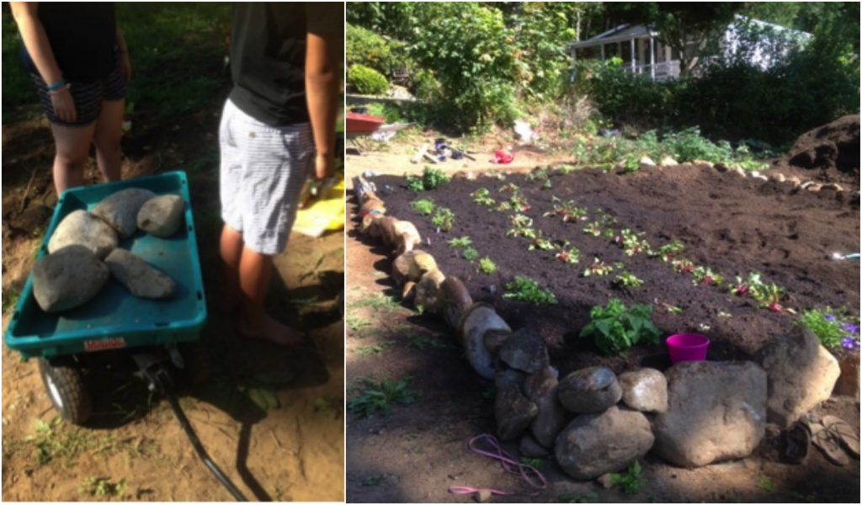
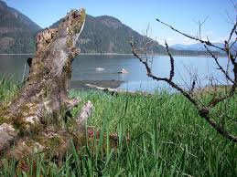
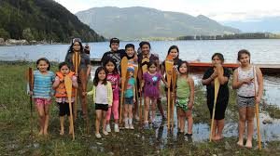
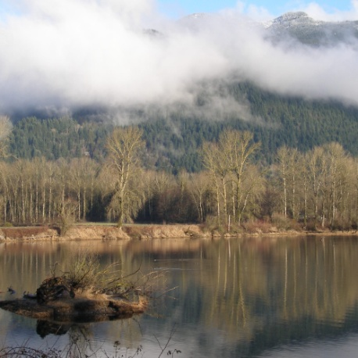
With thanks, this pic is from: https://www.facebook.com/pg/sqewlets/posts/
With thanks, this pic is from: http://leqamel.ca/recreation/community-garden/
Earth Day
What is something you will do to help take care of your community and Mother Earth?
With thanks, this pic is from: https://www.theverge.com/2012/5/12/3016254/russian-satellite-earth-from-space-121-megapixels
With thanks, this pic is from: http://leqamel.ca/discover-leqamel/gallery/
With thanks, this pic is from: http://leqamel.ca/discover-leqamel/gallery/
With thanks, this pic is from: http://leqamel.ca/recreation/community-garden/

Slide 12
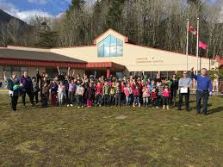
Let’s keep getting to know Mother Earth
by observing her
and learning
how we can help her stay strong
for all us Deroche Bears.

