Slide 1
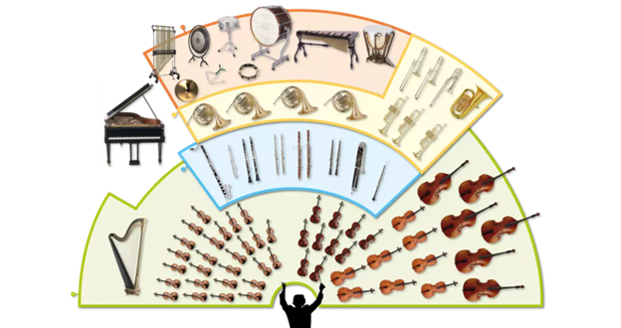
Music Education
Instruments of the Orchestra
Lesson 5 : Grades 3-6

Slide 2
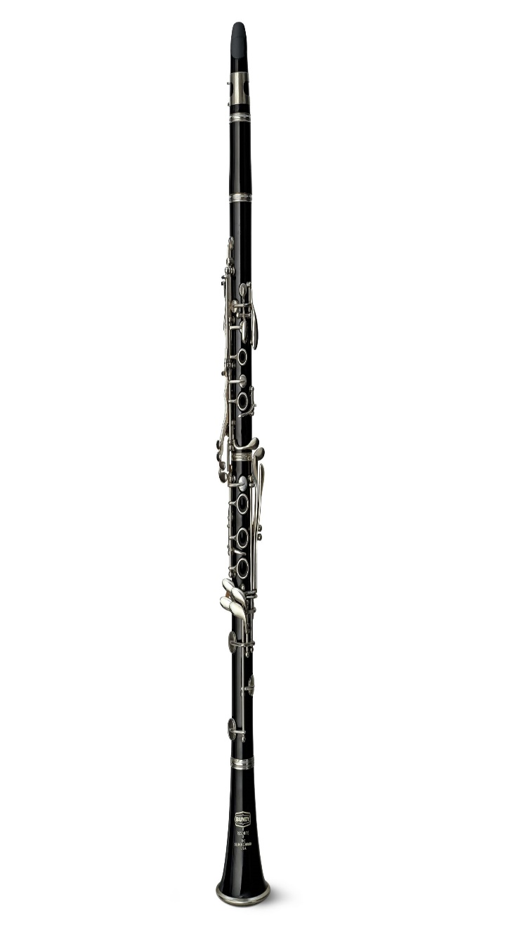
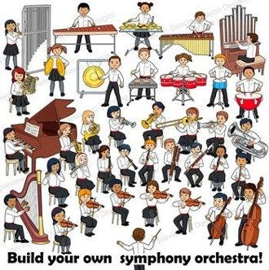
Review of Lesson 4 : Clarinet
M
B
UJ
LJ
B
A clarinet is a member of what orchestra instrument family?
It has five parts. What are they?
(Hint: M, B, UJ, LJ, B)
What are 3 styles of music where the clarinet is prominent?
(Hint: Cl, Ja, Kle)

Slide 3
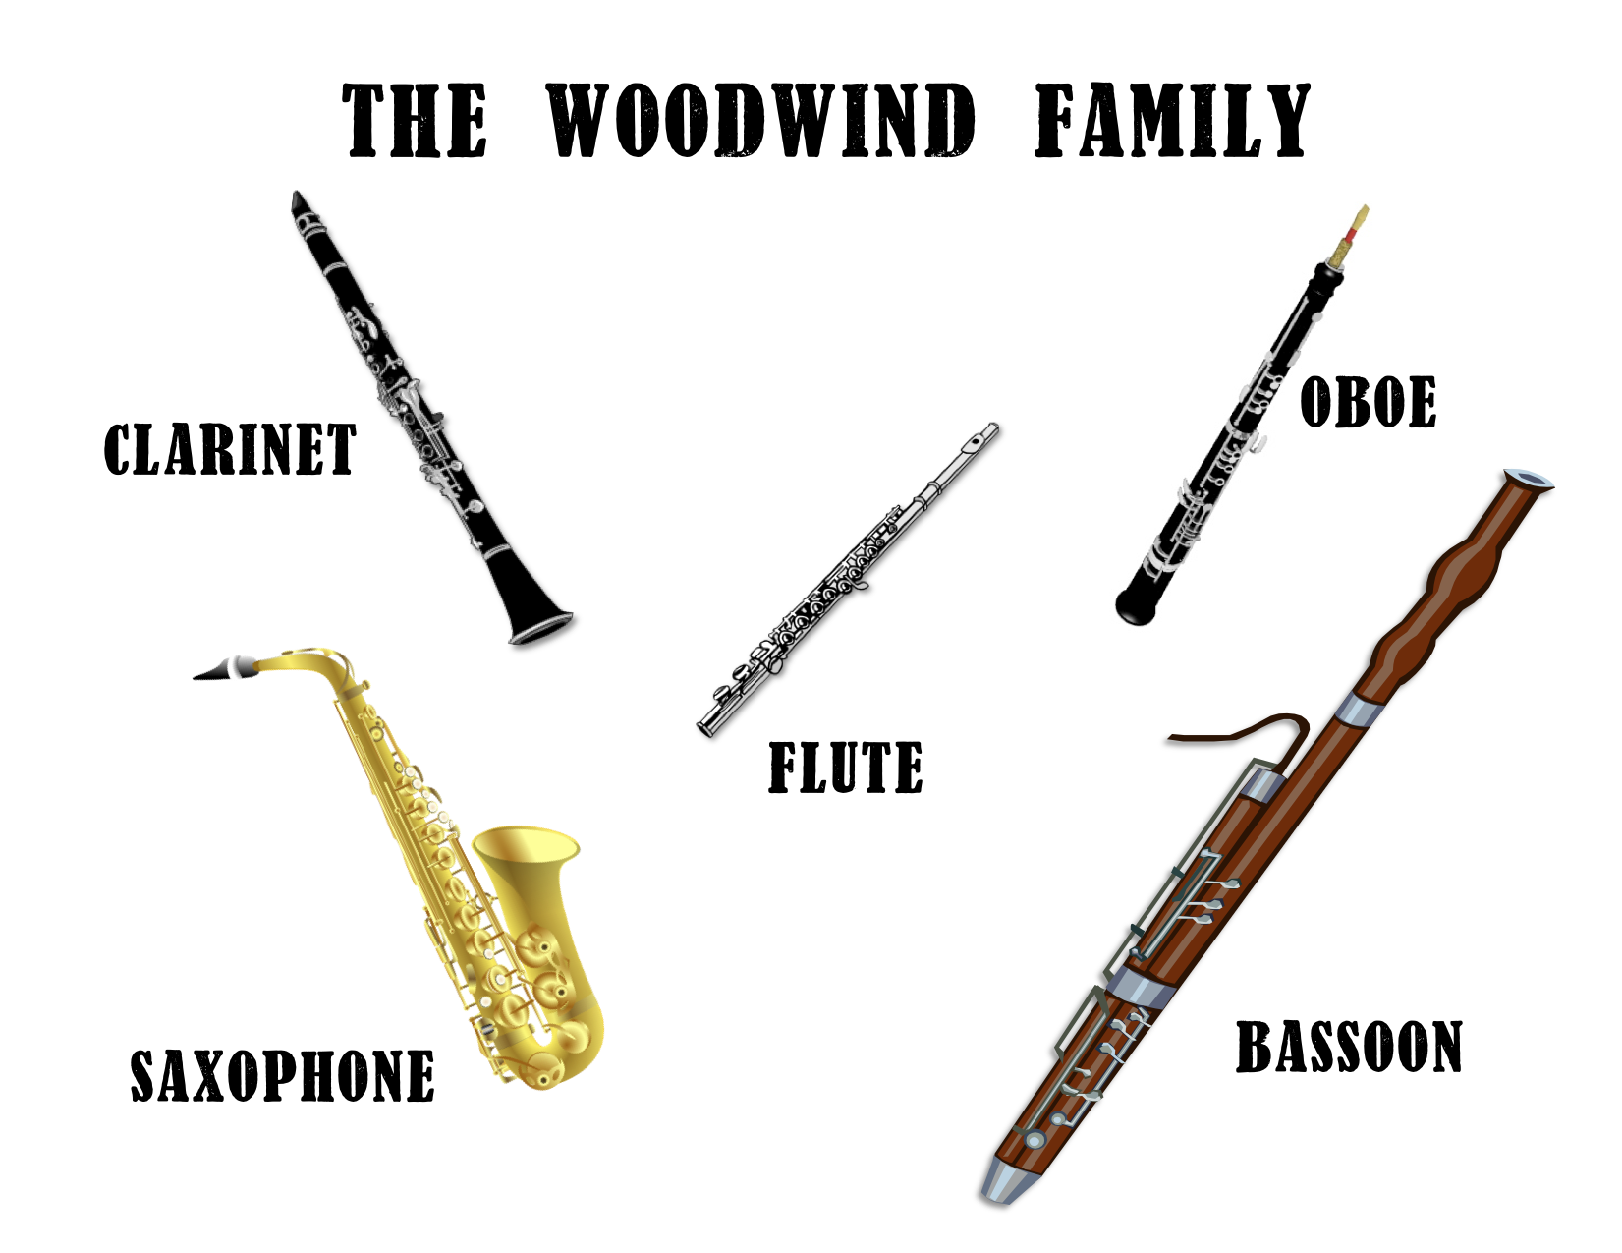
Instruments of the Orchestra
Lesson 5 : Saxophone

Slide 4
Saxophone
Learning Intentions:
I can identify the sound of a saxophone playing.
I know two kinds of music where saxophone is highlighted or prominent.
With thanks, this pic comes fromhttps://reverb.com/ca/p/yamaha-yts-62iii-professional-tenor-saxophone?gclid=Cj0KCQjwzN71BRCOARIsAF8pjfjDs4V6v23bOU8fmpRF45Vzeb3saDOAchJk_awr_SbS68eKkNcBZMUaAs3tEALw_wcB&hfid=23454452&merchant_id=101073192&utm_campaign=1695015338&utm_medium=cpc&utm_source=google

Slide 5
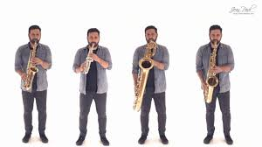
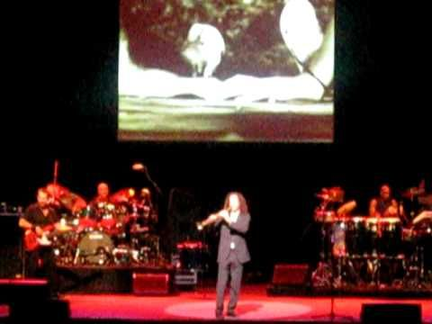
Here’s some videos of saxophone music.
Which compositions do you recognize?
https://www.youtube.com/watch?v=ya_HIM2SjUo
https://www.youtube.com/watch?v=V7g-TOxcnZs

Slide 6
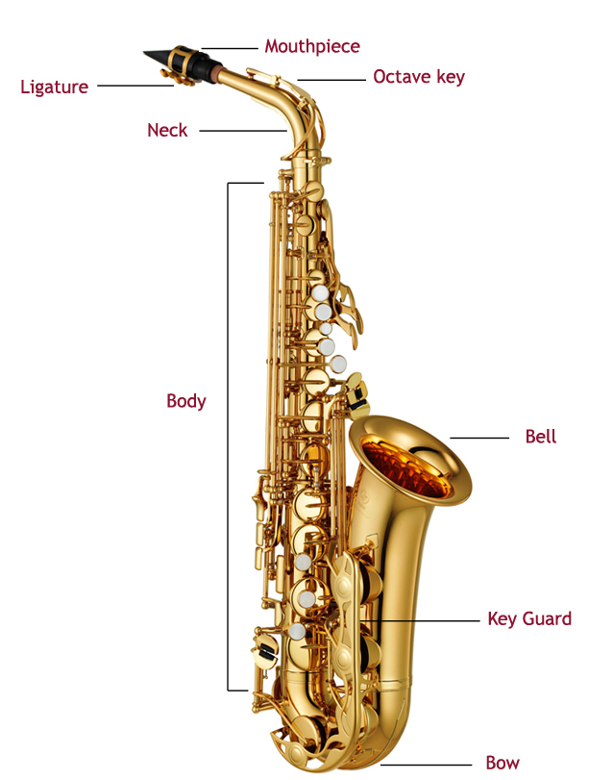
There are 3 main parts to the saxophone:
Mouthpiece Neck Body
Watch this short video (1m 30s): https://www.youtube.com/watch?v=EBVmeOWpFvc
Why does a Saxophone need a reed?
What do you think is the purpose of the “ligature”?
How do you think the “bell” supports the sound when a saxophone is played?
Hint to answers: Music lesson 4, Clarinet
With thanks, this pic comes from: https://www.normans.co.uk/blog/2013/05/caring-for-your-alto-saxophone/

Slide 7
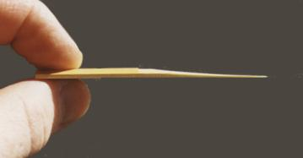
What is a reed for the mouthpiece of a saxophone?
The reed is a thin piece of wood made to act as a fipple for creating the sound of some instruments, including the saxophone.
The reed is attached to the mouthpiece with the ligature.
With thanks, this pic comes from: http://www.the-clarinets.net/english/clarinet-reed.html/
With thanks, this pic comes from: https://www.learnsaxophoneonline.com/reed-alignment.html

Slide 8
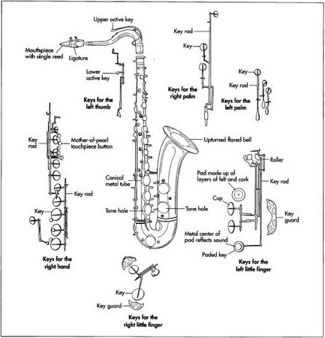
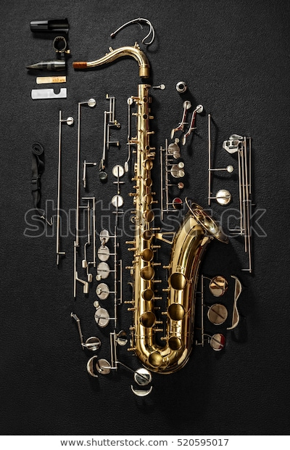
Here’s a diagram of more detailed parts of a Saxophone.
With thanks, this pic comes from: https://rajivssaxophonia.weebly.com/instrument-construction.html
With thanks, this pic comes from: https://www.shutterstock.com/image-photo/tenor-saxophone-exploded-view-drawing-isolated-520595017

Slide 9
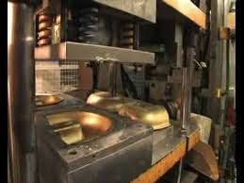
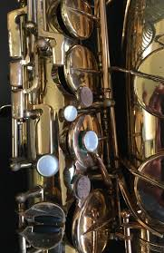
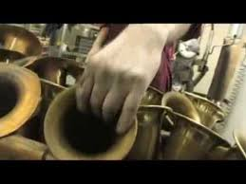
How a Saxophone is Made
There is quite a process to making a saxophone. Below is a video that shows you the factory process of making a saxophone. If you are interested in building things, you may find this process fascinating.
How Saxophones Are Made
https://www.youtube.com/watch?v=cH1YzGqt1HI

Slide 10
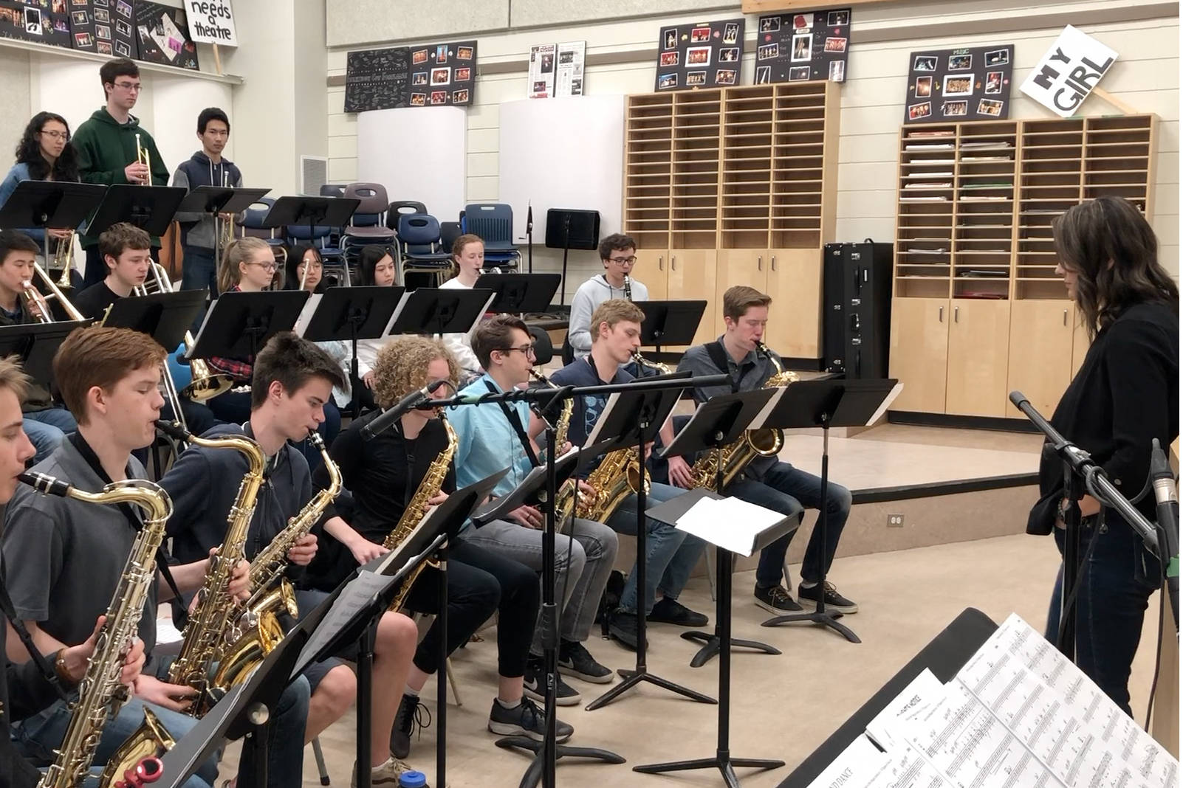
The Saxophone is actually rarely played in an orchestra.
It does feature prominently in two types of music:
Band Music Jazz Music
With thanks, these pics comes from: https://www.stgeorges.bc.ca/senior-school/arts/music/concert-band
With thanks, these pics comes from: https://www.revelstokereview.com/news/kelownas-okm-jazz-band-ready-for-bc-interior-jazz-festival/

Slide 11
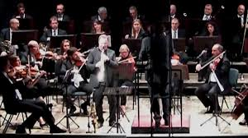
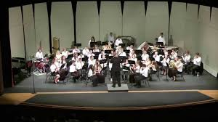
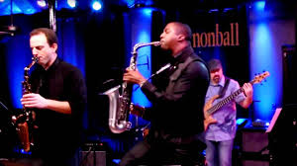
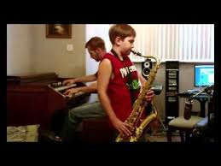
Here is Saxophone played in three musical genre’s.
Genre: Classical Music
https://www.youtube.com/watch?v=zTLKs1giz9I
Genre: Concert Band
https://www.youtube.com/watch?v=DLb8Pk9OeNk
Genre: Jazz Music
https://www.youtube.com/watch?v=bVl-ZFaY8To
Genre: What is your guess?
Do you recognize this piece?
https://www.youtube.com/watch?v=u4FNjQJpJR4

Slide 12
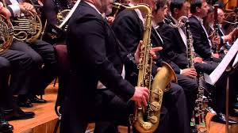
Why is There No Saxophone in the Orchestra?
It is a rare occasion when an orchestra includes saxophones.
If you are interested in the history of why that is, check out this video.
https://www.youtube.com/watch?v=BsfPS7pXg1E

Slide 13
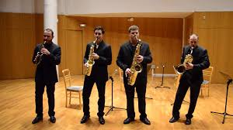
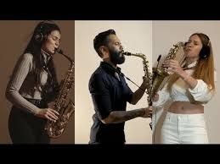
A final short concert for you to enjoy.
Take Five (4:37 min)
https://www.youtube.com/watch?v=pGaUlferotY
Note: “Take Five” is one of the most famous Jazz compositions in the history of jazz music.
Imagine (3:39 min)
https://www.youtube.com/watch?v=KRKrN7JDGF4
Note: This video was created in March, 2020. “Imagine” is a song about everyone in the world understanding each other and getting along.

Slide 14
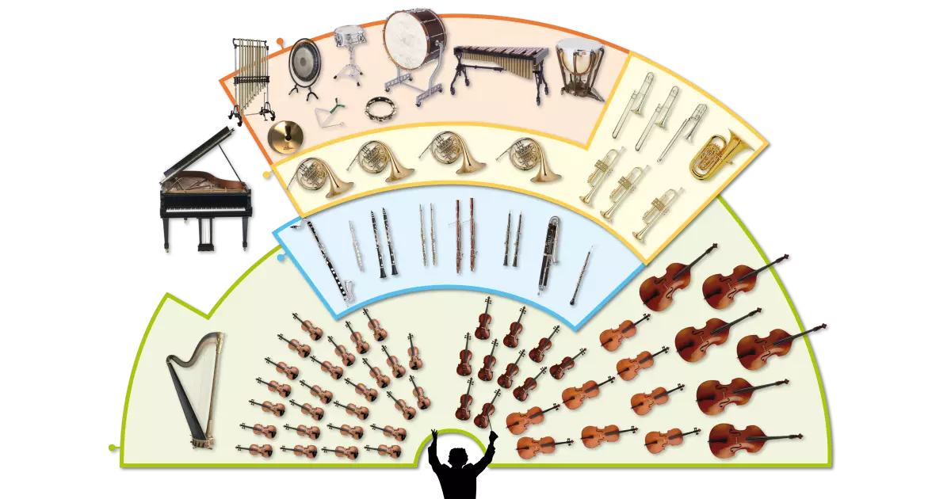
Saxoxphone
The saxophone has a versatile and varied sound.
A saxophone is rarely included within an orchestra.
2 genres of music where saxophone can be prominent are jazz and concert band.

Slide 15
Listen to music. Dance to music. Play music.
Until next time …....

