Slide 1
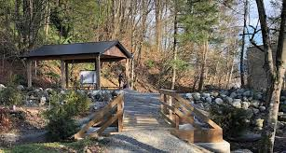
Outdoor Education
Lesson 4 : Grades Gr. K-2
Sto:lo Medicine Plants

Slide 2
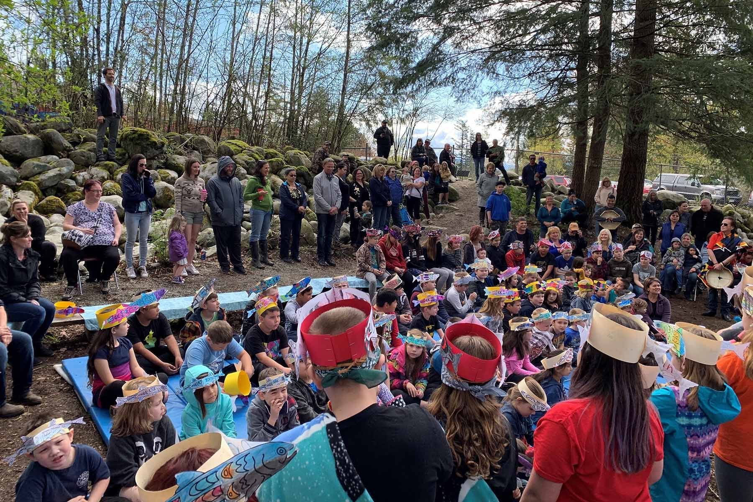
Sto:lo Medicine Plants
I can identify four Sto:lo Medicine plants.

Slide 3
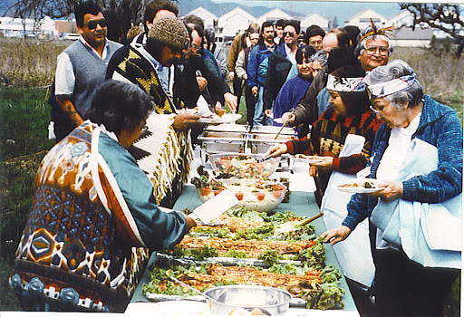
We need plants for food.
Food is like medicine
to our bodies because
food keeps our bodies healthy.
With thanks, this pic is from: http://digitalsqewlets.ca/sqwelqwel/xwelmexw/culture-eng.php/

Slide 4
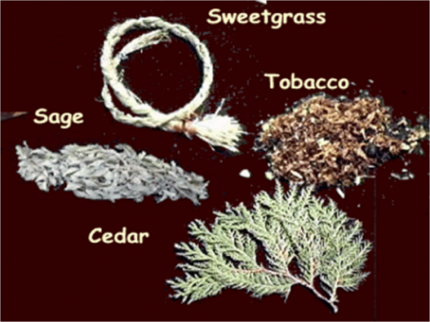
Sto:lo also have 4 sacred medicine plants to help keep people well.
Tobacco
Sage
Sweetgrass
Cedar
With thanks, this pic is from: http://www.northernc.on.ca/indigenous/four-sacred-medicines/

Slide 5
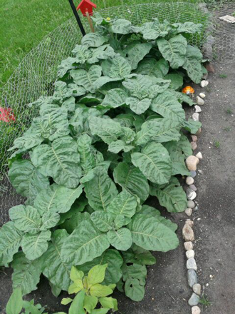
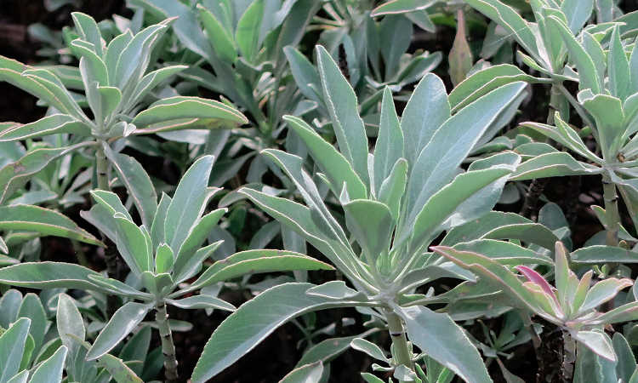
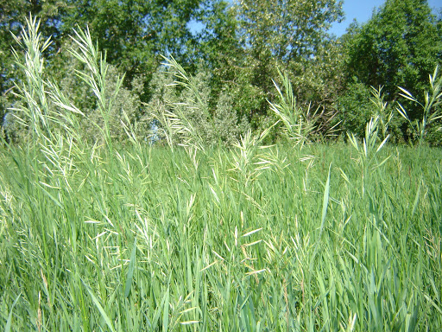
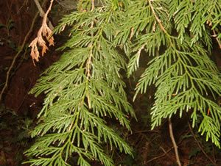
Here’s what each of these sacred plants look like.
Tobacco Sage Sweetgrass Red Cedar
With thanks, this pic is from: https://www.epicgardening.com/white-sage-plant/
With thanks, this pic is from: https://www.gardenguides.com/12545858-how-to-identify-sweet-grass.html
With thanks, this pic is from: https://sierraclub.bc.ca/western-red-cedar/
With thanks, this pic is from: https://www.scientificamerican.com/article/the-fight-to-keep-tobacco-sacred/

Slide 6
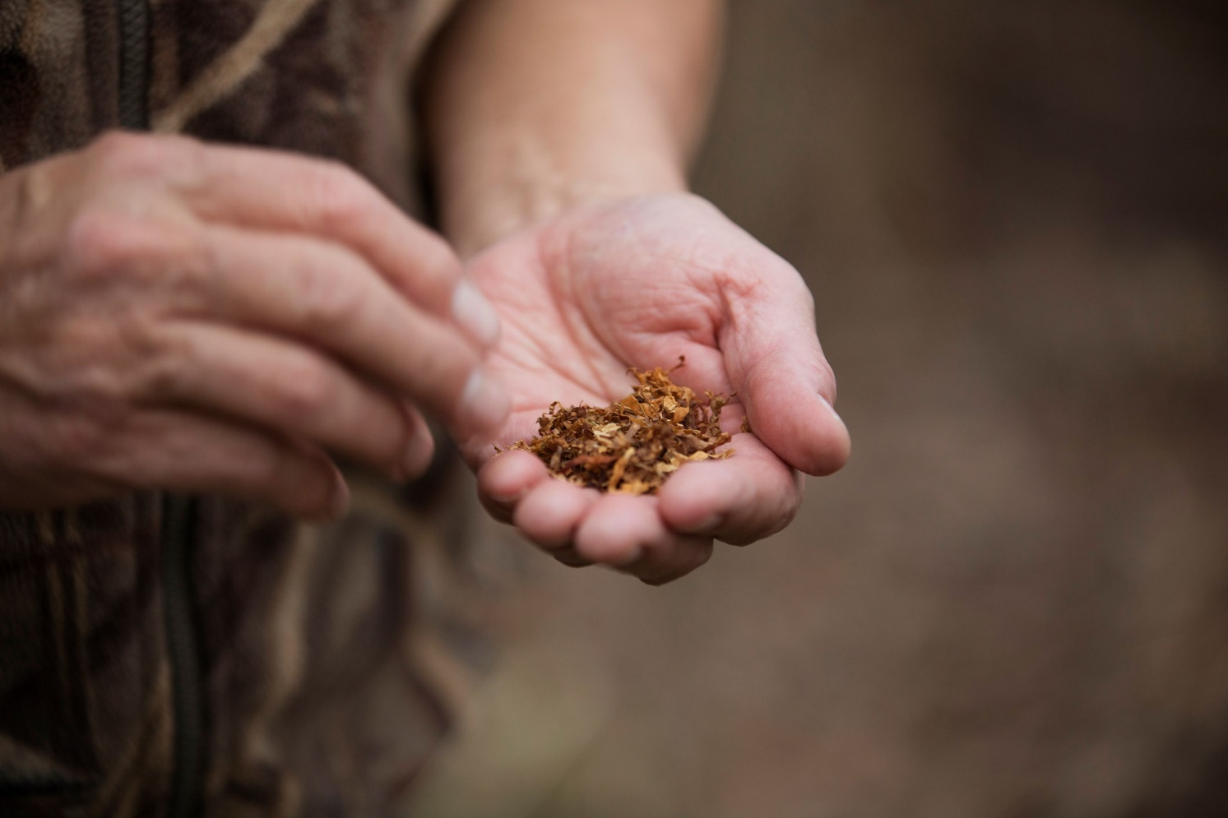
Each of these sacred plants has a special purpose.
Tobacco is for giving thanks.
This is sacred tobacco, not tobacco found in cigarettes.
What do you think is the difference between sacred tobacco and cigarette tobacco?
With thanks, this pic comes from: https://www.pinterest.ca/pin/738308932639704517/

Slide 7
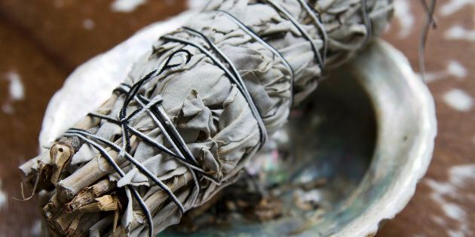
Sage is for smudging.
What is smudging?
Why do you think people smudge?
With thanks, this pic comes from: https://www.huffingtonpost.ca/2018/11/29/indigenous-people-sage-and-smudge-kits_a_23602571/

Slide 8
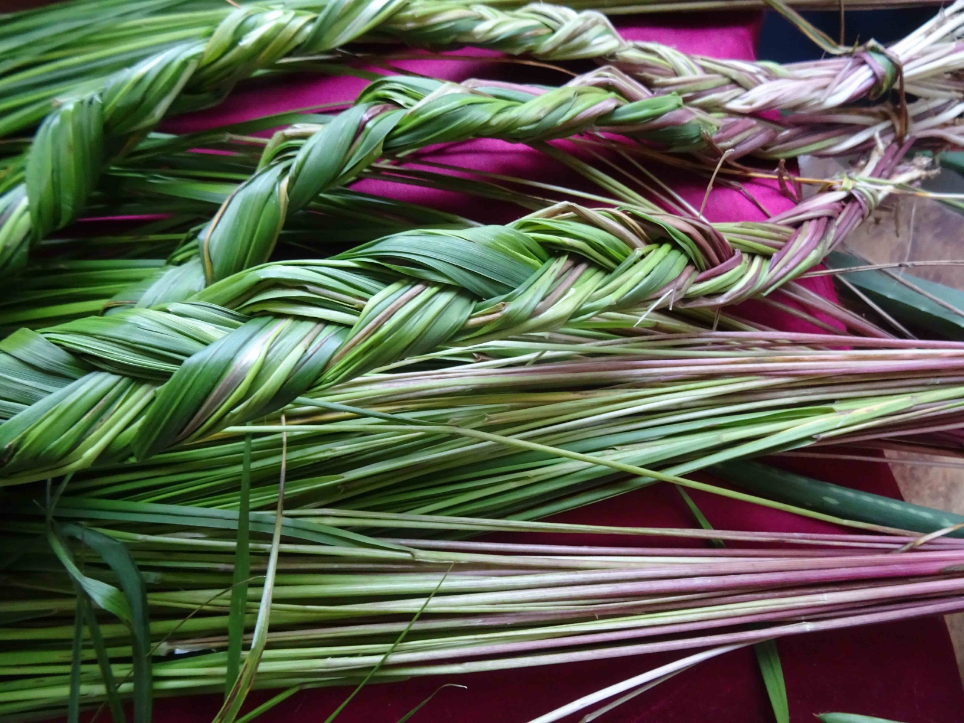
Sweet grass is for smudging
and for making things
like baskets.
What else do you think can be made from sweet grass?
With thanks, this pic comes from: https://www.thecanadianencyclopedia.ca/en/article/sweetgrass

Slide 9
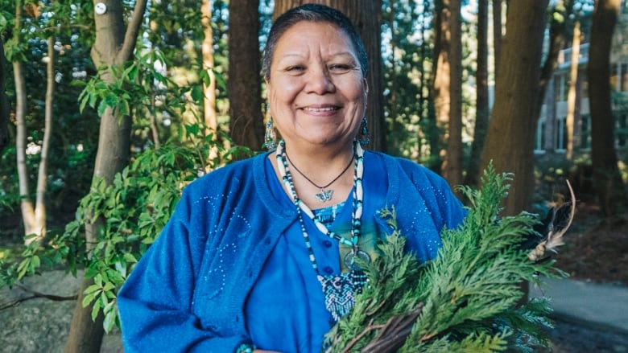
Red Cedar is used
to drive away negative energy
and to make things
like cedar baskets.
What else do you think could be made from red cedar?
Why do you think people want to get rid of negative energy?
With thanks, this pic comes from: https://www.cbc.ca/news/indigenous/indigenous-language-health-care-workers-1.4660009

Slide 10
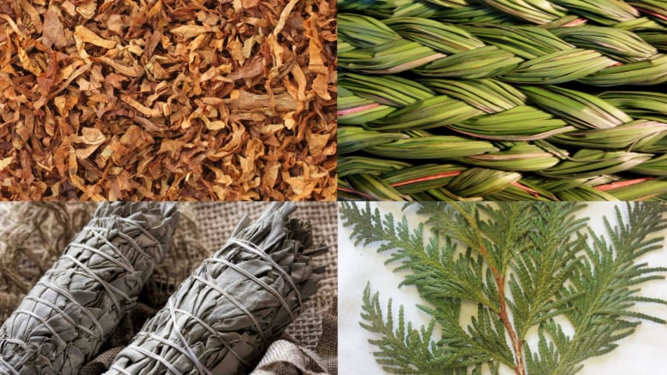
Can you point to and name each of the four sacred medicine plants in this picture?
With thanks, this pic is from: https://www.cbc.ca/radio/unreserved/when-indigenous-healing-practices-meet-modern-medicine-1.3530072

Slide 11
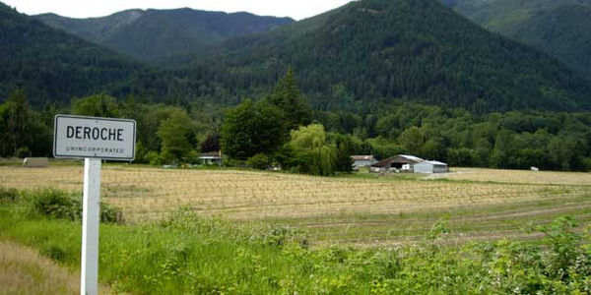
Now, it’s your turn.
Go for a walk and see if you can find any of these four sacred plants in your area.

Slide 12
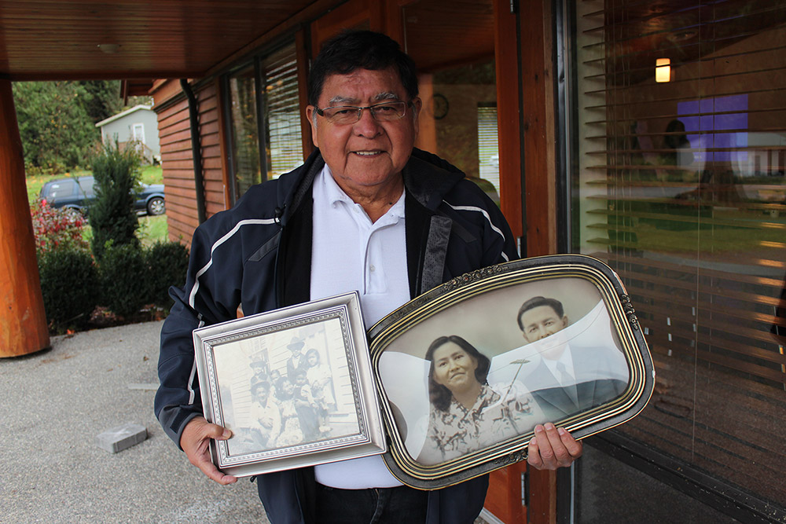
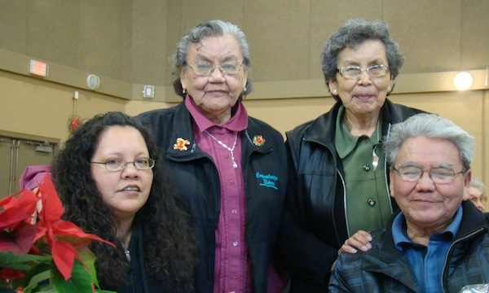
If you have an Elder nearby,
maybe you can ask them to go for a walk with you.
Maybe they’ll tell you about the four sacred medicine plants.
Enjoy your walk.
With thanks, this pic is from:http://digitalsqewlets.ca/sqwelqwel/xwelmexw/sqewlets_families-familles-eng.php
With thanks, this pic is from: http://leqamel.ca/recreation/elders/

