Slide 1
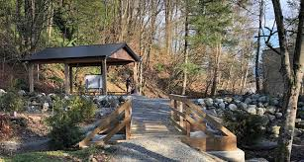
Outdoor Education
Lesson 1 : Grades K-2
Birds of a Feather

Slide 2
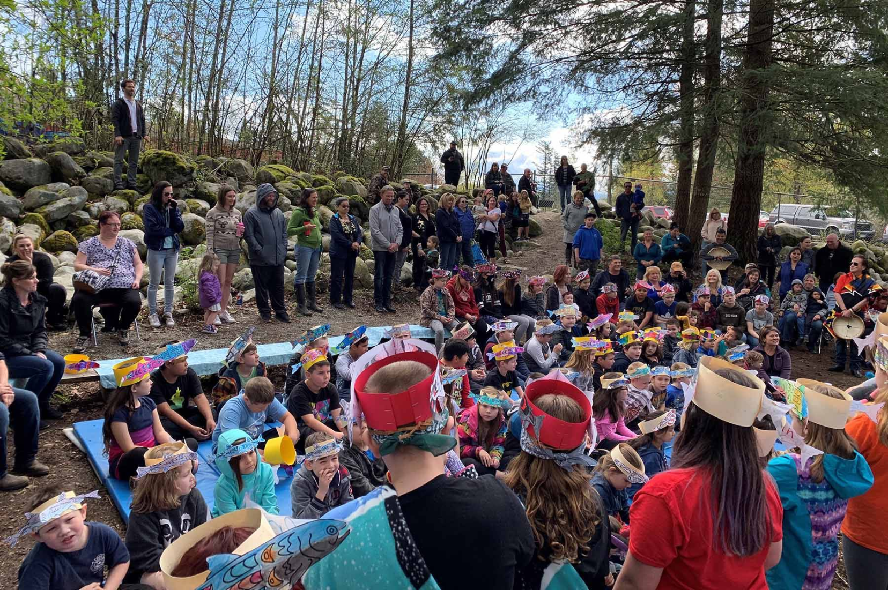
Birds of a Feather
I can learn about birds by observing them.

Slide 3
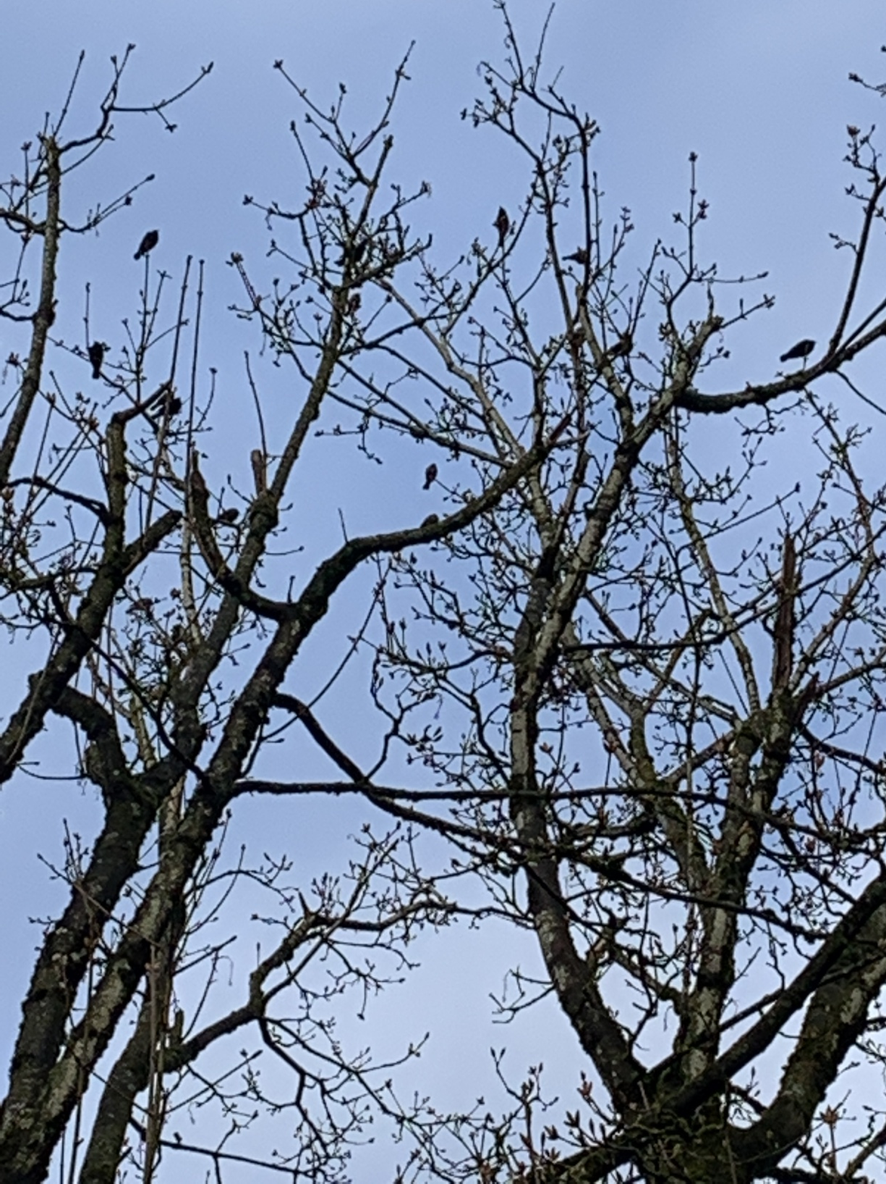
​
How many birds do you see?
5
11
51
??

Slide 4
Have you seen a flock of birds in a tree near where you live?
What does “flock of birds” mean?

Slide 5
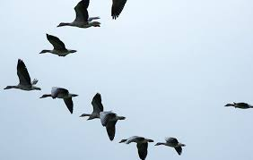
A flock of birds
is a big group of birds
being together.
This is a flock of geese.
With appreciation, this picture is from this website: https://www.natgeokids.com/za/discover/science/nature/birds-flock/

Slide 6
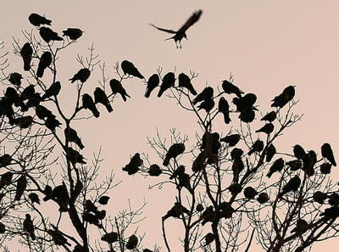
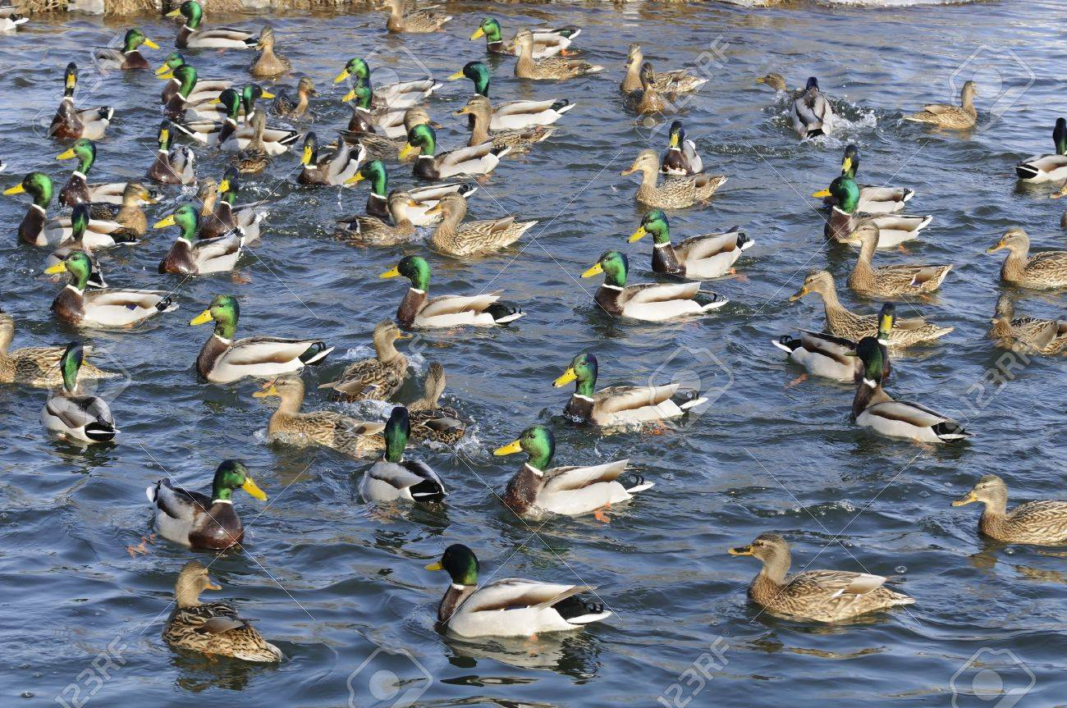
This is a flock of ______________ .
With appreciation, this picture is from this website: https://www.vpr.org/post/something-crow-about-flocks-gather-thousands#stream/0
This is a flock of ______________ .
With appreciation, this picture is from this website: https://www.123rf.com/photo_12841364_flock-of-mallard-ducks-and-drakes-swimming-in-the-lake.html

Slide 7
Your turn.
Go outside and find flocks of birds.
How many do you see?
Did you count one by one or in groups?

Slide 8
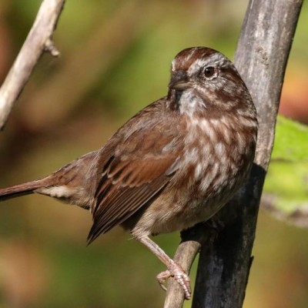
Song Sparrow
What kind of birds do you see?
What sound do they make?
Can you make that sound?
With appreciation, this picture is from this website: http://www.vancouverbirdweek.ca/common-garden-birds/

Slide 9
Happy Bird Watching!

