Slide 1
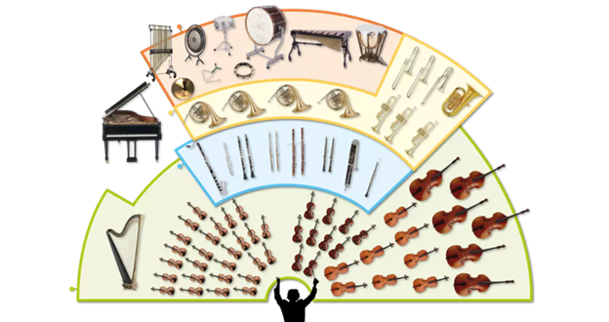
Music Education
Instruments of the Orchestra
Lesson 5: Grades K-2

Slide 2
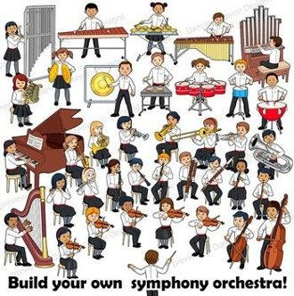
Review of Lesson 4 : Clarinet
A clarinet belongs to the ____________ family of instruments.
5 parts of a clarinet are:
M __ __ th Piece
B __ rr __ l
U __ pp __ r Joint
L __ w __ r Joint
B __ ll
The clarinet has a w__ rm sound.

Slide 3
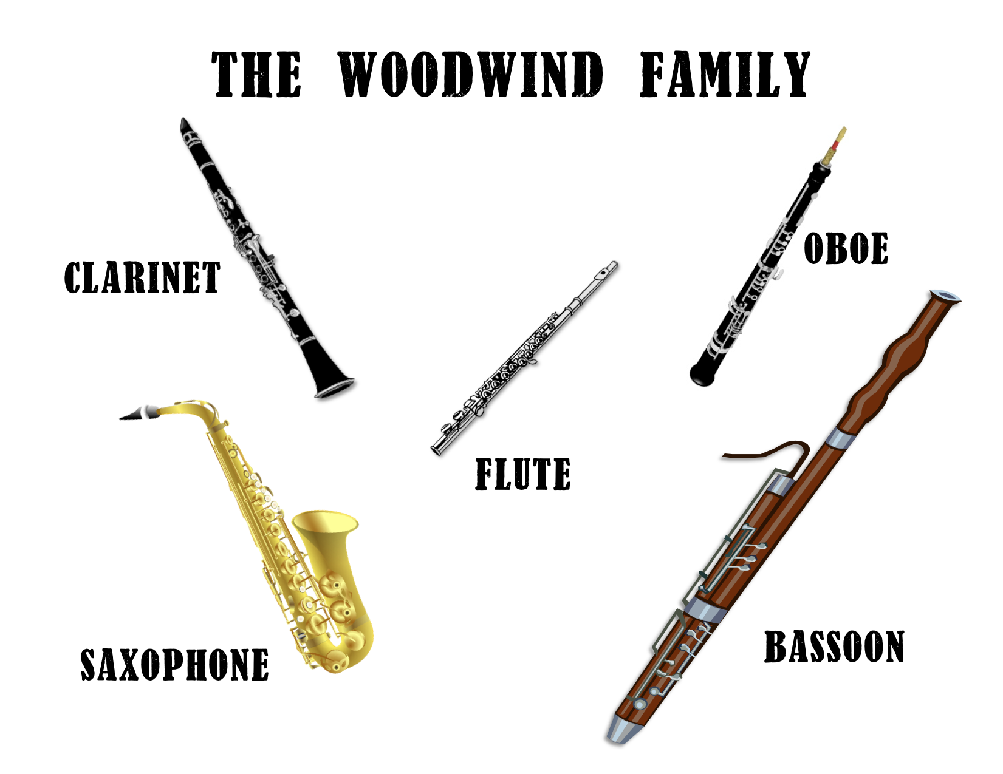
Instruments of the Orchestra
Lesson 5: Saxophone

Slide 4
Saxophone
I can identify the sound of a saxophone playing.
With thanks, this pic comes fromhttps://reverb.com/ca/p/yamaha-yts-62iii-professional-tenor-saxophone?gclid=Cj0KCQjwzN71BRCOARIsAF8pjfjDs4V6v23bOU8fmpRF45Vzeb3saDOAchJk_awr_SbS68eKkNcBZMUaAs3tEALw_wcB&hfid=23454452&merchant_id=101073192&utm_campaign=1695015338&utm_medium=cpc&utm_source=google

Slide 5
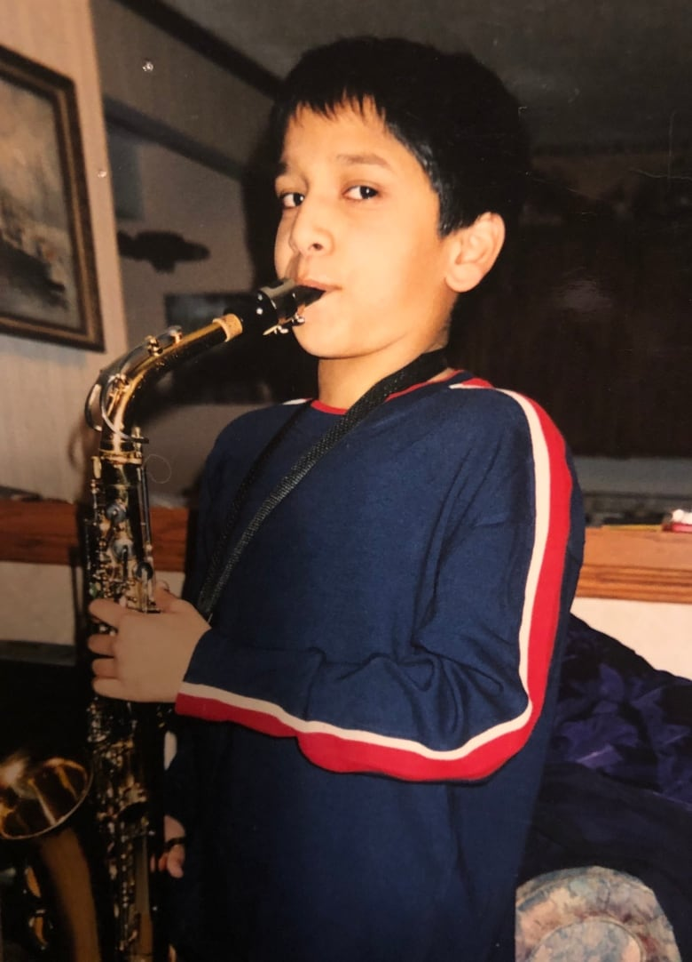
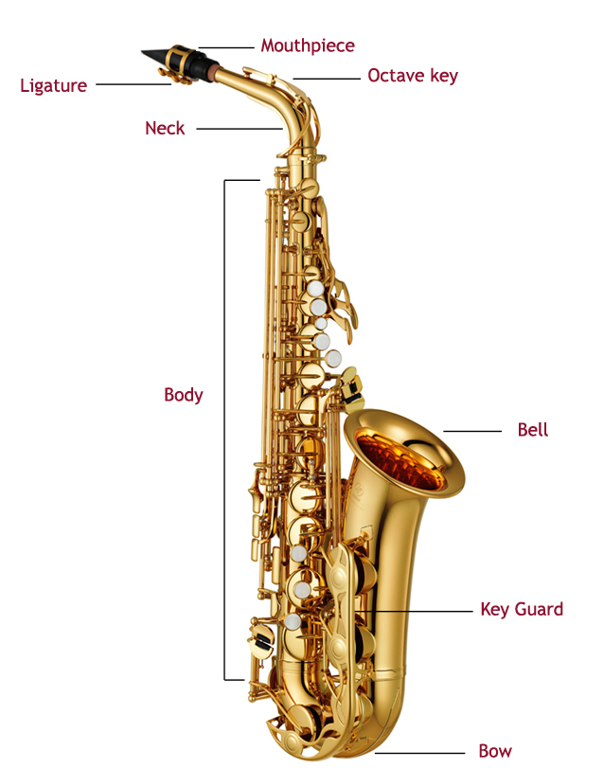
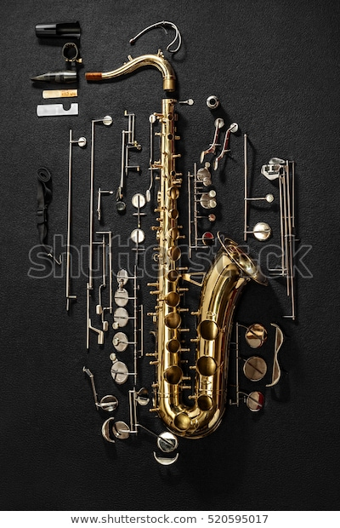
What are the parts of a saxophone? How does it sound?
https://www.youtube.com/watch?v=4fwDxQej5Es
https://www.youtube.com/watch?v=EBVmeOWpFvc
With thanks, this pic comes from:https://www.cbc.ca/radio/docproject/heart-of-gold-1.4999397/my-best-friend-my-confidant-and-my-hype-person-this-musician-s-valentine-to-their-saxophone-1.4999452
With thanks, this pic comes from: https://www.shutterstock.com/image-photo/tenor-saxophone-exploded-view-drawing-isolated-520595017
With thanks, this pic comes from: https://www.normans.co.uk/blog/2013/05/caring-for-your-alto-saxophone/

Slide 6
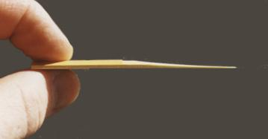
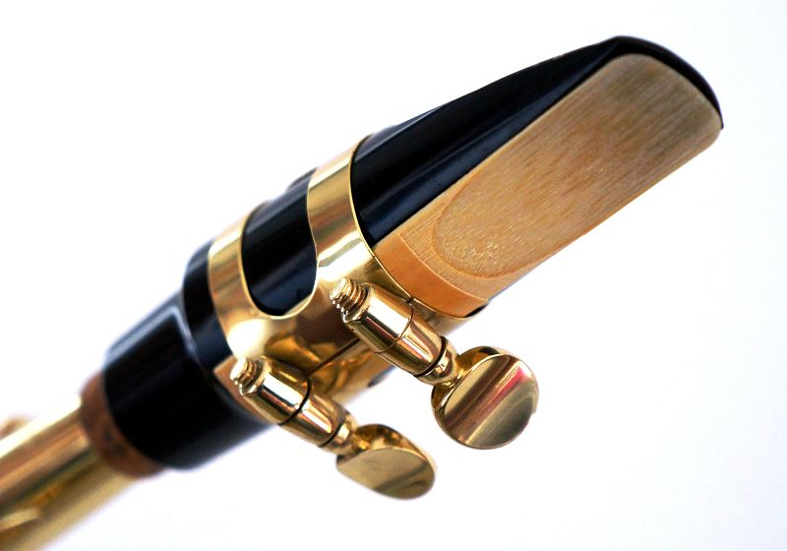
What is a reed for the mouthpiece of a saxophone?
The reed is a thin piece of wood made to act as a fipple for creating the sound of some instruments, including the saxophone.
The reed is attached to the mouthpiece.
With thanks, this pic comes from: http://www.the-clarinets.net/english/clarinet-reed.html/
With thanks, this pic comes from: https://www.learnsaxophoneonline.com/reed-alignment.html

Slide 7
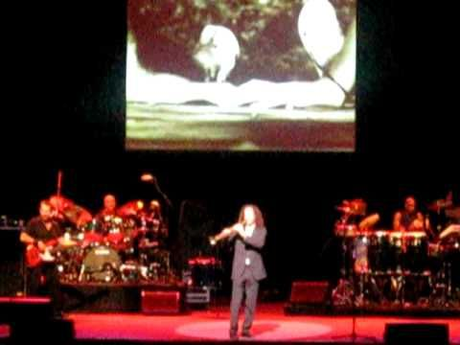
Do you know any of these songs?
https://www.youtube.com/watch?v=ya_HIM2SjUo
https://www.youtube.com/watch?v=V7g-TOxcnZs

Slide 8
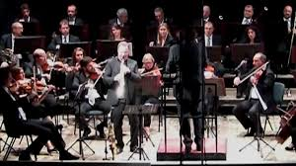
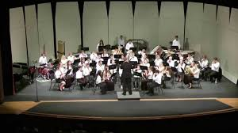
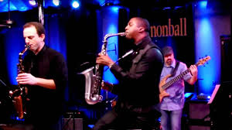
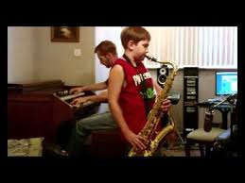
Saxophone is played in many styles or genres of music.
Genre: Classical Music
https://www.youtube.com/watch?v=zTLKs1giz9I
Genre: Concert Band
https://www.youtube.com/watch?v=DLb8Pk9OeNk
Genre: Jazz Music
https://www.youtube.com/watch?v=bVl-ZFaY8To
Genre: What is your guess?
Do you recognize this piece?
https://www.youtube.com/watch?v=u4FNjQJpJR4

Slide 9
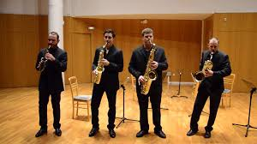
A final short concert for you to enjoy.
Take Five (4:37 min)
https://www.youtube.com/watch?v=pGaUlferotY
Note: “Take Five” is one of the most famous Jazz compositions in the history of jazz music.
Imagine (3:39 min)
https://www.youtube.com/watch?v=KRKrN7JDGF4
Note: This video was created in March, 2020. “Imagine” is a song about everyone in the world understanding each other and getting along.

Slide 10
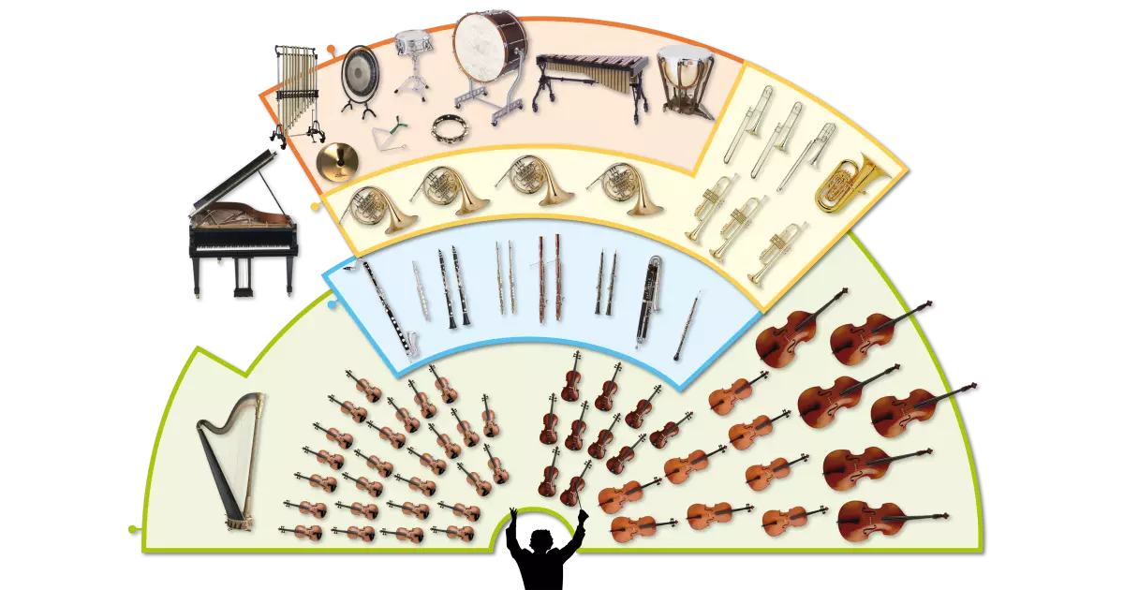
Saxophone
The saxophone can make many different sounds.
In an orchestra, a saxophone is a member of the woodwind family.
2 genres of music where saxophone id often played are jazz and concert band.

Slide 11
Listen to music. Dance to music. Play music.
Until next time …....

