Slide 1
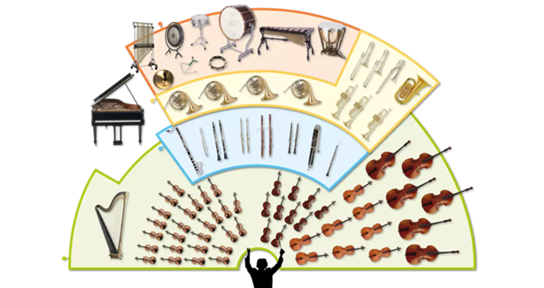
Music Education
Instruments of the Orchestra
Lesson 4 : Grades K-2

Slide 2
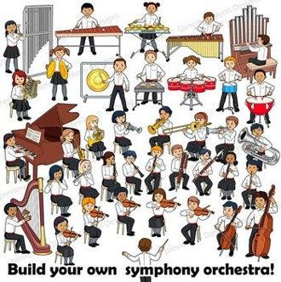
Review of Lesson 3 : Flute
A flute belongs to the ____________ family of instruments.
3 parts of a flute are:
H __ __ d Joint
B __ __ __ y
F __ __ __ Joint
What kind of flute is played by people in Peru? (Hint: Think of cooking.)

Slide 3
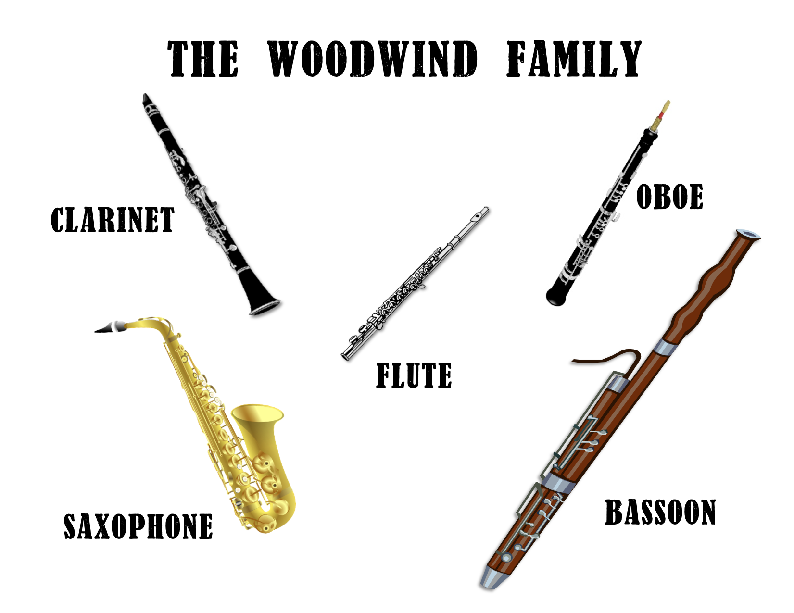
Instruments of the Orchestra
Lesson 4: Clarinet

Slide 4
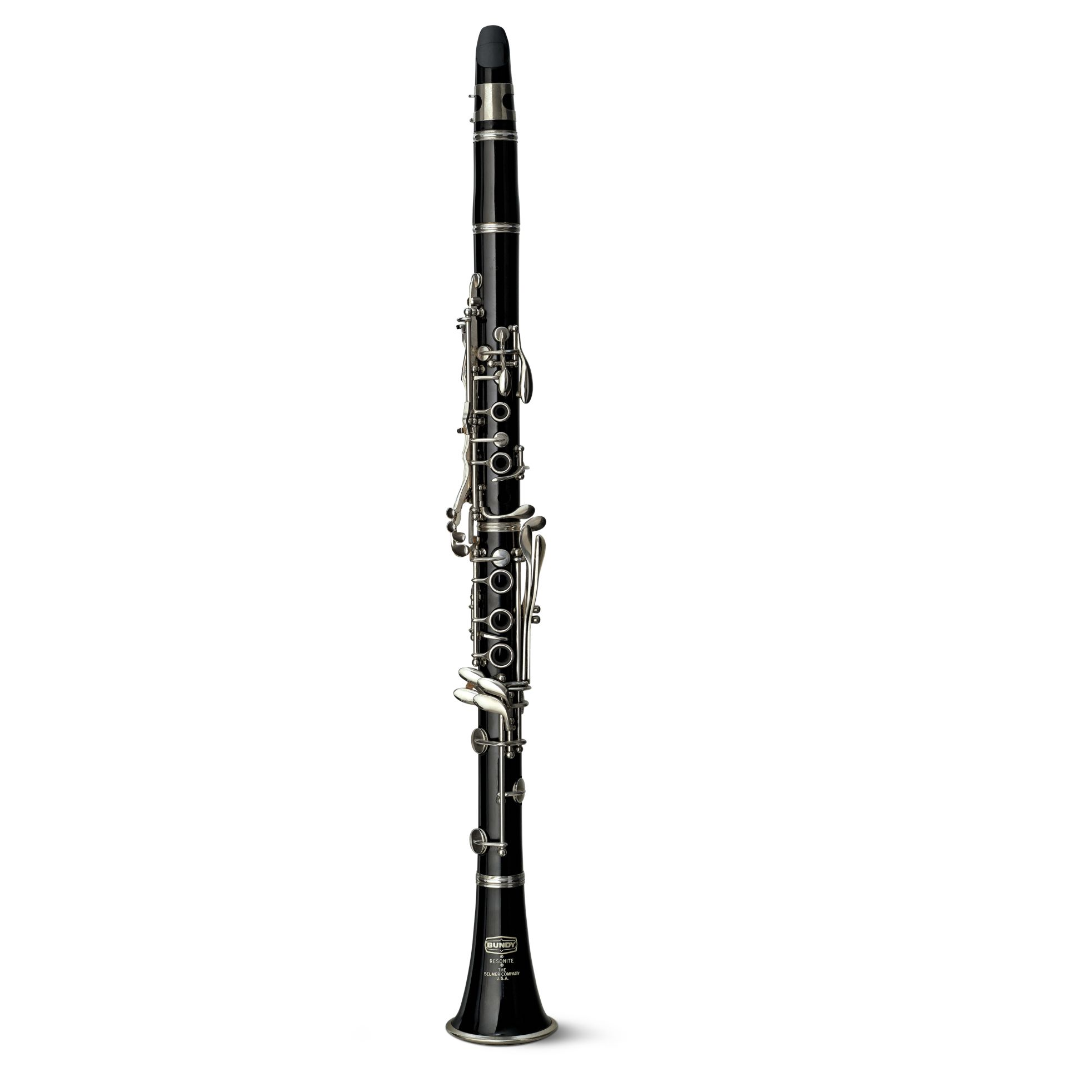
Clarinet
I can identify the sound of a clarinet playing and.
With thanks, this pic comes from: https://www.dkfindout.com/us/music-art-and-literature/musical-instruments/clarinet/t

Slide 5
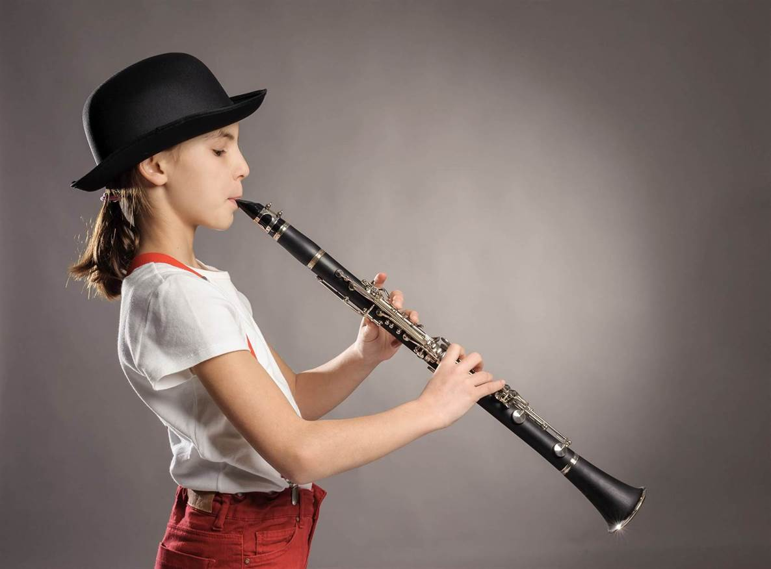
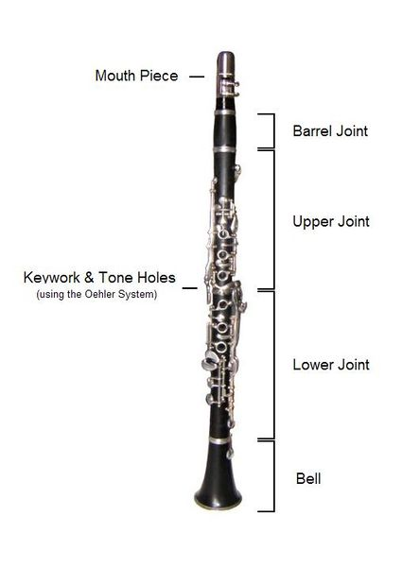
What are the parts of a clarinet? How does it sound?
https://www.youtube.com/watch?v=fQ59ZNpQ3LQ
With thanks, this pic comes from: https://www.academymusic.ca/in-home-lessons/clarinet-program/
With thanks, this pic comes from: https://kids.kiddle.co/Image:Clarinet_construction.JPG

Slide 6
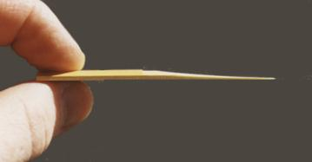
What is a reed for the mouthpiece of a clarinet?
The reed is a thin piece of wood made to act as a fipple for creating the sound of some instruments, including the clarinet.
The reed is attached to the mouthpiece.
With thanks, this pic comes from: http://www.the-clarinets.net/english/clarinet-reed.html/
With thanks, this pic comes from: https://www.amazon.com/Clarinet-Mouthpiece-Ligature-Plastic-Cap-black/dp/B00P0AHRQ0/

Slide 7
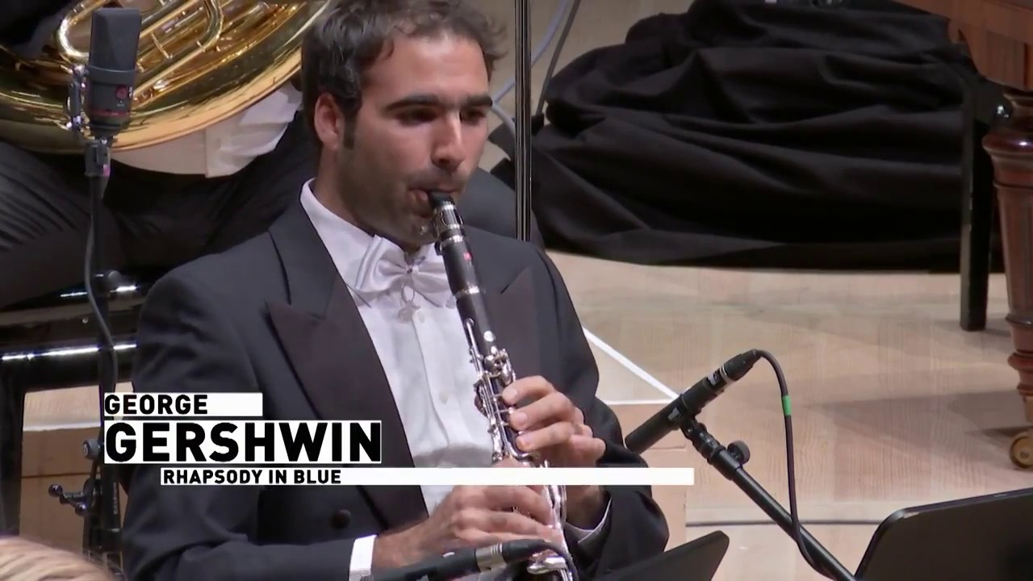
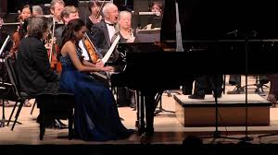
Rhapsody in Blue by George Gershwin
This is a famous composition. Here’s the clarinet part.
https://www.youtube.com/watch?v=xiYxLKWVfR8
Did you hear the warm sound of the clarinet?
Would you like to hear the whole composition?
Click on this link.
https://www.youtube.com/watch?v=7-MJZJjJs4A
What does this song make you think about?
What other instrument is prominent in this composition?

Slide 8
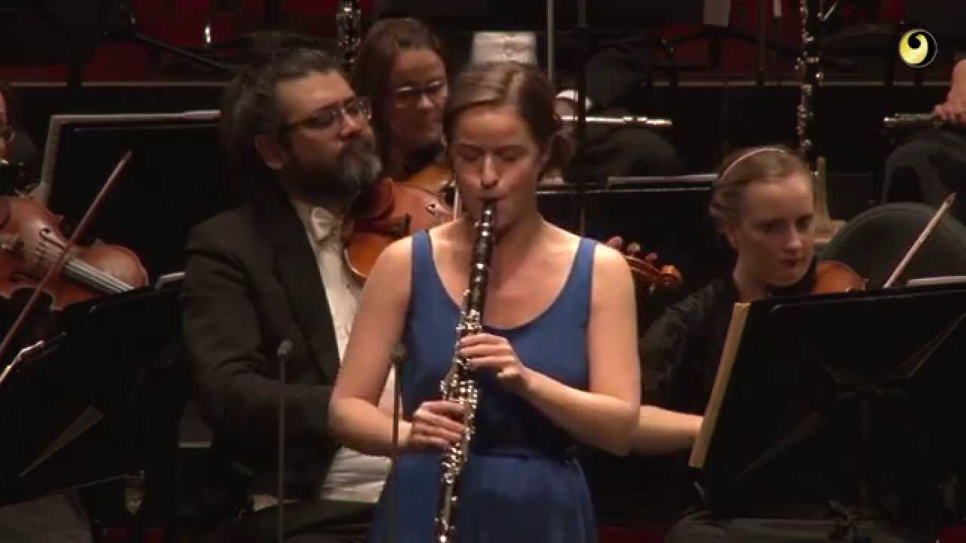
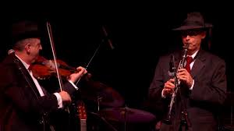
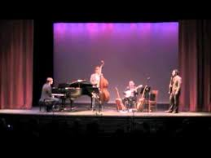
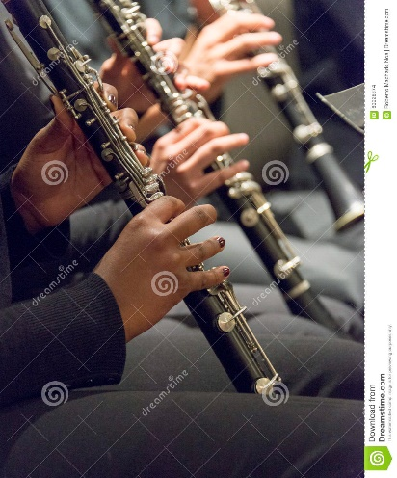
Clarinet is played in many styles or genres of music.
Genre: Classical Music
https://www.youtube.com/watch?v=YT_63UntRJE
Genre: Klezmer Music
https://www.youtube.com/watch?v=yNUY9pqyEaI
Genre: What is your guess? Do you recognize this piece?
https://www.youtube.com/watch?v=xb_O_P84Akw
Genre: Jazz Music
https://www.youtube.com/watch?v=uN6Nul5DS0o
Genre: What is your guess? Do you recognize this piece?
https://www.youtube.com/watch?v=nLaFKsnlvig
With thanks, this pic comes from: https://www.dreamstime.com/stock-photo-musicians-playing-clarinet-band-close-up-image60028374

Slide 9
A final short concert for you to enjoy.
Lean On (3:30 min)
https://www.youtube.com/watch?v=nuEMqMc1Fh4
Despacito (3:30 min)
https://www.youtube.com/watch?v=ZHEA1G4FO5c

Slide 10
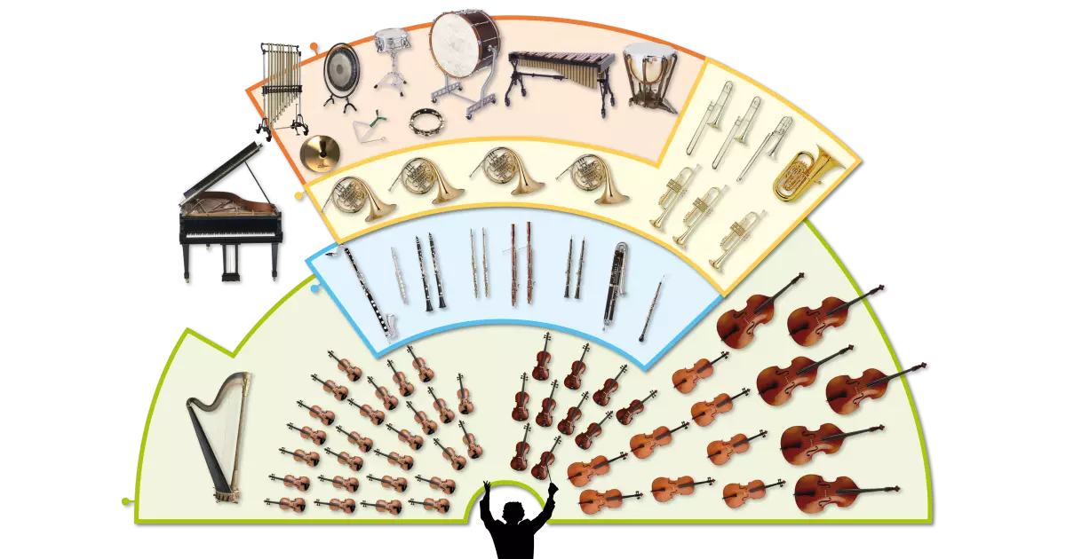
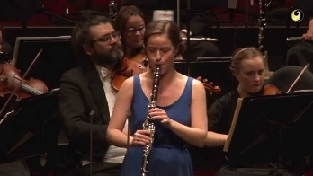
Clarinet
The clarinet has a very warm sound.
In an orchestra, a clarinet is a member of the woodwind family.
The clarinet is important in several genres or styles of music.
3 genres of music where a clarinet is played are classical, jazz, and klezmer.

Slide 11
Listen to music. Dance to music. Play music.
Until next time …....

