Slide 1
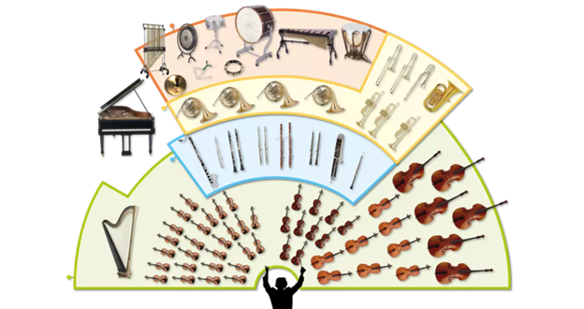
Music Education
Instruments of the Orchestra
Lesson 8 : Grades 3-6

Slide 2
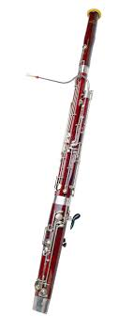
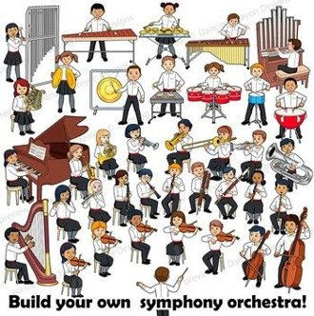
Review of Lesson 7 : Bassoon
A bassoon is a member of what orchestra instrument family?
A bassoon is a ________________
reed instrument. (Hint: related to a number)
In the picture here, point to the bocal or crook on the bassoon.

Slide 3
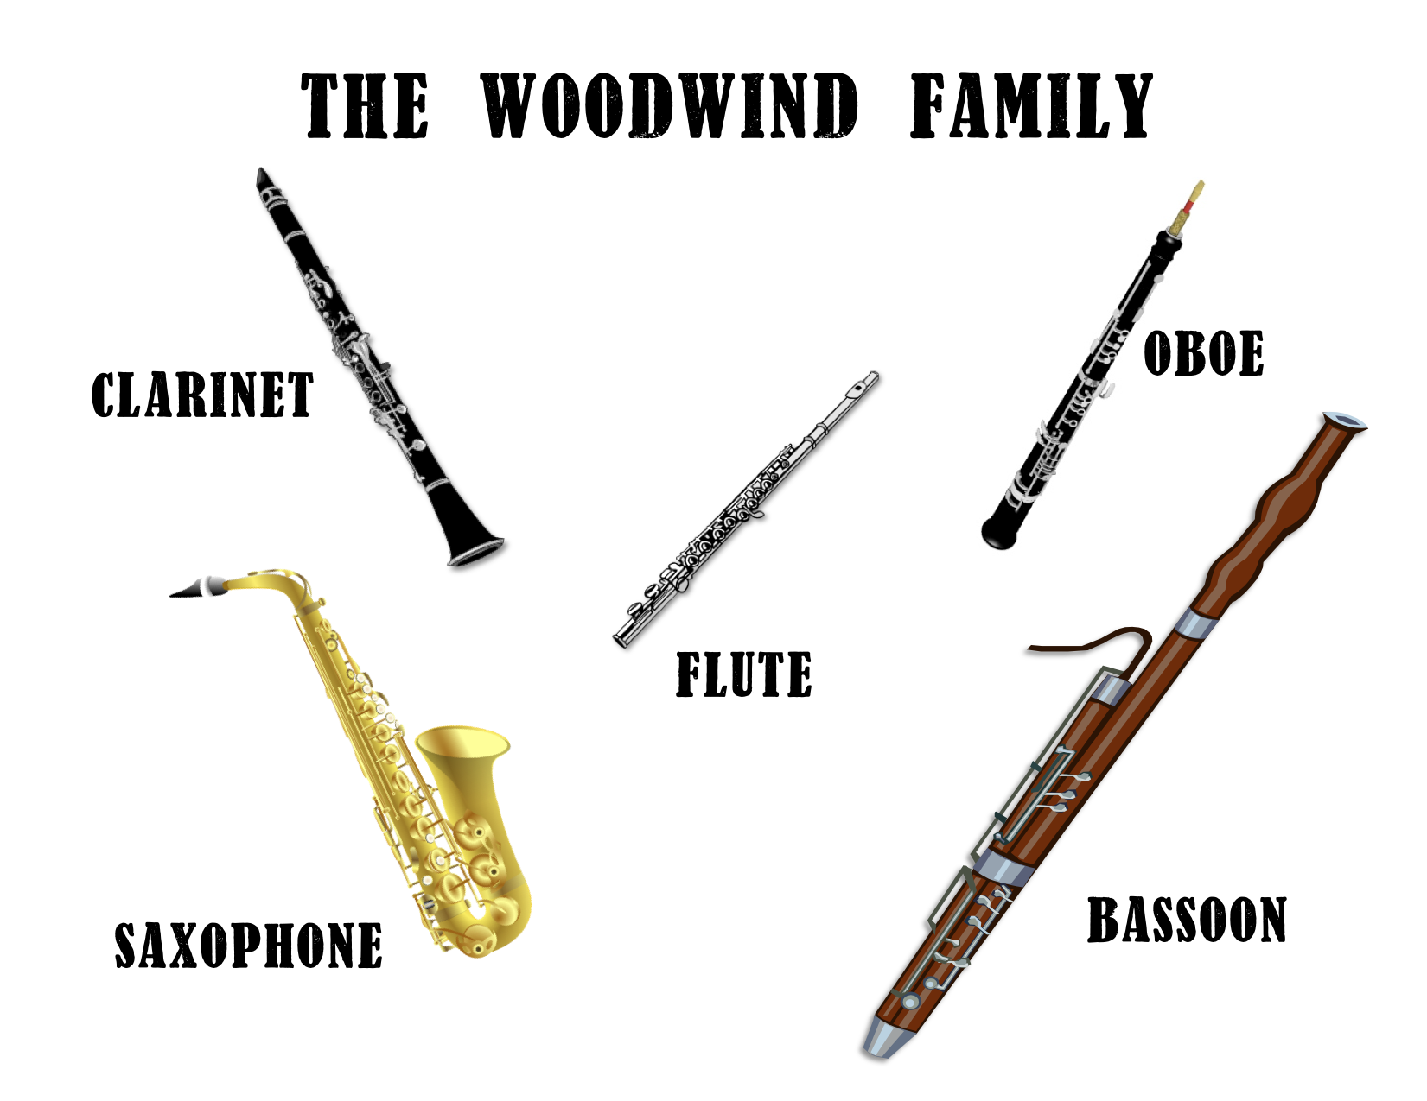
Instruments of the Orchestra
Lesson 8 : Woodwind Instruments Review

Slide 4
Woodwind Instruments
Learning Intention:
I can identify woodwind instruments played in an orchestra or a band; by sound and by how they look.

Slide 5
What woodwind instrument is played in each short video below?
Point to the instrument in the picture.
https://www.youtube.com/watch?v=IZvFXnmeaxs
https://www.youtube.com/watch?v=M8fIFNgHtdI
https://www.youtube.com/watch?v=f149lCY8Mtk
https://www.youtube.com/watch?v=OKfxvyXEe-Q
https://www.youtube.com/watch?v=ur0F5ASYx2A

Slide 6
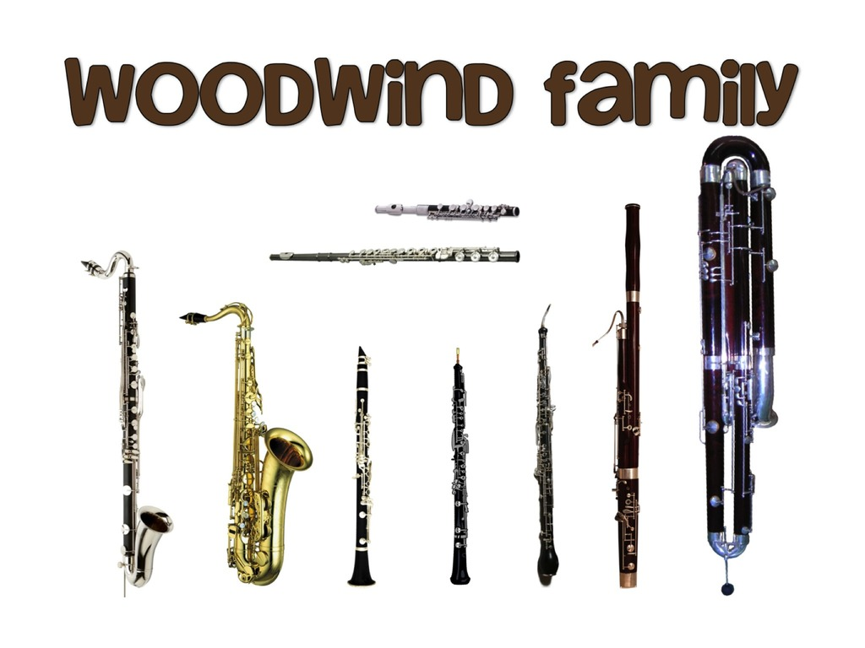
There are more woodwind family instruments than we have studied. Play this video to compare the sounds of each instrument.
What new woodwind instrument was played in the video?
What woodwind instrument was left out? Why?
https://www.youtube.com/watch?v=6JG44ZH_RnQ
With thanks, this pic comes from: https://quizlet.com/au/335026405/instruments-of-the-orchestra-woodwind-diagram/

Slide 7
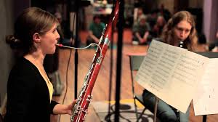
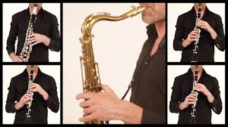
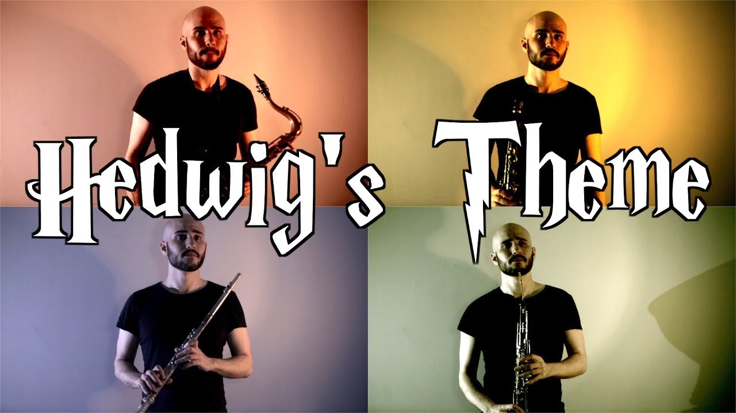
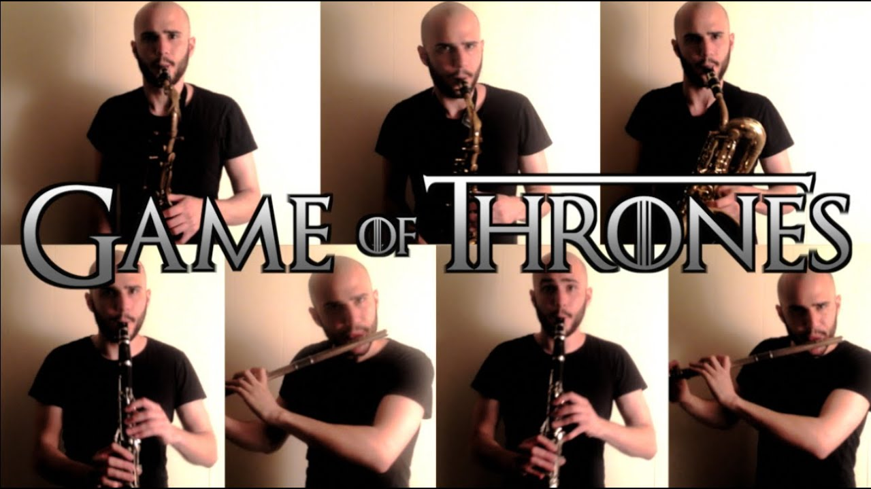
A concert featuring woodwind instruments.
Can you identify each instrument we learned about as it is being played?
Any new looking woodwind instruments you are curious about?
Super Mario Brother’s Suite (4:58 min)
https://www.youtube.com/watch?v=evQSDf0KVzk
Ghostbusters Theme (2:56 min)
https://www.youtube.com/watch?v=CyMRB-R7VeQ
Hedwig’s Theme -- Harry Potter (4:06 min)
https://www.youtube.com/watch?v=cXRlDCyqZJw
Game of Thrones (3:13 min)
https://www.youtube.com/watch?v=yIZlzy3tu-Y

Slide 8
A final concert for you to enjoy.
https://www.youtube.com/watch?v=MfM7Y9Pcdzw (29:30 min)
Peter and the Wolf by Sergei Prokofiev
Played by the Vancouver Symphony Orchestra
If you’ve ever heard the story, “The Boy Who Cried Wolf”, this is the musical version of this Russian Folk Tale. Hope you enjoy this story, where instruments represent each character.
With thanks, this pic is from: https://myvancity.ca/2016/10/31/vancouver-symphony-orchestras-98th-season/

Slide 9
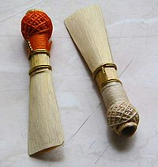
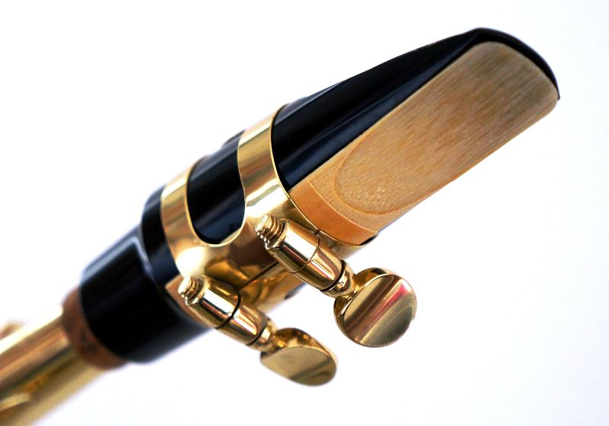
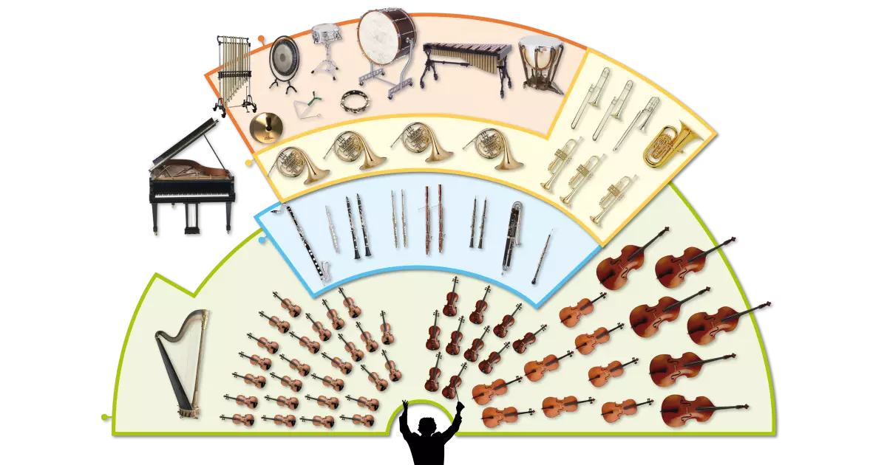
Woodwind Instrument Family
A saxophone is usually played with a concert band and not with an orchestra.
A reed creates the fipple effect in many woodwind instruments.
The woodwind instruments are located in the centre of an orchestra.
5 basic instruments make up the woodwind section in an orchestra.
There are also many more unusual woodwind instruments.

Slide 10
Listen to music. Dance to music. Play music.
Until next time …....

