Slide 1
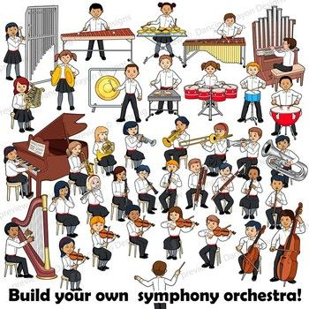
Music Education
Lesson 1: Grades K-2
Instruments of the Orchestra
With appreciation, this picture is from this website: https://www.pinterest.ca/pin/44613852544747596/

Slide 2
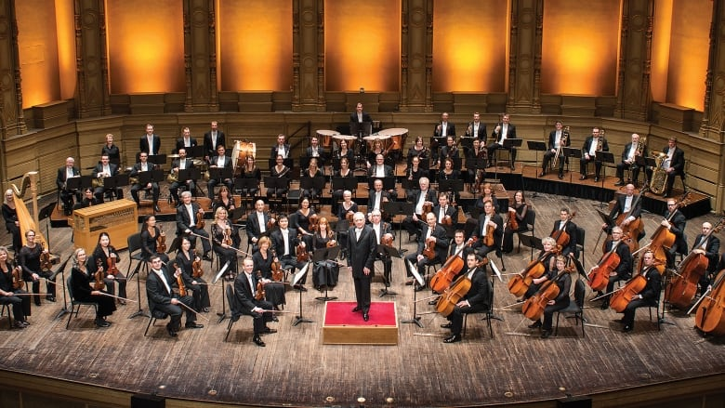
Instruments of the Orchestra
I can learn what each instrument of the orchestra
looks like and sounds like.
With appreciation, this picture is from this website: https://www.cbc.ca/news/canada/british-columbia/we-re-going-to-have-the-biggest-birthday-party-ever-vso-top-brass-reflect-on-100-year-history-1.4994237

Slide 3
Look at this picture.
Point to the instruments you know.
What is it called?

Slide 4
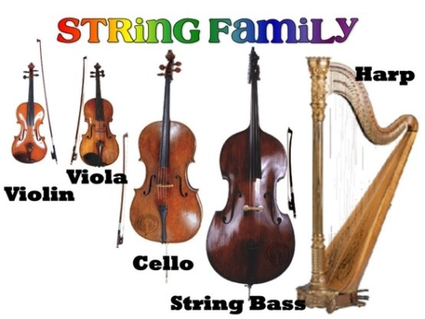
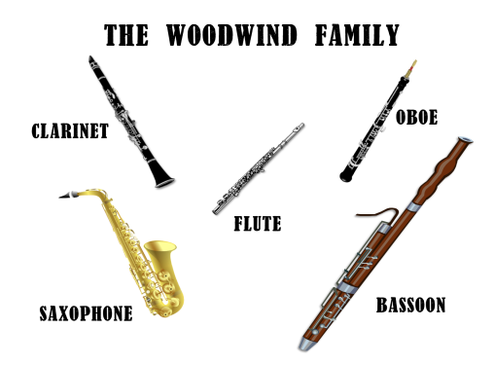
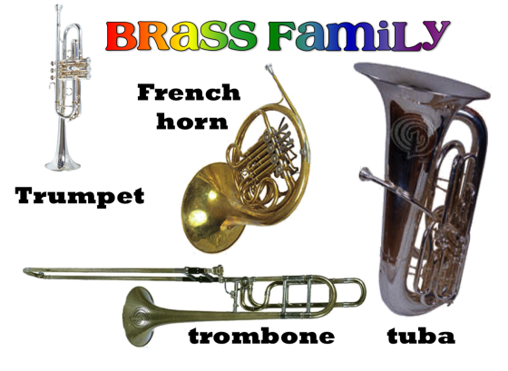
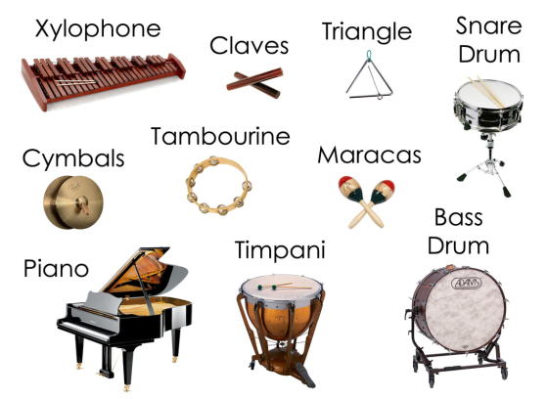
Click on a link. An orchestra will play.
Can you guess what song the orchestra is playing?
Video 1: https://www.youtube.com/watch?v=BekjyAH7c2A
Video 2: https://www.youtube.com/watch?v=1zaJ5LLIRn0
Video 3: https://www.youtube.com/watch?v=__LU8E6dUsI
Video 4: https://www.youtube.com/watch?v=Mvm2r1igPtM

Slide 5
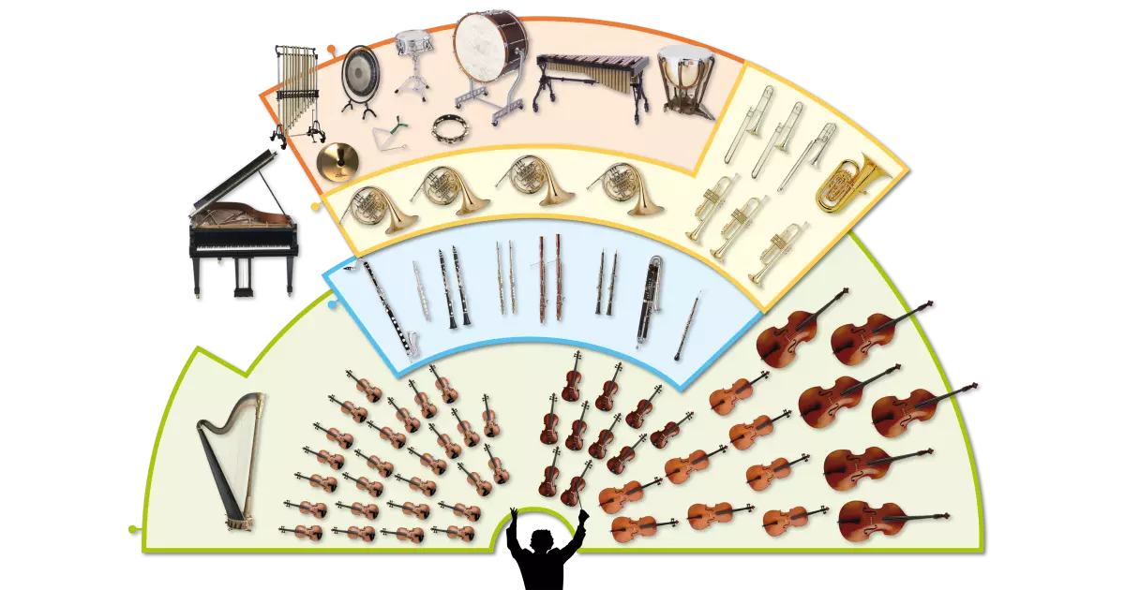
Parts of an orchestra
Point to each part of the orchestra.
Each part or section is a family of instruments.

Slide 6
Percussion Family
With appreciation, this picture comes from this website: https://www.teachingkidsmusic.com/percussion-family.html

Slide 7
String Family
With appreciation, this picture comes from this website: http://wadsworthmusic.weebly.com/string-family.html

Slide 8
Woodwind Family
With appreciation, this picture comes from this website: https://www.pinterest.ca/pin/158118636888236793/

Slide 9
Brass Family
With appreciation, this picture comes from this website: https://www.pinterest.ca/pin/543317142525050433/

Slide 10
Point to and name each instrument family in the orchestra.

Slide 11
Do you remember we learned about the String Family at school?
Which instrument in the String Family is your favourite?
Now we will learn about the other instrument families in the orchestra.
I wonder which one will be your favourite in each family?
A final song:
Instruments of the Orchestra
https://www.youtube.com/watch?v=cIx7khLD2WE
What's your favourite instrument so far?

