Slide 1
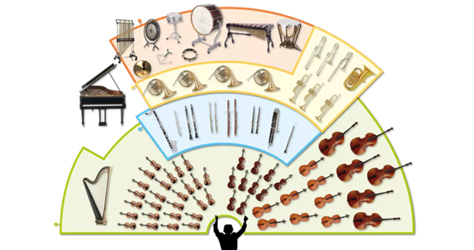
Music Education
Instruments of the Orchestra
Lesson 3 : Grades 3-6

Slide 2
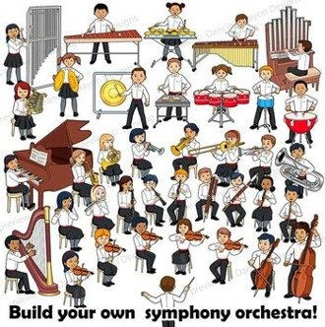
Review of Lesson 2 : Woodwind Family
What are 2 instruments in the Woodwind Family?
Can you describe how a woodwind instrument makes it’s sound?
Hint: airflow, fipple, inside flute
How are the different notes made?

Slide 3
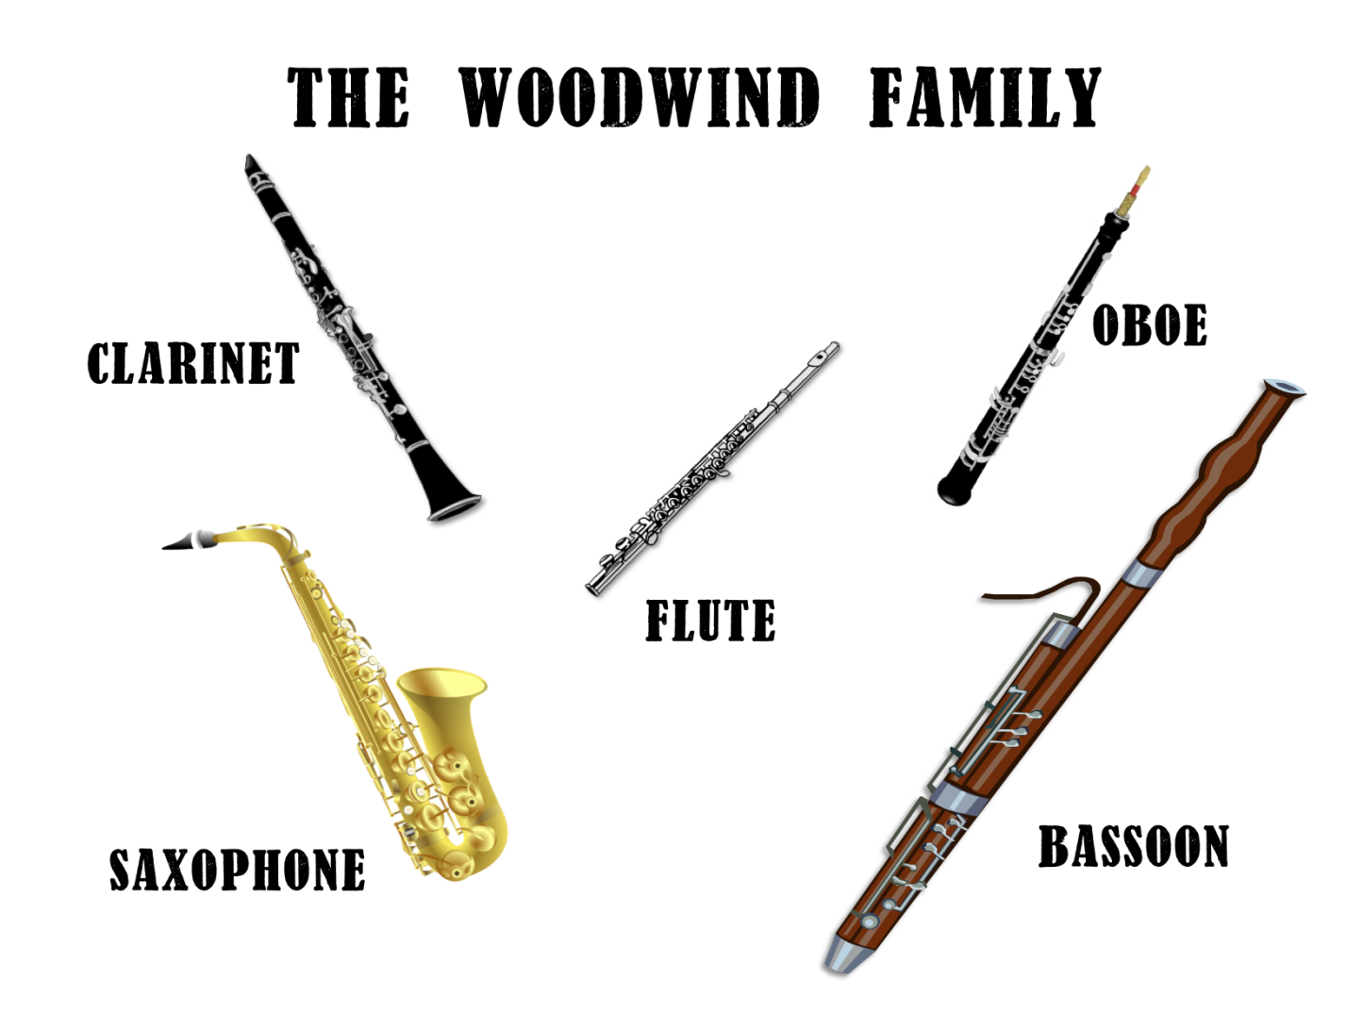
Instruments of the Orchestra
Lesson 3: Flute

Slide 4
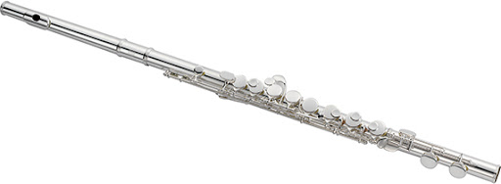
Flute
Learning Intentions:
I can identify the sound of a flute playing.
I can make a pan flute and play it.
With thanks, this pic comes from: http://jupitermusic.com/international/products/woodwinds/flutes/

Slide 5
In this video link, a musician plays 10 songs on a flute.
Which compositions are familiar to you?
Where have you heard these pieces before?
https://www.youtube.com/watch?v=cZ6jv0C2I-4
With thanks, this pic is from: https://www.istockphoto.com/ca/vector/music-player-piano-flute-gm817311006-132230759

Slide 6
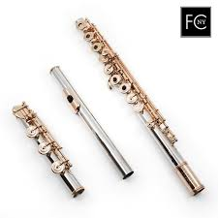
There are 3 parts to the flute.
From this picture, take a guess by pointing to each part:
Head joint
Body
Foot Joint
With thanks, this pic comes from: https://www.flutes4sale.com/products/haynes-pt

Slide 7
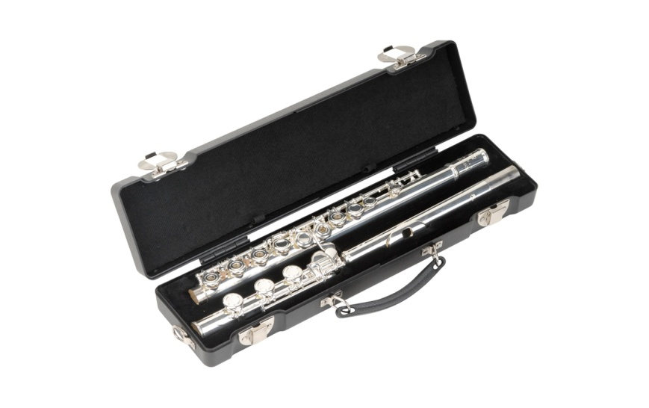
How do you play a flute?
Check out these videos to learn about the flute.
Opening the case and naming the parts.
https://www.youtube.com/watch?v=w9TQS1Ejedo
With thanks, this pic comes from: https://www.lunchboxaudio.com/skb-cases-b-foot-flute-case/
How to make a sound from the head joint.
https://www.youtube.com/watch?v=I7_ABj5Z2Jw

Slide 8
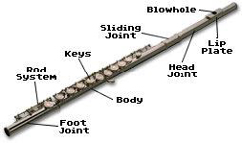
Here’s a diagram of more detailed parts of a flute.
With thanks, this pic comes from: https://www.schoolmusiconline.com/the-flute

Slide 9
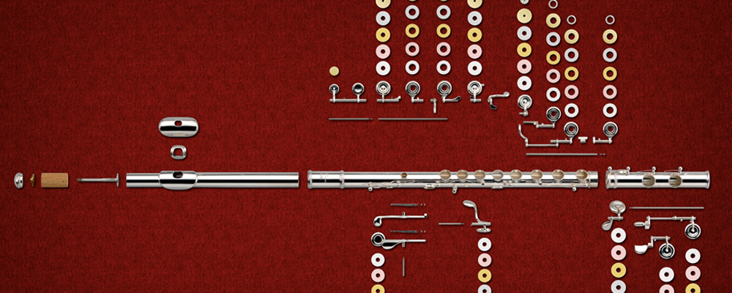
How a Flute is Made
There is quite a process to making a flute. Below is a video that shows you the factory process of making a flute. If you are interested in building things, you may find this process fascinating.
How It’s Made – Flute
https://www.youtube.com/watch?v=DHSu0trGkRg
With thanks, this pic comes from: https://www.yamaha.com/en/musical_instrument_guide/flute/mechanism/

Slide 10
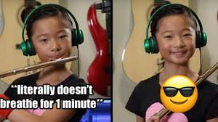
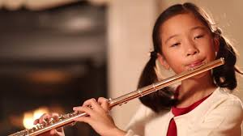
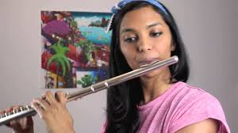
Can you identify the songs in these videos?
https://www.youtube.com/watch?v=pt480pC37DQ
https://www.youtube.com/watch?v=CmwXjj1B4UE
https://www.youtube.com/watch?v=QqIPJZ70khc
https://www.youtube.com/watch?v=J212cbf8esw

Slide 11
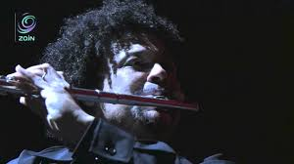
A final short concert for you to enjoy.
Flute and guitar (4 min)
https://www.youtube.com/watch?v=-q_-4s_dDac
Flute and orchestra (4:30 min)
https://www.youtube.com/watch?v=T0NbtMv9lHk

Slide 12
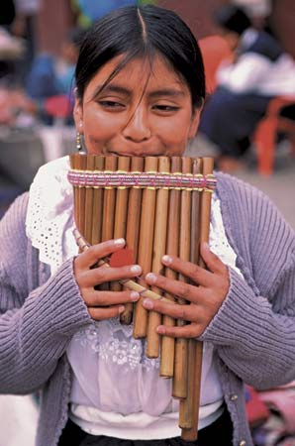
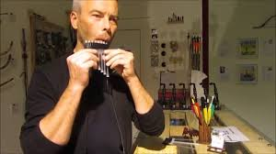
Make a Pan Flute
A pan flute is an instrument that has origins in ancient cultures. It is also a traditional instrument played by Indigenous people of Peru, a country in South America.
You can make a pan flute out of straws. Watch this video to see how to make one, and start playing! (You will need an adult to help you because a small flame is used to make this instrument.)
https://www.youtube.com/watch?v=sglOT1J80Ss
You will need: 8+ plastic drinking straws, scissors, plyers, tape and a lighter.
With thanks, this pic is from: https://feltmagnet.com/crafts/Make-Your-Own-Instrument---Pan-Pipes

Slide 13
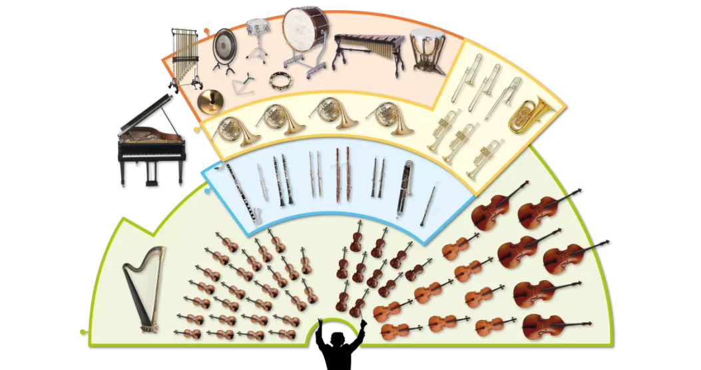
Flute
The flute can have a very high pitched sound, as well as low pitched sounds.
In an orchestra, a flute is a member of the woodwind family.
There are many kinds of flutes. A transverse flute is played in an orchestra.
A pan flute is a traditional instrument.

Slide 14
Listen to music. Dance to music. Play music.
Until next time …....

