Slide 1
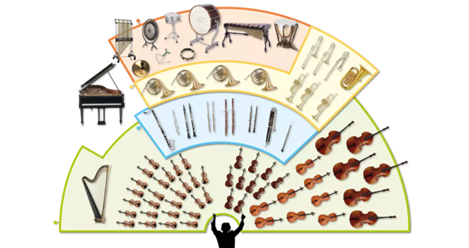
Music Education
Instruments of the Orchestra
Lesson 2 : Grades 3-6

Slide 2
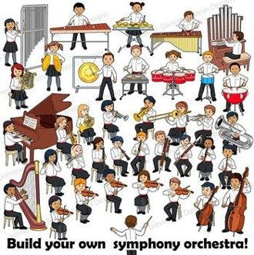
Review of Lesson 1 : Instruments of the Orchestra
How many instrument families are in an orchestra?
Look at this picture. Point to each section.
Do you remember the names of each instrument family?

Slide 3
Last week, you listened to orchestras play music from different movies.
Did you guess any of the movies they came from?
Weller and Jackson emailed Ms. T., wondering where the theme from Star Wars was. Did Ms. T. forget to include this popular song?
Thank you for reminding me of this iconic composition!
Click here to see and hear a student orchestra playing the full Star Wars Theme:
https://www.youtube.com/watch?v=pU8D7qZ3RDw (31 min.)
If you have any questions or suggestions about these music lessons, please email Ms. T. She will do her best to answer you either by email reply or in next week's music lesson.

Slide 4
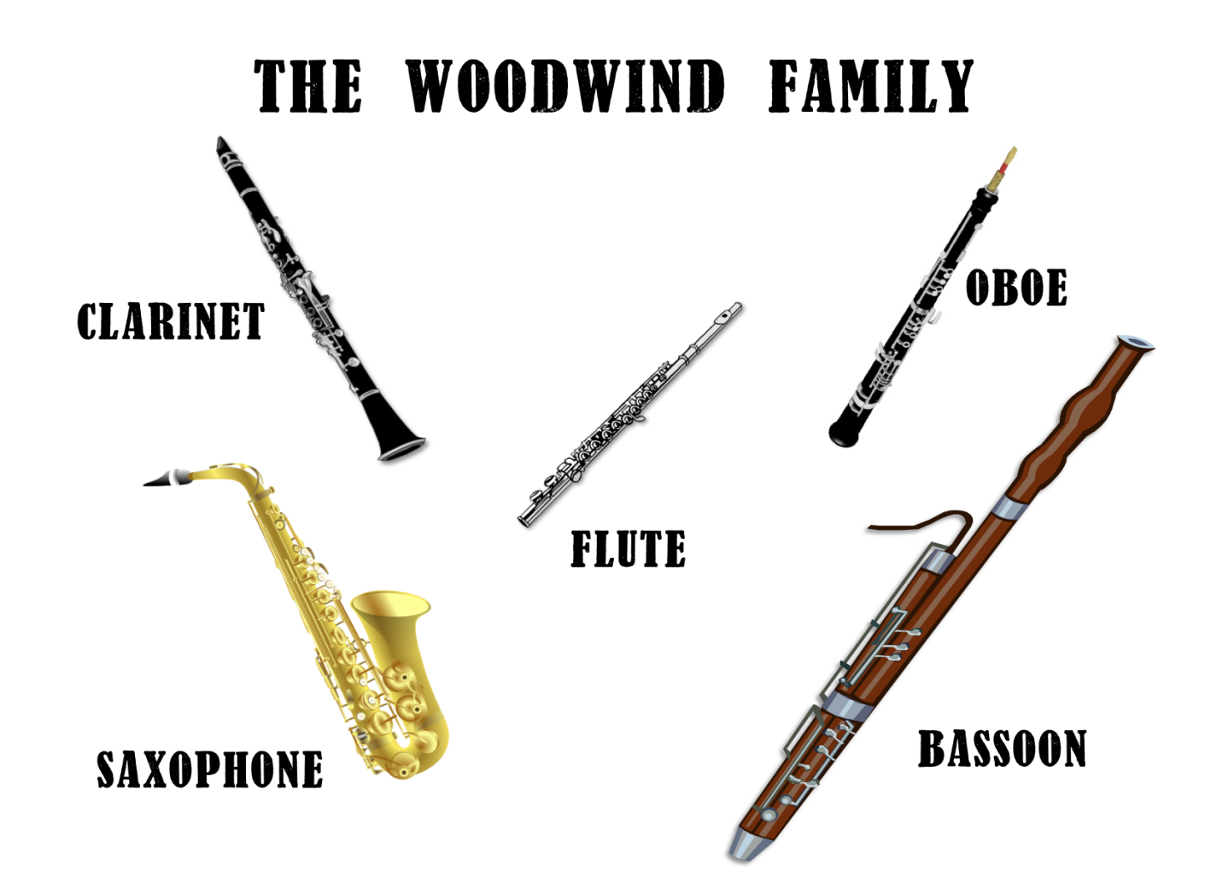
Instruments of the Orchestra
Lesson 2: Woodwind Family

Slide 5
Woodwind Family
Learning Intentions:
I will know how woodwind instruments work.
I can identify the sounds of different woodwind instruments.

Slide 6
Look carefully at this picture.
Which woodwind instruments are familiar to you and you have heard them played before?
Which woodwind instruments are unfamiliar to you and you haven't heard them played before?

Slide 7
How does a woodwind instrument work?
Check out this video to find out:
https://www.youtube.com/watch?v=S6gBYYxvizs

Slide 8
Did you see how the sound is created when
you blow air through a woodwind instrument?

Slide 9
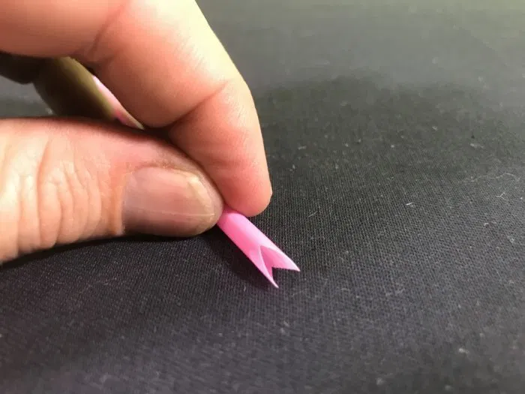
Did you make a straw flute?
Did you make different pitches, high and low sounds, with your straw flute?
Click here for steps and instructions:
https://www.fizzicseducation.com.au/150-science-experiments/light-sound-experiments/make-a-straw-flute/ (With thanks, these picture here came from this website.)

Slide 10
How do woodwind instruments sound?
Watch this video to learn how each woodwind instrument sounds.
https://www.youtube.com/watch?v=Cwfj9Xx2LF4

Slide 11
Which woodwind instrument is your favourite?
If you want to see musicians playing the woodwinds, click on this link: https://www.youtube.com/watch?v=7OjqeyOvC1c

Slide 12
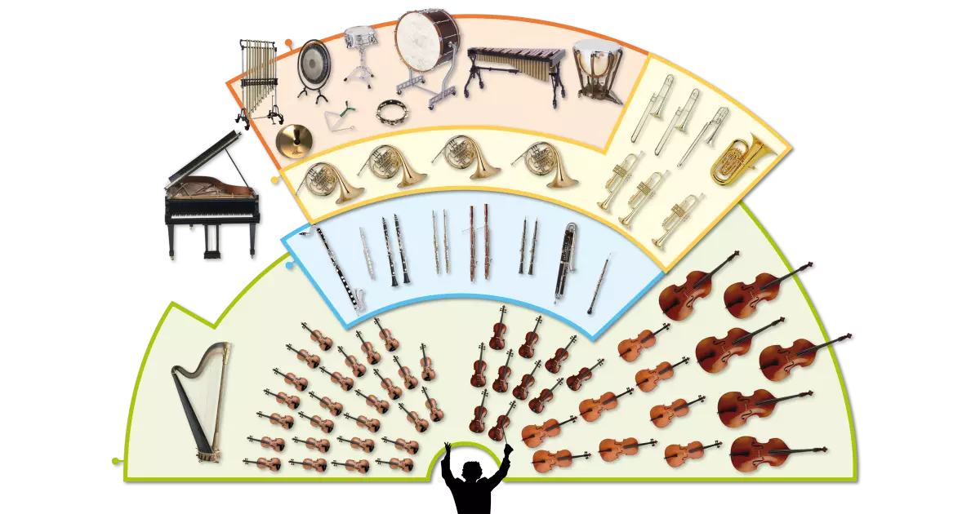
Woodwind Family
Point to the instruments in the woodwind section.
Can you name them?

Slide 13
Woodwind Family
Upcoming lessons will focus closely on specific woodwind instruments.
Here is one last orchestra video to watch. Do you remember this song or composition from the beginning of this lesson?
Do you remember what the composition is called?
https://www.youtube.com/watch?v=5LoUm_r7It8
Do you notice how the woodwinds are prominent or stand out in this composition?

Slide 14
Listen to music. Dance to music. Play music.
Until next time …....

